Slide 1
Quiz 1, Friday 9/12/25
Lectures L1 to L4
Assignments 1 to 5
Topics:
Definition and representation of DFAs, NFAs, and ε-NFAs
String testing for DFAs, NFAs, and ε-NFAs
Induction on integers and length of a string
Given NFA, find equivalent DFA
Given ε-NFA, find equivalent NFA and DFA

Slide 2
Proof by induction on integers has the follow elements present and identified.
Proof of base case
Setup equation designed to use the inductive hypothesis
Statement of inductive hypothesis
Application of inductive hypothesis
  Algebra that completes the proof
  All algebraic operations must be on the right-hand-side of the equals sign.

Slide 3
Example: structured proof of
Σ_{k=1 to n} k² = n(n+1)(2n+1)/6
using “if S(n-1) then S(n)”
worked in class.

Slide 4
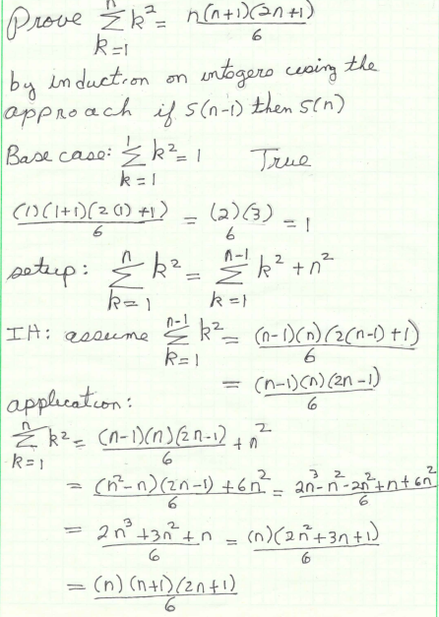

Slide 5
Induction on the length of string: proof must include the following elements:
(1) base case:
(2) setup
(3) inductive hypothesis
(4) application of inductive hypothesis

Slide 6
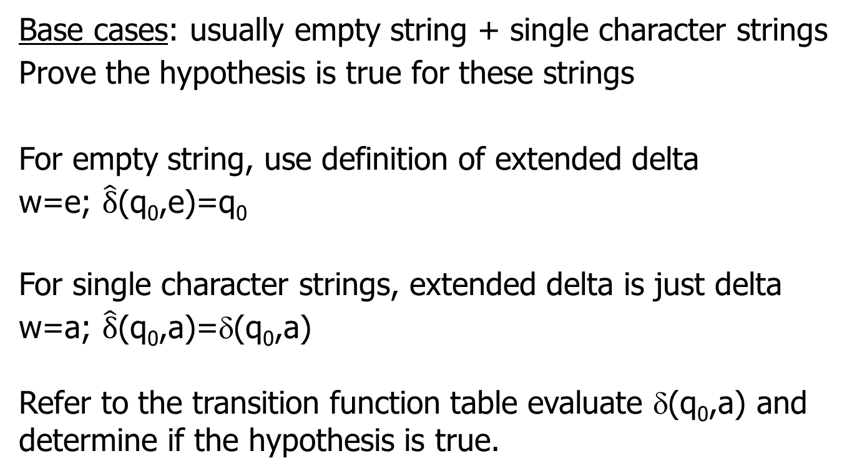
Base cases: usually empty string + single character strings
Prove the hypothesis is true for these strings
For empty string, use definition of extended delta
w=e; $\hat{δ}$(q₀,e)=q₀
For single character strings, extended delta is just delta
w=a; $\hat{δ}$(q₀,a)=δ(q₀,a)
Refer to the transition function table evaluate δ(q₀,a) and determine if the hypothesis is true.

Slide 7
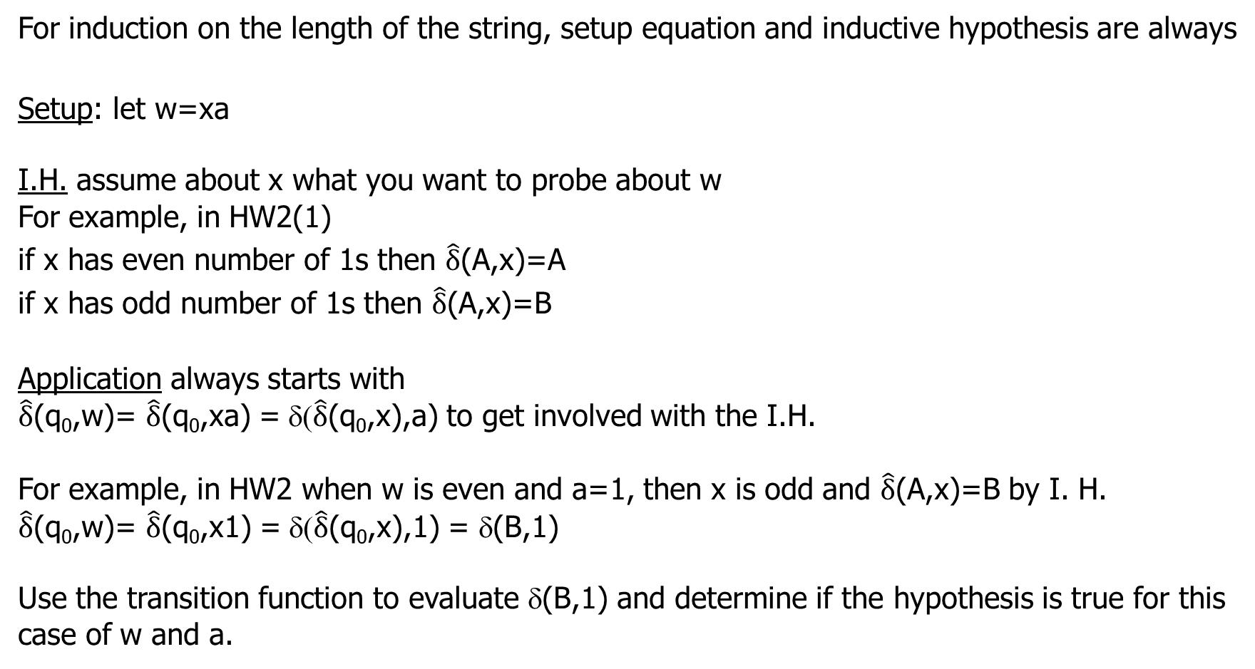
For induction on the length of the string, setup equation and inductive hypothesis are always
Setup: let w=xa
I.H. assume about x what you want to probe about w
For example, in HW2(1)
if x has even number of 1s then $\hat{δ}$(A,x)=A
if x has odd number of 1s then $\hat{δ}$(A,x)=B
Application always starts with
$\hat{δ}$(q₀,w)= $\hat{δ}$(q₀,xa) = δ($\hat{δ}$(q₀,x),a) to get involved with the I.H.
For example, in HW2 when w is even and a=1, then x is odd and $\hat{δ}$(A,x)=B by I. H.
$\hat{δ}$(q₀,w)= $\hat{δ}$(q₀,x1) = δ($\hat{δ}$(q₀,x),1) = δ(B,1)
Use the transition function to evaluate δ(B,1) and determine if the hypothesis is true for this case of w and a.

Slide 8

Elements in the formal definition of a DFAs
  Q = finite set of states
  Σ = input alphabet
  δ = transition function
  q₀ = start state in Q
  F = set of final states ⊆ Q
  “Final” and “accepting” are synonyms.
The set of strings accepted by DFA=(Q,Σ,δ,q₀,F) is the
language of the DFA defined by L={w|$\hat{δ}$(q₀,w)∈F}

Slide 9
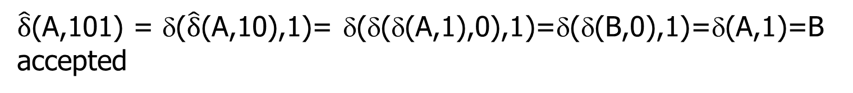
I will always ask you to use the definition of delta-hat when testing acceptance of a string by a DFA.
Example: use the definition of delta-hat to test the
acceptance of string 101 by the DFA defined by the
transition function table
0
1
A* A B
B* A C
C C C
$\hat{δ}$(A,101) = δ($\hat{δ}$(A,10),1)= δ(δ(δ(A,1),0),1)=δ(δ(B,0),1)=δ(A,1)=B
accepted

Slide 10
S 0 1
Test acceptance of string 011 by NFA
Use the method of all prefixes.
A
A,B
A
B
nil
C
*
C
nil
nil
˄
δ(A,e)={A}
δ(A,0)=δ(A,0)={A,B}
δ(A,01)=δ(A,1)Uδ(B,1) = AUC = {A,C}
δ(A,011)= δ(A,1)Uδ(C,1) = Aunil = A
Rejected
Algebra between 1st and 2nd = is not required.
˄
˄
˄

Slide 11
Is string 011 accepted by ε-NFA below?
Use the method of all prefixes with ECLOSE on all states
ε
0 1 ε
A {E} {B} ∅
B ∅ {C} {D}
C ∅ {D} ∅
D ∅ ∅ ∅
E {F} ∅ {B, C}
F {D} ∅ ∅
1
1
1
B
C
D
A
ε
ε
0
0
E
F
*
0
˄
(A,ε) = CL(A) = {A}
(A,0) = CL(E) = {E, B, C, D}
(A,01)=CL(∅UCUDU∅U)=CL({C, D})=CL(C)UCL(D)={C,D}
(A,011) = CL(DU∅)=CL(D)={D} accepted
δ
˄
δ
˄
δ
˄
δ

Slide 12
Given NFA find DFA_{eq}
1st row DFA transition table same as NFA transition table. Add {A,B} to the states of DFA
Find where {A,B} goes when DFA processes 0 AND 1
subsets 0 1
S 0 1
A
A,B
A
A
A,B
A
A,B
B
nil
C
*
C
nil
nil
Growing transition table of DFA_{eq}
Transition table of NFA
δ_{D}({A,B},0)= δ_{N}(A,0) U δ_{N}(B,0)={A,B} U nil={A,B}
δ_{D}({A,B},1)= δ_{N}(A,1) U δ_{N}(B,1)={A} U {C}={A,C}
Add {A,C} to the states of DFA with * to denote final state

Slide 13
subsets 0 1
S 0 1
A
A,B
A
A
A,B
A
A,B
A,B
A,C
B
nil
C
*
A,C
*
C
nil
nil
Growing transition table of DFA_{eq}
Transition table of NFA
Find out where {A,C} goes under 0 and 1
δ_{D}({A,C},0)= δ_{N}(A,0) U δ_{N}(C,0)={A,B} U nil={A,B} δ_{D}({A,C},1)= δ_{N}(A,1) U δ_{N}(C,1)={A} U nil={A}
No new subsets. We can complete DFA transition table

Slide 14
subsets 0 1
We can rename the states of DFA_{eq}
A
A,B
A
q₀ =A
q₁ ={A,B}
q₂ ={A,C}
A,B
A,B
A,C
*
A,C
A,B
A
Transition table of DFA_{eq}
States 0 1
Transition table of DFA_{eq} with new state names.
Test acceptance of 101 by the definition of delta-hat
q₀
q₁
q₀
q₁
q₁
q₂
*
q₂
q₁
q₀

Slide 15
e-NFA->NFA: Find the accepting states of equivalent NFA
0 1 ε
A {E} {B} ∅
B ∅ {C} {D}
C ∅ {D} ∅
D ∅ ∅ ∅
E {F} ∅ {B, C}
F {D} ∅ ∅
ε
1
1
1
B
C
D
ε-NFA
ε
A
ε
0
*
0
E
F
0
CL(A)= {A}
CL(B)= {B,D}*
CL(C)= {C}
CL(D)= {D}*
CL(E)= {E,B,C,D}*
CL(F)= {F}
ECLOSE of q in Q_{E} shows NFA has 2
additional accepting state, B and E

Slide 16
ε-NFA
Construct the transition
table of equivalent NFA
Let S = CL(q).
δ_{N}(q,a) is the union over
all p in S of δ_{E}(p,a)
0 1 ε
A {E} {B} ∅
B ∅ {C} {D}
C ∅ {D} ∅
D ∅ ∅ ∅
E {F} ∅ {B, C}
F {D} ∅ ∅
*
CL(A) = {A}
δ_{N}(A,0)=δ_{E}(A,0)={E}, δ_{N}(A,1)=δ_{E}(A,1)={B}
CL(B) = {B,D}
δ_{N}(B,0)=δ_{E}(B,0) U δ_{E}(D,0)=nil U nil = nil
δ_{N}(B,1)=δ_{E}(B,1) U δ_{E}(D,1)={C} U nil = {C}
CL(C) = {C}
δ_{N}(C,0)=δ_{E}(C,0)=nil, δ_{N}(C,1)=δ_{E}(C,1)={D}
CL(D) = {D}
δ_{N}(D,0)=δ_{E}(D,0)=nil, δ_{N}(D,1)=δ_{E}(D,1)=nil
NFA
0 1
A {E} {B}
B ∅ {C}
C ∅ {D}
D ∅ ∅
E
F
*
*
*

Slide 17
More construct the transition table of equivalent NFA
ε-NFA
NFA
0 1 ε
A {E} {B} ∅
B ∅ {C} {D}
C ∅ {D} ∅
D ∅ ∅ ∅
E {F} ∅ {B, C}
F {D} ∅ ∅
0 1
A {E} {B}
B ∅ {C}
C ∅ {D}
D ∅ ∅
E {F} {C,D}
F {D} ∅
*
*
*
*
CL(E) = {E,B,C,D}
δ_{N}(E,0)=δ_{E}(E,0) U δ_{E}(B,0) U δ_{E}(C,0) U δ_{E}(D,0)={F} U nil U nil U nil={F}
δ_{N}(E,1)=δ_{E}(E,1) U δ_{E}(B,1) U δ_{E}(C,1) U δ_{E}(D,1)=nil U {C} U {D} U nil={C, D}
CL(F) = {F}
δ_{N}(F,0) = δ_{E}(F,0) ={D}, δ_{n}(F,1) = δ_{E}(F,1) = nil
As with e-NFA, nil means thread termination in NFA

Slide 18
Given ε-NFA find equivalent DFA
Add ECLOSE to lazy subset construction
Start state of DFA is CL(q_{0E}), where q_{0E} is start state of ε-NFA
Lazy subset construction of DFA from ε-NFA same as for DFA from NFA except that we use the ECLOSE of the states in the transition table of ε-NFA

Slide 19
Lazy sublet construction of the equivalent DFA
0 1 ε
A {E} {B} ∅
B ∅ {C} {D}
C ∅ {D} ∅
D ∅ ∅ ∅
E {F} ∅ {B, C}
F {D} ∅ ∅
ε-NFA
CL(A)= {A}
CL(B)= {B,D}
CL(C)= {C}
CL(D)= {D}
CL(E)= {E,B,C,D}
CL(F)= {F}
*
Since CL(A)={A}, {A} is the start state DFA_{eq}
Use transition table of ε-NFA with ECLOSE of states to find where {A} goes under 0 and 1.
δ_{D}(A,0)=CL(E)={E,B,C,D} δ_{D}(A,1)=CL(B)={B,D}
{E,B,C,D} and {B,D} are states of DFA_{eq}
Find where they go under 0 and 1
Continue until no new subset are encountered

Slide 20
Construct the equivalent DFA
ε-NFA
DFA_{eq}
0 1 ε
A {E} {B} ∅
B ∅ {C} {D}
C ∅ {D} ∅
D ∅ ∅ ∅
E {F} ∅ {B, C}
F {D} ∅ ∅
0 1
A {EBCD} {BD}
{EBCD} {F} {CD}
{BD}
{F}
{CD}
*
*
*
*
δ_{D}({E,B,C,D},0)=CL(δ_{E}(E,0)Uδ_{E}(B,0)Uδ_{E}(C,0)Uδ_{E}(D,0))
CL(FU∅U∅U∅)=CL(F)=F
δ_{D}({E,B,C,D},1)=CL(δ_{E}(E,1)Uδ_{E}(B,1)Uδ_{E}(C,1)Uδ_{E}(D,1))
CL(∅UCuDU∅)=CL({C,D})=CL(C)UCL(D)={C,D}
Now add {F}, {CD}, and {BD} to the list of DFA_{ep} states

Slide 21
Construct the equivalent DFA
ε-NFA
DFA_{eq}
0 1 ε
A {E} {B} ∅
B ∅ {C} {D}
C ∅ {D} ∅
D ∅ ∅ ∅
E {F} ∅ {B, C}
F {D} ∅ ∅
0 1
A {EBCD} {BD}
{EBCD} {F} {CD}
{BD} ∅ {C}
{F} {D} ∅
{CD} ∅ {D}
*
*
*
*
δ_{D}({B,D},0)=CL(δ_{E}(B,0)Uδ_{E}(D,0))=CL(∅U∅)=CL(∅)= ∅ δ_{D}({B,D},1)=CL(δ_{E}(B,1)Uδ_{E}(D,1))=CL(CU∅)=CL({C})=C
δ_{D}({F},0)=CL({D})=D δ_{D}({F},1)=CL(∅)=∅
δ_{D}({C,D},0)=CL(δ_{E}(C,0)Uδ_{E}(D,0))=CL(∅U∅)=CL(∅)= ∅
δ_{D}({C,D},1)=CL(δ_{E}(C,1)Uδ_{E}(D,1))=CL(DU∅)=CL({D})=D
Now add {C} and {D} to the list of DFA_{ep} states

Slide 22
Construct the equivalent DFA
ε-NFA
DFA_{eq}
0 1 ε
A {E} {B} ∅
B ∅ {C} {D}
C ∅ {D} ∅
D ∅ ∅ ∅
E {F} ∅ {B, C}
F {D} ∅ ∅
0 1
A {EBCD} {BD}
{EBCD} F {CD}
{BD} ∅ C
F D ∅
{CD} ∅ D
C ∅ D
D ∅ ∅
*
*
*
*
*
δ_{D}({C},0)=CL(∅)=∅ δ_{D}({C},1)=CL(D)=D
δ_{D}({D},0)=CL(∅)=∅ δ_{D}({D},1)=CL(∅)=∅
List of DFA_{ep} states is complete
In DFA_{eq}, interpret ∅ as loop on the state

Slide 23
Construct the equivalent DFA
ε-NFA
DFA_{eq}
0 1 ε
A {E} {B} ∅
B ∅ {C} {D}
C ∅ {D} ∅
D ∅ ∅ ∅
E {F} ∅ {B, C}
F {D} ∅ ∅
0 1
A {EBCD} {BD}
{EBCD} F {CD}
{BD} {BD} C
F D F
{CD} {CD} D
C C D
D D D
*
*
*
*
*
Rename the states of DFA_{eq}: A=q₀, {EBCD}=q₁, {BD}=q₂, F=q₃
{CD}=q₄, C=q₅, and D=q₆.
Be consistent changing the names of states in columns 0 and 1

Slide 24
Rename the states in DFA_{eq}
0 1
A {BCDE} {BD}
{BCDE} F {CD}
{BD} {BD} C
F D F
{CD} {CD} D
C C D
D D D
0 1
q0 q1 q2
q1 q3 q4
q2 q2 q5
q3 q6 q3
q4 q4 q6
q5 q5 q6
q6 q6 q6
*
*
*
*
*
*
*
*
ε-NFA accepts string 011.
Use delta-hat to show that DFA_{eq} accepts string 011.
(q₀,011)=δ(δ(δ(q₀,0),1),1)=δ(δ(q₁,1),1)= δ(q₄,1)=q₆
accepted
˄
δ

