Slide 1
Quiz 1, Friday 8/30/24
Lectures L1 and L2
Assignments 1 and 2
Topics:
Definition and representation of DFAs
String testing for DFAs
Induction on integers
Induction on the length of a string

Slide 2
Elements in the formal definition of a DFAs
Q = finite set of states
Σ = input alphabet
δ = transition function
q₀ = start state in Q
F = set of final states ⊆ Q
“Final” and “accepting” are synonyms.
The set of strings accepted by DFA=(Q,Σ,δ,q₀,F) is the
language of the DFA defined by L={w|$\hat{δ}$(q₀,w)∈F}

Slide 3
I will always ask you to use the definition of delta-hat when testing acceptance of a string by a DFA.
Example: use the definition of delta-hat to test the
acceptance of string 101 by the DFA defined by the
transition function table
0
1
A* A B
B* A C
C C C
$\hat{δ}$(A,101) = δ($\hat{δ}$(A,10),1)= δ(δ(δ(A,1),0),1)=δ(δ(B,0),1)=δ(A,1)=B
accepted

Slide 4
Proof by induction on integers has the follow elements present and identified.
Proof of base case
Setup equation designed to use the inductive hypothesis
Statement of inductive hypothesis
Application of inductive hypothesis
Algebra that completes the proof
All algebraic operations must be on the right-hand-side of the equals sign.

Slide 5
Example: structured proof of
Σ_{k=1 to n} k² = n(n+1)(2n+1)/6
using “if S(n-1) then S(n)”
worked in class.

Slide 6
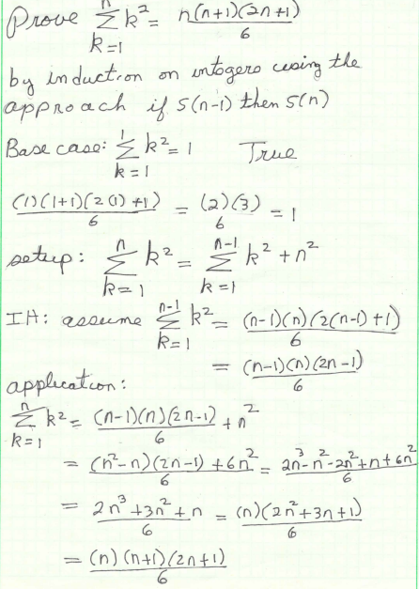

Slide 7
Induction on the length of string: proof must include the following elements:
(1) base case:
(2) setup
(3) inductive hypothesis
(4) application of inductive hypothesis

Slide 8
Base cases: usually empty string + single character strings
Prove the hypothesis is true for these strings
For empty string, use definition of extended delta
w=e; $\hat{δ}$(q₀,e)=q₀
For single character strings, extended delta is just delta
w=a; $\hat{δ}$(q₀,a)=δ(q₀,a)
Refer to the transition function table evaluate δ(q₀,a) and determine if the hypothesis is true.

Slide 9
For induction on the length of the string, setup equation and inductive hypothesis are always
Setup: let w=xa
I.H. assume about x what you want to probe about w
For example, in HW2(1)
if x has even number of 1s then $\hat{δ}$(A,x)=A
if x has odd number of 1s then $\hat{δ}$(A,x)=B
Application always starts with
$\hat{δ}$(q₀,w)= $\hat{δ}$(q₀,xa) = δ($\hat{δ}$(q₀,x),a) to get involved with the I.H.
For example, in HW2 when w is even and a=1, then x is odd and $\hat{δ}$(A,x)=B by I. H.
$\hat{δ}$(q₀,w)= $\hat{δ}$(q₀,x1) = δ($\hat{δ}$(q₀,x),1) = δ(B,1)
Use the transition function to evaluate δ(B,1) and determine if the hypothesis is true for this case of w and a.

