Slide 1
Parse Trees
Definitions
Relationship to lm and rm Derivations
Ambiguity in Grammars

Slide 2
Parse Trees: graphical representations of derivations
Parse trees have nodes labeled by symbols of a CFG.
Leaves: labeled by a terminal or ε.
Interior nodes: labeled by variables.
Children are labeled by the right side of a production for the parent.
Root: labeled by the start symbol.
Yield: string produced by concatenation of leaves left-to-right

Slide 3
Example: Parse Tree for
Derivation of (())() in S -> SS | (S) | ()
S =>_{lm} SS =>_{lm} (S)S =>_{lm} (())S =>_{lm} (())()
S =>_{rm} SS =>_{rm} S() =>_{rm} (S)() =>_{rm} (())()
S
S
S
(
S
)
(
)
Yield: (())()
(
)

Slide 4
Parse trees of lm and rm derivations are the same.
Only affects which branch you assemble first.
S =>_{lm} SS =>_{lm} (S)S =>_{lm} (())S =>_{lm} (())()
S =>_{rm} SS =>_{rm} S() =>_{rm} (S)() =>_{rm} (())()
S
S
S
(
S
)
(
)
Yield: (())()
(
)

Slide 5
For CFG with start symbol S and productions
S->A1B
A->0A|e
B->0B|1B|e
Show that the parse trees of lm and rm derivations of string
00101 are identical

Slide 6
S->A1B A->0A|e B->0B|1B|e
Show that the parse trees of lm and rm derivations of string 00101 are identical
The sequence of the derivation is root to leaves.
Yield by read left to right determines configuration of branches.
Hence, parse trees have no “leftmost” or “rightmost” distinction.

Slide 7
Ambiguous CFG’s
3 equivalent properties of “ambiguous” CFGs
There is a string in the L(CFG) that has two different leftmost derivations.
There is a string in the L(CFG) that has two different rightmost derivations.
There is a string in the L(CFG) that is the yield of 2 distinct parse trees
Proof of any one of these shows that CFG is ambiguous

Slide 8
Prove S -> SS | (S) | () is ambiguous by 2 left-most derivations of ()()() and
by 2 parse trees.
Work on board

Slide 9
S -> SS | (S) | () is ambiguous Prove by 2 lm derivations of ()()()
S=>SS=>SSS=>()SS=>()()S=>()()()
S=>SS=>()S=>()SS=>()()S=>()()()
Branches of parse tree can be exchanged because yield is the same read L->R and R->L

Slide 10
CptS 317 Fall 2023
Assignment 12, Exercises 5.4.1 text p 215
Use string aab to show that S->aS|aSbS|ε is ambiguous by all 3 methods: 2 left-most, 2 right-most, and 2 parse trees.

Slide 11
Exercise 5.4.3 p216
Remove the ambiguity in S->aS|aSbS|ε
As you will demonstrate in HW12, derivations of aab can start with either S=>aS or S=>aSbS.
To remove ambiguity in derivation of aab we change the production S=>aSbS to one that forces only one way to start.
Example: add variable T with productions such that starting with S=>aTbS cannot produce aab by lm steps.

Slide 12
Show on board that in CFG
S->aS
S->aTbS
S->e
T->aTbT
T->e
the left-most derivation of aab is unique
Do on board

Slide 13
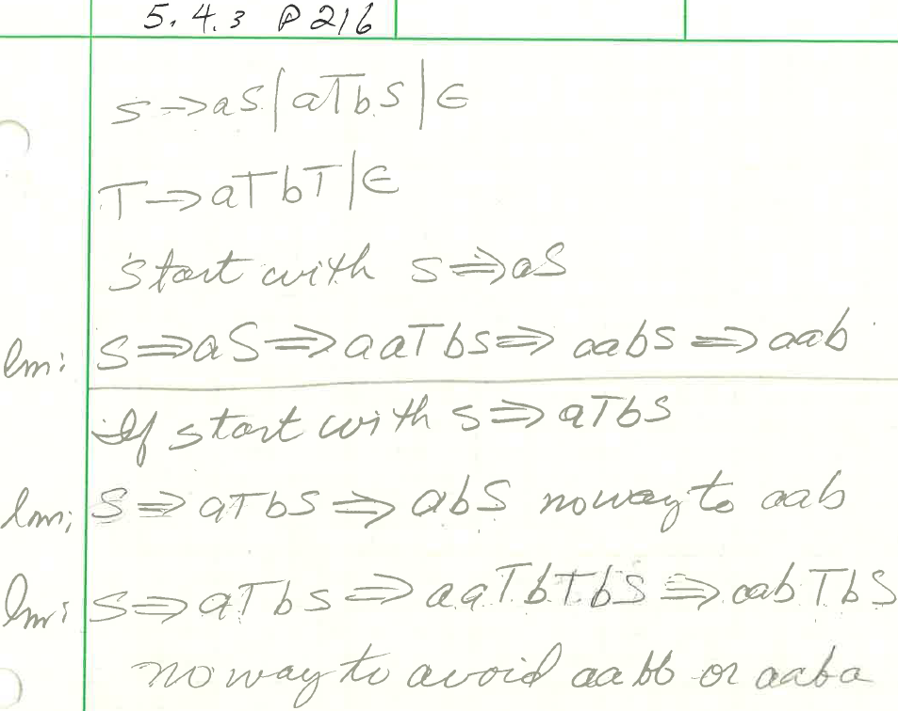

Slide 14
Easy to prove ambiguous. Only requires one string
Hard to prove unambiguous
Removing ambiguity in derivation of aab does not prove
that S=>aS|aTbS|e with T=>aTbT|e is unambiguous.
Difficult to know if changes designed to avoid ambiguity
in derivation of aab apply to all strings in L(CFG)
Change to CFG must preserve the content of L(CFG)

Slide 15
Ambiguity is a Property of Grammars, not Languages
Same CFL may have ambiguous and unambiguous CFGs
Example: balanced-parentheses CFL
Recall, S -> SS | (S) | () shown to be ambiguous by 2 lm derivations of ()()()
Balanced-parentheses CFL also has an unambiguous CFG

Slide 16
Unambiguous balanced-parenthesis CFG
B -> (RB | ε R -> ) | (RR
B is the start symbol
Derivations must start with B ->(RB
To expand with “(“, use R->(RR
To expand with “)”, use R ->)
End with B->ε
Example of LL(1) CFG: “Leftmost derivation, left-to-right scan, one symbol of look-a-head.”

Slide 17
Unambiguous balanced-parenthesis CFG
B -> (RB | ε R -> ) | (RR
Example derivation of (())() by LL(1)
Work on board

Slide 18
Unambiguous balanced-parenthesis CFG
B -> (RB | ε R -> ) | (RR
Example derivation of (())()
B =>_{lm} (RB =>_{lm} ((RRB =>_{lm} (()RB =>_{lm} (())B
(())B =>_{lm} (())(RB =>_{lm} (())()B =>_{lm} (())()
At each lm step, the production needed is uniquely defined.

Slide 19
LL(1) Grammars
By construction obviously unambiguous
You can always figure out the production to use in a leftmost derivation by scanning the given string left-to-right and looking at the next symbol only
Most programming languages have LL(1) grammars.

Slide 20
Inherent Ambiguity
Not every ambiguous grammar can be “fixed” as was the case with the balanced-parentheses grammar.
Some CFL’s are inherently ambiguous; every grammar for the language is ambiguous.

Slide 21
Example: Inherent Ambiguity
The language {0^{i}1^{j}2^{k} | i = j or j = k} is inherently ambiguous.
At least some of the strings of the form 0^{n}1^{n}2^{n} can be generated by two left-most derivations depending on which you check first: equal number of 0’s and 1’s or equal number of 1’s and 2’s.

Slide 22
Example of ambiguous grammar for {0^{i}1^{j}2^{k} | i = j or j = k}
S -> AB | CD
A -> 0A1 | 01
B -> 2B | 2
C -> 0C | 0
D -> 1D2 | 12
A generates equal 0’s and 1’s
B generates any number of 2’s
C generates any number of 0’s
D generates equal 1’s and 2’s
There are two leftmost derivations of every string with equal numbers of 0’s, 1’s, and 2’s.
Show true for n=2, w=001122, with 2 lm derivations
Show on board

Slide 23
Example of ambiguous grammar for {0^{i}1^{j}2^{k} | i = j or j = k}
S -> AB | CD
A -> 0A1 | 01
B -> 2B | 2
C -> 0C | 0
D -> 1D2 | 12
A generates equal 0’s and 1’s
B generates any number of 2’s
C generates any number of 0’s
D generates equal 1’s and 2’s
lm: S => AB => 0A1B =>0011B => 0112B => 001122
lm: S => CD => 0CD=>00D => 001D2 => 001122

