Slide 1
Review for quiz 4
Lecture L9-L13
HW 13-15
Principal component analysis
Genetic algorithm
Radial basis function network

Slide 2
Principal Components Analysis (PCA)
Assume that attribute vectors in the population are drawn from a multivariate normal distribution. P(x)=N(μ, Σ)
Covariance matrix:
diagonal elements are σ² of individual attributes.
Off diagonals show
correlation between variation of attributes.
dxd
dx1
1xd
2

Slide 3
Summary of PCA
PCs are linear combinations of attributes defined by the eigenvectors of the covariance matrix. z_{i} = w_{i}^{T}x
Var(z_{i}) = λ_{i} the eigenvalue associated with eigenvector w_{i}
PCs are ordered by decreasing variance.
Covariance matrix of PCs is diagonal; hence no correlation.
Sum over i of Var(z_{i}) = total variance of attributes in dataset
PoV(k) =
is the proportion variance captured by k PCs

Slide 4
Z-scores: attributes transformed to zero mean and unit variance
If variable x is normally distributed with mean μ and variance σ²,
then z = (x – μ)/σ
is normally-distributed with zero mean and unit variance.
The covariance matrix of z-scores is the correlation matrix with ones on the
diagonal and correlation coefficients off the diagonal.
Sum of the eigenvalues of z-scores is the number of attributes in a record
PoV(k) is the equivalent number of attributes accounted for by k principal components of z-scores

Slide 5
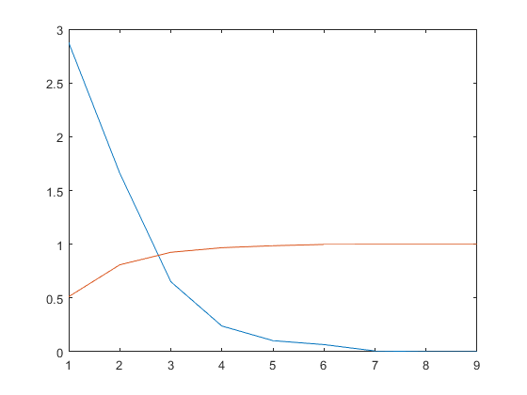
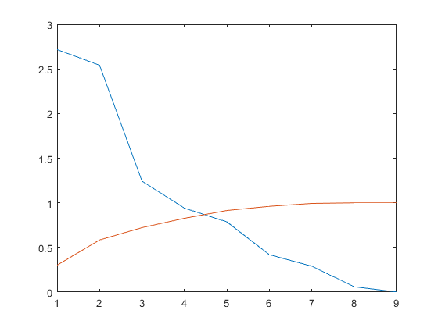
HW 13 PCA of glass data
Eigenvalues of covariance matrix
sum=5.6046
Eigenvalues of correlation matrix
sum=9
eigenvals
eigenvals
PoV
PoV

Slide 6
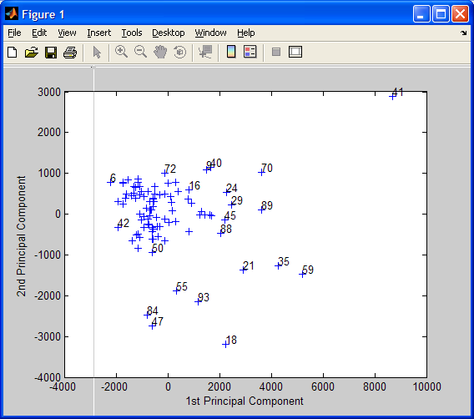
Scatter plot of PC₂ vs PC₁: z_{i}^{t}= w_{i}^{T}x^{t} is the value of PC_{i} from record t of dataset. w_{i} is the i^{th} eigenvector (i^{th} column of W matrix)

Slide 7
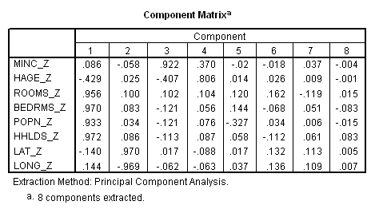
Component matrix: PC loadings
What correlated variable contribute to a PC?
Used in profiling PCs
Define L_{k} = sqrt(l_{k})w_{k} as the loading vector of PC_{k}. Loading vectors are
the columns of the “Component Matrix”. L_{ij} is the loading of the j^{th} PC by
the i^{th} attribute of a record. When z-score are used, -1< L_{ij} <+1
_z denotes z-scores as attributes

Slide 8
Threshold on loadings for profiling PCs
Squared loading = amount of the attribute’s total variability explained by a PC
To be considered significant |loading| > 0.5
This threshold value means that at least 25% of an attribute’s variance is explained by a particular PC
Communality of an attribute = sum of squared loadings over all PCs of a PCA
Communality must be > 0.5 for an attribute to be considered adequately represented in a PCA.
If PCs are used for downstream analysis, only attributes with communality > 0.5 may be considered part of the analysis

Slide 9
Example of communality for variable housing median age from PCA of Houses dataset:
  Communality for housing median age, 3 PCs retained in PCA:
  (-0.429)² + (0.025)² + (-0.407)² = 0.350315
    housing median age is not adequate represented in this PCA
  Communality for housing median age, 4 PCs retained in PCA:
  (-0.429)² + (0.025)² + (-0.407)² + (0.806)² = 0.999951
    meets requirement for representation in PCA

Slide 10
Genetic algorithm for attribute selection
Find the best subset of attributes for data mining
GA is well suited to this task since it can explore many combinations of attributes.

Slide 11
Fitness and selection of chromosomes
00100 = 4 fitness = 0.0011 pi = 0.044
01001 = 9 fitness = 0.0216 pi = 0.861
11011 = 27 fitness = 0.0023 pi = 0.091
11111 = 31 fitness = 0.0001 pi = 0.004
Σ_{i} f(x_{i}) = 0.0251
\ \ \
|---------|---------|---------|---------|---------|---------|---------|---------|---
0 .1 .2 .3 .4 .5 .6 .7 .8
What is the range of random numbers that will lead to the
selection of 11011?
What is the range of random numbers that will lead to the
selection of 01001?

Slide 12
Crossover selected to induce change
Assume a mixing point (locus) is chosen between first and
second bit.
Mutation is rejected as method to induce change

Slide 13
1st generation
|\ \ \
|---------|---------|---------|---------|---------|---------|---------|---------|---
0 .1 .2 .3 .4 .5 .6 .7 .8
What is the range of random numbers that will lead to the
selection of 11011? (0.048 to 0.139)
What is the range of random numbers that will lead to the
selection of 01001? (0.139 to 1.0)
2nd generation: bias of initial guess persist
\ \ \
|---------|---------|---------|---------|---------|---------|---------|---------|---
0 .1 .2 .3 .4 .5 .6 .7 .8
What is the range of random numbers that will lead to the
selection of 11001? (0.0219 to 0.1661)
What is the range of random numbers that will lead to the
selection of 01001? (0.1661 to 1.0)

Slide 14
Radial Basis Function Network:
Dimensionality reduction by k-means clustering.

Slide 15
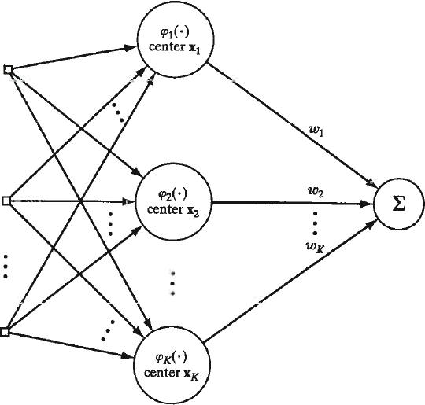
Gaussian basis function as features in multivariate linear regression
ϕ_{j}(x) = exp(-½(|x-μ_{j}|/σ_{j})²)
Given converged K-means centers, estimate variance for RBFs by σ² = d²_{max}/2K, where d_{max} is the largest distance between clusters.
How do we calculate distance between clusters?
d_{ij} = ||m_{i}-m_{j}||

Slide 16
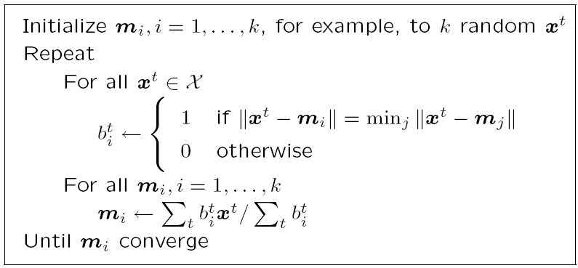
K-means clustering pseudo code with EM steps labeled
E - step
M - step
16

Slide 17
Davies-Bouldin index (DBI) is one of several methods used to find the optimum number of clusters.
Rationale: Choose K that makes the clusters least similar
R_{ij} = similarity of clusters i and j = (S_{i} + S_{j})/M_{ij} where
S_{k} is the dispersion of cluster k, which is the average
separation of its members from the centroid.
M_{ij} is the distance between the centroids of clusters i and j.
Small dispersions and wide separation -> low similarity

