Slide 1
Review for quiz 3
Lecture L5-L8
HW 8-12

Slide 2
L5 Fundamentals of Classification
2x2 confusion matrix
class information in rows
class specific TP and FP rates

Slide 3
Class dependent performance metrics
FP rate = FP/(FP+TN)
TP rate = TP/(TP+FN
If either class could be the “positive” class, then the Confusion Matrix, TP rate, and FP rates become class specific.
Example:
a is the positive class
a b ← classified as
431 13 | a
236 | b
FP rate = 3/(3+236)=0.013
TP rate = 431/(431+13)=0.971
b is the positive class
b a ← classified as
236 3 | b
431 | a
FP rate = 13/(13+413)=0.029
TP rate = 236/(236+3)=0.987
3

Slide 4
Assignment 8a: KNN classification
Open the leukemia gene expression file (on class website) in Weka.
Find IBk (aka KNN) classification method. Use default values. Find additional detail in lecture L6 Methods of Classification.
Report accuracy of classification and confusion matrix assuming ALL is the positive class (Weka’s choice)
Construct the confusion matrix assuming AML is the positive class
Calculate the class-dependent TP and FP rates. Show your work and compare to Weka.

Slide 5
Assignment 8b Parametric Bayesian Classification
Use WEKA’s naïve Bayes to classify ALL and AML by leukemia gene expression. Compare with KNN results from HW8a

Slide 6
Assignment 9: Bayes’ discriminant points
Write a MATLAB code to find the Bayes’ discriminant points in a 1D, 2-class problem with equal priors and Gaussian class likelihoods by the following method
A function that calculates the coefficients in the quadratic equation on the previous slide.
Find the solution of the quadratic equation by the usual method.
Allow for the possibility only one root if variances are equal, as illustrated in slide 35.
Apply the code to the following example:
Mean and variance of C1 are 3 and 1, respectively
Mean and variance of C2 are 2 and 0.3, respectively
Remember! variance = standard deviation squared

Slide 7
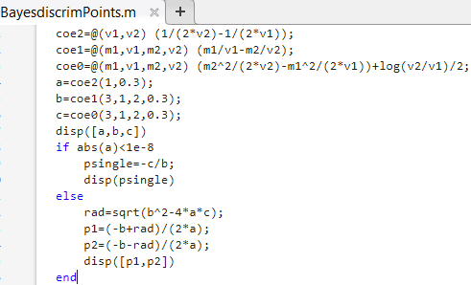

Slide 8
Pattern Recognition
Linear discriminants
Decision boundaries and margins

Slide 9
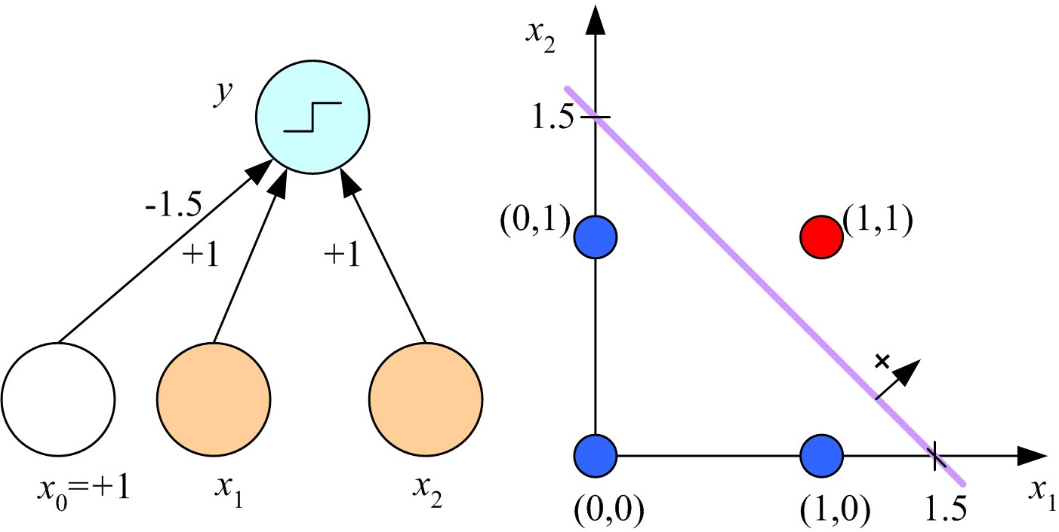
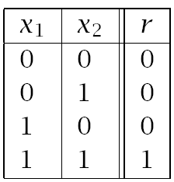
Given w find b so that margins are equal
Find equation of decision boundary and plot
Calculate margins
Boolean AND
Lecture Notes for E Alpaydın 2010 Introduction to Machine Learning 2e © The MIT Press (V1.0)
9

Slide 10
Example: Boolean AND dataset
If w=[1,1]^{T}, x⁺ = [1,1]^{T}, x⁻ = [0,1]^{T}, then
w^{T}x⁺ = 2, w^{T}x⁻ = 1, b = -(2+1)/2 = -1.5
Equation of the decision boundary, w^{T}x + b = 0, is x₁ + x₂ = 1.5
Margin = (w^{T}x⁺ + b)/||w|| = (2-1.5)/1.414 = 0.3536
10

Slide 11
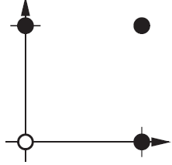
Assignment 10a: Boolean OR dataset
Chose w=[1,1]^{T}
Find a decision boundary with equal margins
Show y intercept on plot of decision boundary
Calculate margins
Members have label = 1
p₁ p₂ t
0 0 0
0 1 1
1 0 1
1 1 1
Logical OR

Slide 12
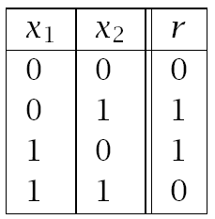
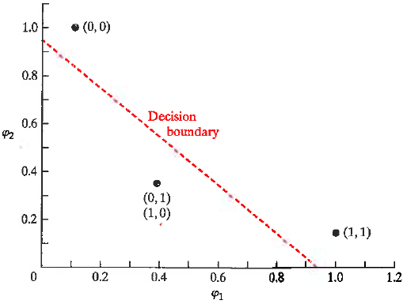
XOR data
XOR in Gaussian feature space
φ₁ = exp(-|X – [1,1]|²)
φ₂ = exp(-|X – [0,0]|²)
X φ₁ φ₂ r
(1,1) 1 0.1353 0
(0,1) 0.3678 0.3678 1
(0,0) 0.1353 1 0
(1,0) 0.3678 0.3678 1
r=0
Assignment 10b: feature space Boolean XOR
Chose w=[1,1]^{T}
Find a decision boundary with equal margins
Show y intercept on plot of the decision boundary
Calculate margins
x⁺ = [1,1]^{T}, x⁻ = [0,1]^{T}
r=1

Slide 13
Perceptron Classifier/Controller
Perceptron Learning Algorithm (PLA)
Control theory
Least Mean Square algorithm (LMS)

Slide 14
Summary of perceptron leaning rules
Binomial labels t={0,1}
a = Perceptron output in hardlimit(w^{T}p+b)
a = 1 if w^{T}p+b > 0
a = 0 if w^{T}p+b < 0
e = Error = t-a
Update weights after randomly choosing a misclassified example.

Slide 15
Assignment 11: PLA
Use perceptron learning rules to find a weight vector w and bias b that correctly
classify a pattern in 3D attribute space defined by 2 points. Assume the output of
the perceptron is hardlim(w^{T}p + b)
p₁^{T} = [-1,1,-1], t₁= 1
p₂^{T} = [1,1,-1], t₂=0
initial weight w^{T} = [0.5,-1,-0.5], initial bias b = 0.5
Verify that both patterns are misclassified with initial weight and bias.
Choose p₁ as the initial misclassified example.
Use final weight vector and b value to calculate margins.

Slide 16
Least Mean Square algorithm:
Gradient search for w* that minimizes E[e²] approximated by e_{k}²
With no bias, e_{k}²(w) = (t_{k}-w^{T}p_{k})² gradient(e_{k}²(w)) = -2e_{k}p_{k}
Choose a gradient-decent step size α
w_{k+1} = w_{k} – α gradient(e_{k}²(w)) w_{k+1} = w_{k} + 2αe_{k}p_{k}
Step size 0.2 is reasonable.

Slide 17
Example from lecture
Initial weight vector = w_{i}^{T}=[0,0,0]. b=0
Alternate between prototype vectors for orange and apple.
a = w^{T}p, e = t-a, t_{O}= -1, t_{A} = 1
p_{O}$=\left[\begin{matrix}\begin{aligned}1 \\ −1\end{aligned} \\ −1\end{matrix}\right]$
a = w^{T}p = 0
e = t_{O} - a = -1
w^{T}_{new} = w^{T}_{old} + 2αep^{T}
w^{T}_{new} = [0, 0 ,0] + 2(0.2)(-1)[1,-1,-1] = [-0.4, 0.4, 0.4]

Slide 18
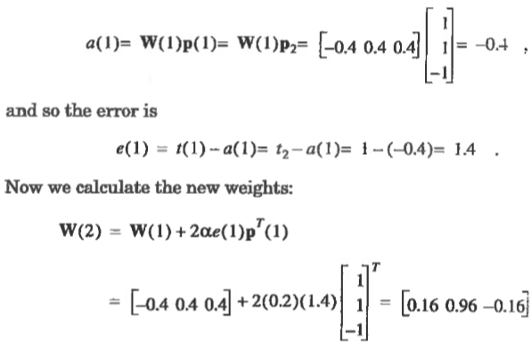
Present apple prototype vector p₂ with target = 1 to network
Note: W = w^{T}

Slide 19
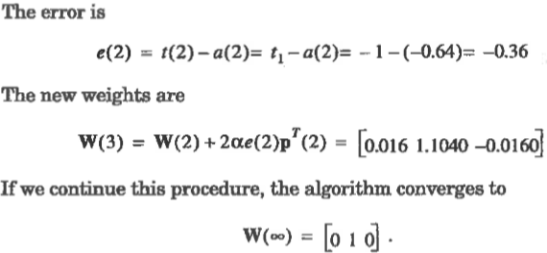
Present orange prototype again with target = -1

Slide 20
LMS decision boundary and margins
p_{O}$=\left[\begin{matrix}\begin{aligned}1 \\ −1\end{aligned} \\ −1\end{matrix}\right]$
Prototype orange
Prototype apple
p$=\left[\begin{matrix}\begin{aligned}shape \\ texture\end{aligned} \\ weight\end{matrix}\right]$
p_{A}$=\left[\begin{matrix}\begin{aligned}1 \\ 1\end{aligned} \\ −1\end{matrix}\right]$
Decision boundary defined by w^{T} = [0,1,0] and b=0
(goes through origin)
$\left[0, 1, 0\right]\left[\begin{matrix}p1 \\ \begin{aligned}p2 \\ p3\end{aligned}\end{matrix}\right]$ + 0 = p₂ = 0
Decision boundary is the p₂ = 0 plane. Classification is by
texture only, negative for orange, positive for apple.
Calculate the margins.

Slide 21
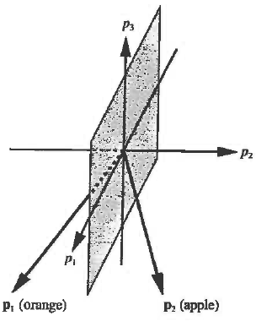
What are the margins on the orange and apple prototype points?
w^{T}=[0, 1, 0], ||w|| = sqrt(1) = 1
g(p_{O})$=\left[0,1,0\right]\left[\begin{matrix}1 \\ \begin{aligned}−1 \\ −1\end{aligned}\end{matrix}\right]$ = -1
Margin orange class = |g(p₀)|/ ||w||=1
g(p_{A})$=\left[0,1,0\right]\left[\begin{matrix}1 \\ \begin{aligned}1 \\ −1\end{aligned}\end{matrix}\right]$ = 1
Margin apple class =1

Slide 22
Assignment 12: one cycle in LMS with b=0.
Initial weight w_{i} = [0.5,-1, -0.5] ^{T}
Use prototype vector for apple p = [1,1,-1]^{T} with t = 1
Use a step size of 0.2
Carry out the first cycle of Least Mean Square search for optimum weight vector by
Calculating perceptron output, a
(b) Calculating the error in perceptron output, e
(c) Calculating the new weight vector, w

