Slide 1
Review for quiz 2, Tuesday 10/18/22
Lecture L4-L6 classify by regression
HW 5, 6a, 6b,7
What is most likely to by on this quiz?
Are your scripts ready to use?

Slide 2
Assignment 5: Multivariate linear regression on Cereals dataset
Write a script to use linfit2D for regression of nutritional rating vs sugar and fiber. Report b₀, b_{s}, b_{f}, r², s, and F.
Consider protein, fat, and sodium (columns 2, 3, and 4 of Z matrix) separately as a third attribute, in addition to sugar and fiber, to predict the nutritional rating cereals.
Expand your script to use linfit3D for regression of nutritional rating vs sugar, fiber and the third attribute. Report the changes in R² and s relative to their value in fit of nutritional rating vs sugar and fiber for each case of a third attribute.

Slide 3
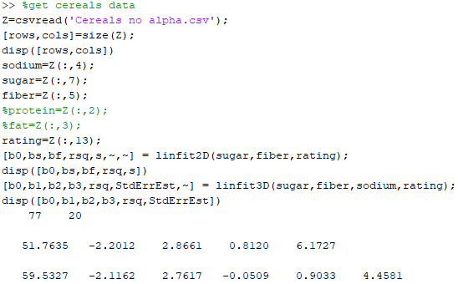
Beginning of a script for HW5. Add
calculation of changes in rsq and s
relative to fit with sugar and fiber.

Slide 4
Assignment 6a: Inference in multivariate linear regression on Cereals dataset
Write a script to use linfit2D for regression of nutritional rating vs sodium and fiber. Report b₀, b_{s}, b_{f}, r², s, and F. Plot standard residuals as a function of fit.
Expand your script to use inference2D to calculate 95% confidence intervals on slopes bs and bf.
Use the regression model to predict nutritional rating for 200 units of sodium and 5 units of fiber.
Find the 95% confidence intervals on prediction of the mean nutritional rating for a sample of cereals with 200 units of sodium and 5 units of fiber.
Find the 95% confidence intervals on prediction of nutritional rating for a random cereal with 200 units of sodium and 5 units of fiber.

Slide 5
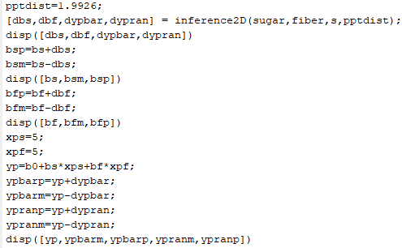
Part of script for HW 6a. Uses standard
error of estimation, s, from linfit2D. Reports
confidence intervals as a upper and lower limit.

Slide 6
Assignment 6b:
Generate the in silico data set of 2sin(1.5x)+N(0,1) with 100 random values of x between 0 and 5
Use 25 samples for training, 75 for validation
Fit polynomials of degree 1 – 5 to the training set.
Calculate sum of squared residuals in the training set at each degree.
Without changing the parameters, calculate the sum of squared residuals in the validation set at each degree
Plot sum of squared residuals training and validation as a function of degree on the same axes. What is the best degree of polynomial to use for the model?
Use the full data set to find the optimum polynomial of best polynomial degree
Show this result as plot of data and fit on the same set of axes.
Report the coefficient of determination
OK to use script valpoly5 that is on the class web page

Slide 7
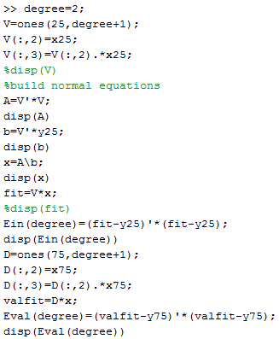
Given data (x25 and y25 in this script),
calculate in-sample and validation errors
for specified degree of polynomial.

Slide 8
Assignment 7:
Use dataset glass_data_HW6.csv on the class webpage to develop a classifier for beer-bottle glass by multivariate regression. Keep the class labels as 1, 2, and 6. After fitting class labels as though they are a continuous response, bin the results to make predictions of class assignment. Default bin=2, Fit<1.5, bin=1, and Fit>4, bin=6
Report the following:
coefficient of determination (aka R²)
number of records in each class and accuracy of class assignment
overall accuracy
3-way confusion matrix as shown below (columns sum to total records in a class)
# in class 1 assigned class 1 # in class 2 assigned class 1 # in class 6 assigned class 1
# in class 1 assigned class 2 # in class 2 assigned class 2 # in class 6 assigned class 2
# in class 1 assigned class 6 # in class 2 assigned class 6 # in class 6 assigned class 6

Slide 9
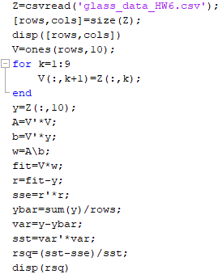
Setup and solve normal equations,
get fit and coefficient of determination
Like any other multivariate linear
regression script

Slide 10
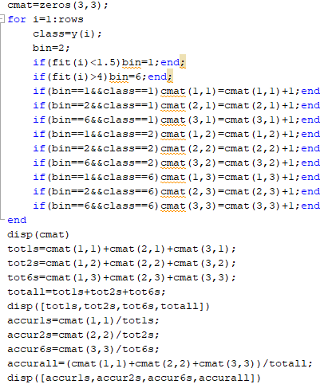
Not likely that building a confusion
matrix will be on quiz. More likely
to give you a confusion matrix with
row or column class specificity,
and ask you to calculate class
and overall accuracies.

Slide 11
More possible hand calculations on quiz 2
FP rate = FP/(FP+TN)
TP rate = TP/(TP+FN)
If either class could be the “positive” class, then the Confusion Matrix, TP rate, and FP rates become class specific.
Example:
a is the positive class
a b ← classified as
431 13 | a
236 | b
FP rate = 3/(3+236)=0.013
TP rate = 431/(431+13)=0.971
b is the positive class
b a ← classified as
236 3 | b
431 | a
FP rate = 13/(13+413)=0.029
TP rate = 236/(236+3)=0.987
11

