Slide 1
Dimensionality=Number of predictors in a record
Payoffs for smaller dimensions of data
Reduces time complexity: Less computation
Reduces space complexity: Less parameters
Simpler models are more robust on small datasets
More interpretable
Easier to visualize
Lecture Notes for E Alpaydın 2010 Introduction to Machine Learning 2e © The MIT Press (V1.0)
1

Slide 2
Methods of Dimensionality Reduction
Dimensionality reduction by attribute selection
Selection by genetic algorithm (cancer diagnostics)
Selection by information gain (cancer diagnostics)
Dimensionality reduction by feature extraction
Principal component analysis
Eigenvalues of covariance matrix
Analysis of principal components
Profiling

Slide 3
Principal Components Analysis (PCA)
Assume that attributes in dataset are drawn from a multivariate normal distribution. P(x)=N(μ, Σ)
Covariance matrix:
diagonal elements are σ² of individual attributes.
Off diagonals show
correlation between variation of attributes.
dxd
dx1
1xd
3

Slide 4
dxd
dx1
1xd
Dividing elements covariance matrix by the product of standard
deviations produces the “correlation” matrix with 1’s on diagonal.
Off-diagonals are “correlation coefficients”
Correlation among attributes makes it difficult to say how
each attribute contributes to a prediction.

Slide 5
If attributes are normally distributed, then features obtained
by linear transformation of attributes, z = Mx ,
where M is any dxd matrix, will also be normally distributed.
A choice of M that results in a diagonal covariance matrix
in feature-space has the following advantages:
1. Interpretation of uncorrelated features is easier
2. Total variance of features is the sum of diagonal elements
3. Since the trace of a matrix (sum of diagonal elements) is invariant under diagonalization, total variance of features equals total variance of attributes.

Slide 6
Diagonalization of the covariance matrix:
The transformation z = Mx that leads to a diagonal feature-space covariance has M = W^{T} where the columns of W are the eigenvectors, w_{k}, of the covariance matrix Σ, obtained by solution of the eigenvalue equations Σw_{k} = λ_{k}w_{k}
The collection of eigenvalue equations can be written as ΣW = WD where D = diag(λ₁...λ_{d}) and W is formed by column vectors [w₁ ... w_{d}].
W is an “orthogonal” matrix with the property W^{T}= W⁻¹
Hence W^{T}ΣW = W⁻¹WD = D and z = W^{T}x is a feature vector with components z_{i} = w_{i}^{T}x, that are uncorrelated (diagonal covariance)
If we arrange the eigenvectors in W so that their eigenvalues λ₁...λ_{d} are in decreasing order of magnitude, then we can reduce the dimension of feature space by only included eigenvalues that account for most of the variance (called principal components)

Slide 7
Proof that if attributes x are normally distributed with mean μ and covariance Σ then, any feature, z=w^{T}x is normally distributed with mean w^{T}μ and variance w^{T}Σw.
Mean(z) = E(w^{T}x) = w^{T}E(x) = w^{T}μ
Var(z) = Var(w^{T}x) = E[(w^{T}x – w^{T}μ)²]
= E[(w^{T}x – w^{T}μ)(x^{T}w – μ^{T}w)]
= E[w^{T}(x – μ)(x – μ)^{T}w]
= w^{T} E[(x – μ)(x –μ)^{T}]w = w^{T} ∑ w
Find w = w₁ such that Var(z₁)=w₁^{T} ∑ w₁ is a maximum
subject to the constraint ||w₁|| = w₁^{T}w₁ = 1
Lecture Notes for E Alpaydın 2010 Introduction to Machine Learning 2e © The MIT Press (V1.0)
7

Slide 8
Application of Lagrange multipliers
Find w₁ such that w₁^{T}Σw₁ is maximum subject to constraint w₁^{T}w₁ = 1
Maximize L = w₁^{T}Σw₁ + c(w₁^{T}w₁ – 1)
gradient of L = 2Σw₁+ 2cw₁ = 0
Σw₁ = -cw₁
w₁ is an eigenvector of covariance matrix
let c = -λ₁
λ₁ is eigenvalue associate with eigenvector w₁
Lecture Notes for E Alpaydın 2010 Introduction to Machine Learning 2e © The MIT Press (V1.0)
8

Slide 9
Prove that λ₁ is the variance of z₁
z₁ = w₁^{T}x
Σw₁ = λ₁ w₁
var(z₁) = w₁^{T}Σw₁ = w₁^{T} λ₁ w₁ = λ₁w₁^{T}w₁ = λ₁
To maximize var(z₁), chose λ₁ as largest eigenvalue of the covariance matrix.
Definition of PC1
Eigenvalue equation of PC1
9

Slide 10
Summary
PCs are defined by the eigenvectors of the covariance matrix.
z_{i} = w_{i}^{T}x
Var(z_{i}) = λ_{i}
PCs are ordered by decreasing variance.
Covariance matrix of PCs is diagonal; hence no correlation.
Sum over i of Var(z_{i}) = total variance of attributes in dataset

Slide 11
Proportion of Variance (PoV)
PoV(k) =
A plot PoV(k) vs k shows how many PCs are required to capture a given part of the total variance of attributes
11

Slide 12
Example: cancer diagnostics
Metabolomics data
94 samples
35 metabolites in each sample = d
60 samples non-cancer patients
34 samples cancer patients

Slide 13
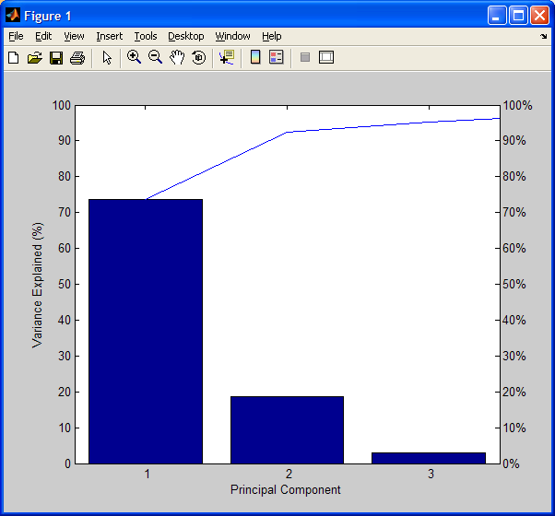
proportion of variance plot
ranked
eigenvalues
3 PCs capture > 95%
73.6809
18.7491
2.8856
1.9068
0.7278
0.5444
0.4238
0.3501
0.1631

Slide 14
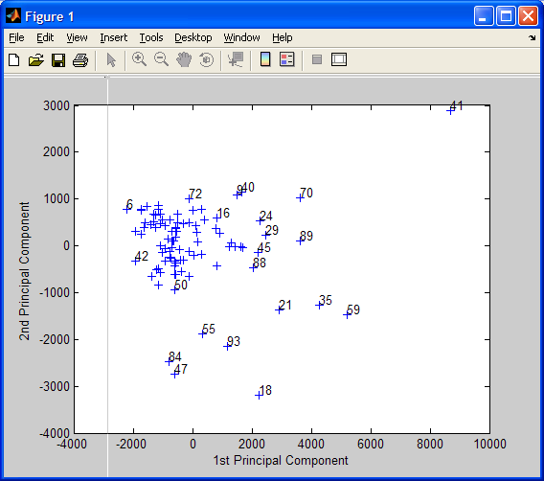
Scatter plot of PCs 1 and 2
1-34 cancer, >35 control

Slide 15
Calculating PCs and PoV using MatLab
z=csvread(‘datafile.csv’);
sig=cov(z);
[V,D]=eig(sig)
%columns of V are the eigenvectors
%D is diagonal
%eigenvalues on diagonal are in increasing order
%invert order and store in array eigenvals
d = length(eigenvals)
for k=1:d
pov(k) =
plot(pov)
%index of pov array will be used as x coordinate
15

Slide 16
Assignment 13
Calculate principal components of attributes in
glass data short noclass.csv on the class webpage. Plot the eigenvalues ranked by decreasing magnitude. Calculate PoV for all eigenvalues and plot. Make a scatter plot of PC2 as a function of PC1.

Slide 17
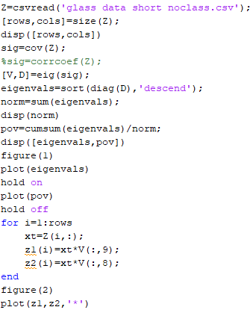
MATLAB functions
that make HW13
easier

Slide 18
Z-scores: attributes transformed to zero mean and unit variance
If variable x is normally distributed with mean μ and variance σ²,
then z = (x – μ)/σ
is a normally-distributed variable with zero mean and unit variance.
The covariance matrix of z-scores is the correlation matrix with ones on the
diagonal and correlation coefficients of diagonal.

Slide 19
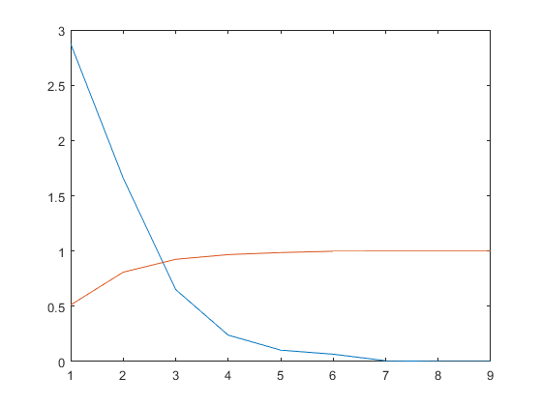
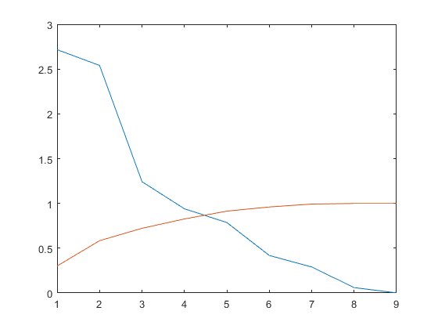
Glass dataset
Eigenvalues of covariance matrix
sum=5.6046
Eigenvalues of correlation matrix
sum=9
eigenvals
eigenvals
PoV
PoV

Slide 20
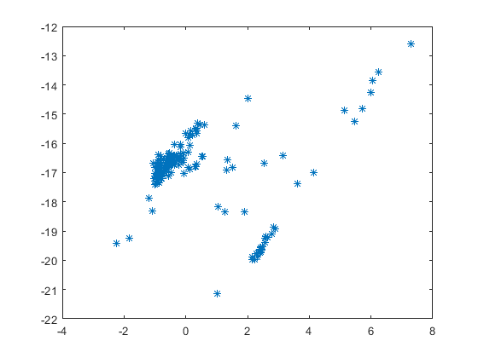
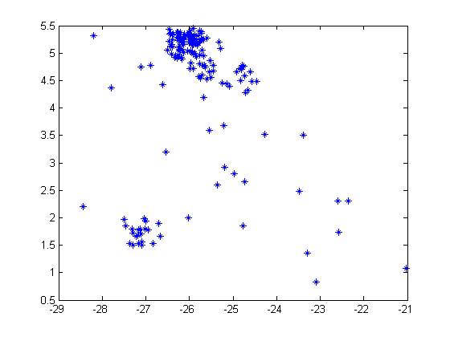
attributes
z-scores
PC 2
PC 1

