Slide 1
Perceptron Classifier/Controller
Perceptron Learning Algorithm (PLA)
Control theory
Least Mean Square algorithm (LMS)

Slide 2
Perceptron Learning Algorithm (PLA)

Slide 3
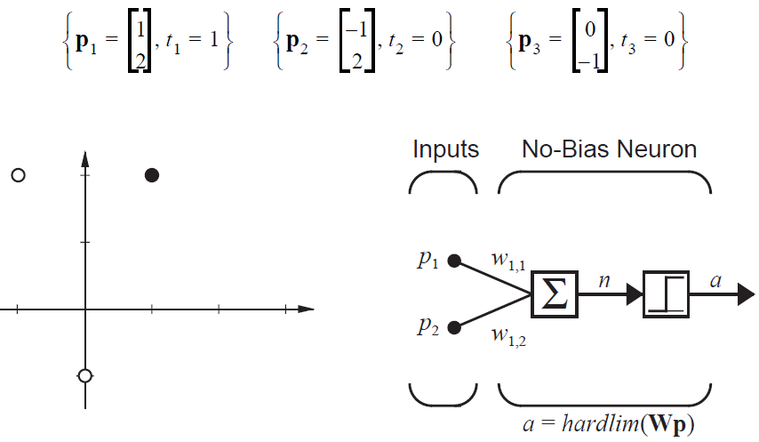
Find a decision boundary with equal margin that separates members, t=1, from non-members, t=0.
2nd component
1st component
This problem could be solved by choosing a weight vector perpendicular to the line joining the non-member points and finding a bias that gives equal margins.

Slide 4
Instead, choose b=0 (decision boundary goes through origin) and use the PLA to find the weight vector w.
2nd component
1st component
Meaning of a = hardlim(w^{T}p): If w^{T}p>0 , a=1. If w^{T}p<0 , a=0.
e = Error in assignment = t-a

Slide 5
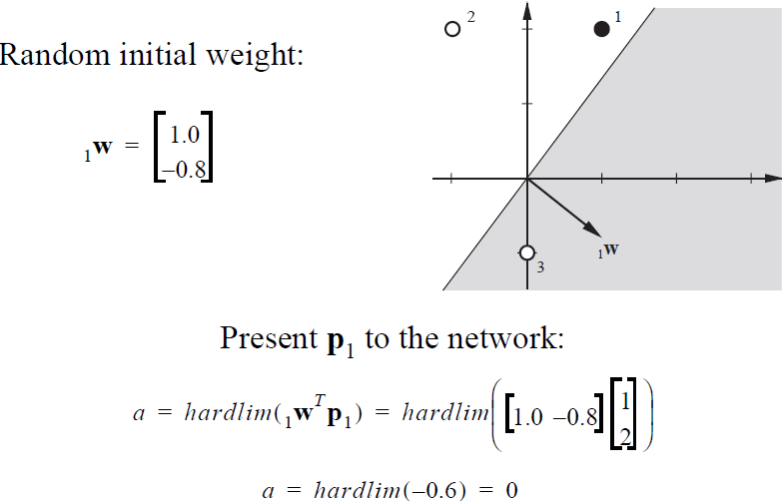
Initial decision
boundary
Components of w chosen from uniformly
distributed between -1 and 1
Boundary does not separate p₁ and p₂
Randomly chose a one as misclassified
Misclassified: t₁=1, a=0 black dot should be in shaded region
e = t₁-a = 1-0 = 1

Slide 6
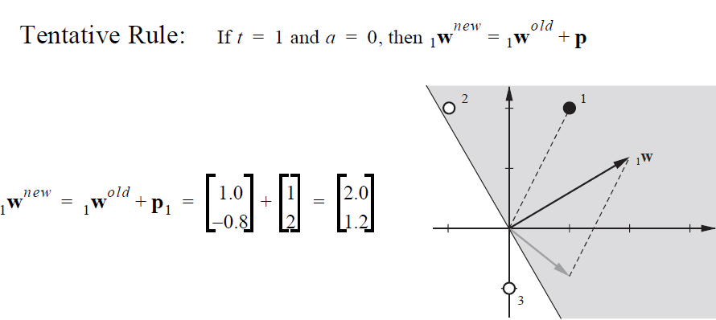
PLA weight update rule: w^{new} = w^{old} + e p
new
p
With new decision boundary, only
example 2 is misclassified.
Present p₂ = [-1, 2]^{T} to the network.
a = hardlim(w^{T}p₂) = hardlim(0.4) =1
e = t₂ – a = 0-1 = -1
old

Slide 7
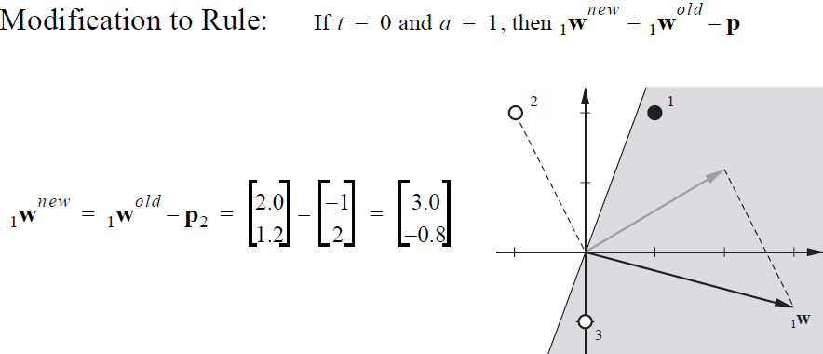
PLA weight update rule: w^{new} = w^{old} + e p
old
-p
new
With new decision boundary only example 3 is misclassified.
Present p₃ to network. Calculate e = t₃ – a = -1 on board

Slide 8
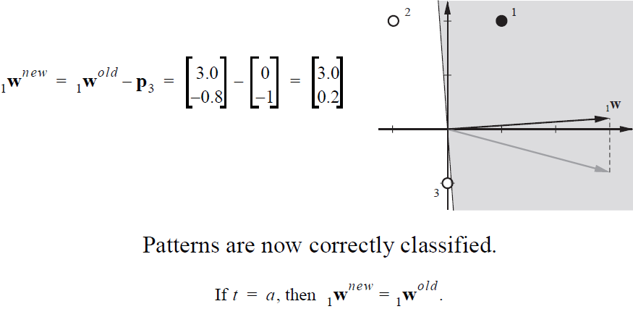
PLA weight update rule: w^{new} = w^{old} + e p
Note how close example 3 is to the decision boundary.
PLA does not guarantee optimum margins. Calculate margins on board.

Slide 9
Calculate class margins
w^{T}=[3, 0.2]
||w|| = sqrt(9+0.04) = 3.0067
g(p₁)$=\left[3, 0.2\right]\left[\begin{matrix}1 \\ 2\end{matrix}\right]$ = 3.4
Margin positive class = 3.4/3.0067 = 1.1308
g(p₃)$=\left[3, 0.2\right]\left[\begin{matrix}0 \\ −1\end{matrix}\right]$ = -0.2
Margin non-member class = 0.2/3.0067 = 0.0665

Slide 10
Summary of perceptron leaning rules
Binomial labels t={0,1}
a = Perceptron output in hardlim(w^{T}p+b)
a = 1 if w^{T}p+b > 0
a = 0 if w^{T}p+b < 0
e = Error = t-a
Update weights after randomly choosing a misclassified example. Stop when all examples are correctly classified for linearly separable patterns.

Slide 11
Assignment: 11
Use perceptron learning rules to find a weight vector w and bias b that correctly
classify a pattern in 3D attribute space defined by 2 points. Assume the output of
the perceptron is hardlim(w^{T}p + b)
p₁^{T} = [-1,1,-1], t₁= 1
p₂^{T} = [1,1,-1], t₂=0
initial weight w^{T} = [0.5,-1,-0.5], initial bias b = 0.5
Verify that both patterns are misclassified with initial weight and bias.
Choose p₁ as the initial misclassified example.

Slide 12
Least Mean Square (LMS) Algorithm

Slide 13
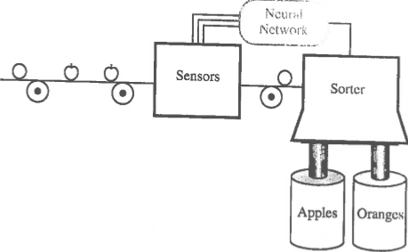
LMS applied to sorting apples from oranges
p$=\left[\begin{matrix}\begin{aligned}shape \\ texture\end{aligned} \\ weight\end{matrix}\right]$
A
adaline
Sensors measure shape, texture and weight.
Adaline classifies data as apple or orange.
Sorter uses output to adjust path to collection bin.

Slide 14
p$=\left[\begin{matrix}\begin{aligned}shape \\ texture\end{aligned} \\ weight\end{matrix}\right]$
Data from sensors
p_{O}$=\left[\begin{matrix}\begin{aligned}1 \\ −1\end{aligned} \\ −1\end{matrix}\right]$
Prototype pattern for orange
Target t_{O} = -1
Prototype pattern for apple
Target t_{A} = 1
p_{A}$=\left[\begin{matrix}\begin{aligned}1 \\ 1\end{aligned} \\ −1\end{matrix}\right]$
Use the LMS to find a decision boundary w^{T}p + b = w^{T}p = 0
(b = 0 in this example) that separates the prototypical patterns
with equal margins. Note that prototypes differ in texture only.

Slide 15
LMS formalism (with b=0)
Consider data {p} from sensors as a population variable.
For a given w, the class to which p is assigned and error e=t-a
(continuous) in classification are also population variables.
We want the w* for which expectation of e² is minimum.
Analytical solution:
F(w)=E[e²]=E[(t-a)²]=E[(t-w^{T}p)²]
=E[(t²-2w^{T}E[tp]+w^{T}E[pp^{T}]w)]
F(w) = c – 2w^{T}h + w^{T}Rw,
where c=E[t²], h=E[tp], and R=E[pp^{T}]
gradient(F(w)) = -2h + 2Rw* = 0 -> w* = R⁻¹h
This method has problems if R is singular.
Alternative: perform an approximate gradient search for w*

Slide 16
Approximate radient search for w*
Approximate F(w)=E[e²] by e_{k}², square of error on k^{th} iteration
of the search.
With no bias, e_{k}²(w) = (t_{k}-w^{T}p_{k})² gradient(e_{k}²(w)) = -2e_{k}p_{k}
Choose a gradient-decent step size α
w_{k+1} = w_{k} – α gradient(e_{k}²(w)) w_{k+1} = w_{k} + 2αe_{k}p_{k}
Step size 0.2 is reasonable.
Initial weight vector = w_{i}^{T}=[0,0,0].
Alternate between prototype vectors for orange and apple.
Use a = w^{T}p_{k} to calculate e_{k}.
a = w^{T}p, e = t-a, t_{O}= -1, t_{A} = 1

Slide 17
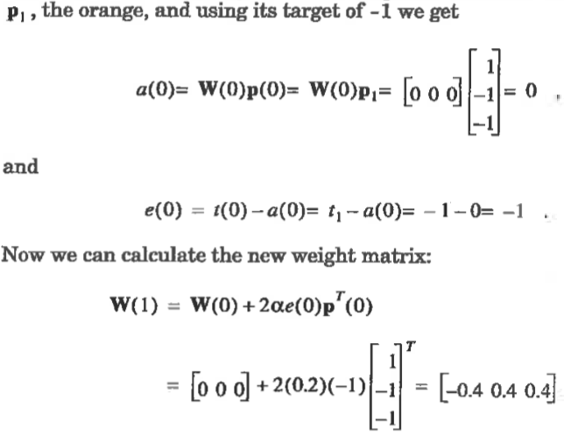
Note! W(0) is a row vector = w_{i}^{T}= [0,0,0].
Note! b = 0 in this example and t₁=t_{O} because p₁ is the orange prototype vector.

Slide 18
p_{A}$=\left[\begin{matrix}\begin{aligned}1 \\ 1\end{aligned} \\ −1\end{matrix}\right]$
Present apple prototype vector
with target = 1 to network.
Calculate error and new weight vector.
Do on board

Slide 19
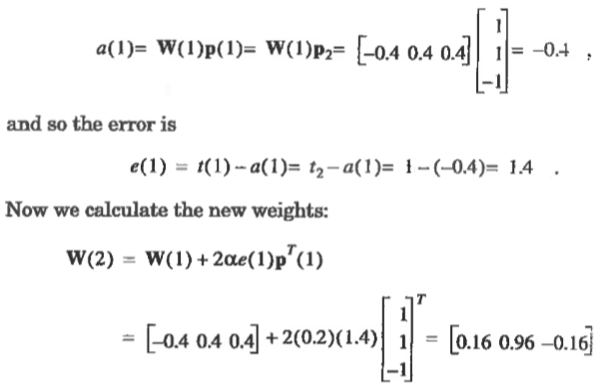
Present apple prototype vector with target = 1 to network

Slide 20
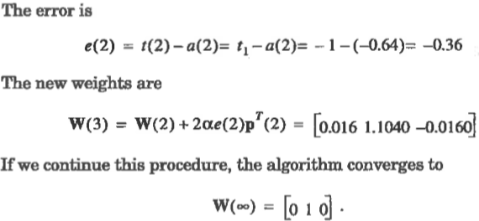
Present orange prototype again with target = -1

Slide 21
LMS decision boundary and margins
p_{O}$=\left[\begin{matrix}\begin{aligned}1 \\ −1\end{aligned} \\ −1\end{matrix}\right]$
Prototype orange
Prototype apple
p$=\left[\begin{matrix}\begin{aligned}shape \\ texture\end{aligned} \\ weight\end{matrix}\right]$
p_{A}$=\left[\begin{matrix}\begin{aligned}1 \\ 1\end{aligned} \\ −1\end{matrix}\right]$
Decision boundary defined by w^{T} = [0,1,0] and b=0
(goes through origin)
$\left[0, 1, 0\right]\left[\begin{matrix}p1 \\ \begin{aligned}p2 \\ p3\end{aligned}\end{matrix}\right]$ + 0 = p₂ = 0
Decision boundary is the p₂ = 0 plane. Classification is by
texture only, negative for orange, positive for apple.
Calculate the margins on board.

Slide 22
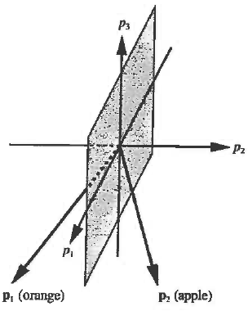
What are the margins on the orange and apple prototype points?
w^{T}=[0, 1, 0], ||w|| = sqrt(1) = 1
g(p_{O})$=\left[0,1,0\right]\left[\begin{matrix}1 \\ \begin{aligned}−1 \\ −1\end{aligned}\end{matrix}\right]$ = -1
Margin orange class = 1
g(p_{A})$=\left[0,1,0\right]\left[\begin{matrix}1 \\ \begin{aligned}1 \\ −1\end{aligned}\end{matrix}\right]$ = 1
Margin apple class =1

Slide 23
Assignment 12: one cycle in LMS with b=0.
Initial weight w_{i} = [0.5,-1, -0.5] ^{T}
Use prototype vector for apple p = [1,1,-1]^{T} with t = 1
Use a step size of 0.2
Carry out the first cycle of Least Mean Square search for optimum weight vector by
Calculating perceptron output, a
(b) Calculating the error in perceptron output, e
(c) Calculating the new weight vector, w

