Slide 1
Pattern Recognition
Linear discriminants
Decision boundaries and margins

Slide 2
Linear Discriminants: g(x) = w^{T}x + b
Weight vector, w, and bias, b, are optimized by a training set to minimize classification errors.
If patterns are “linearly separable” error is zero
x is the position vector of attribute space (i.e. vector from the origin to any point)
In 2D attribute space, g(x) = w₁x₁ + w₂x₂ + b

Slide 3
Decision boundaries: g(x) = w^{T}x + b = 0
In 2D attribute space, g(x) = w₁x₁ + w₂x₂ + b
In 2D attribute space, g(x) = 0 is a line x₂ = f(x₁) with slope –(w₁/w₂) and y intercept -b/w₂.
For linearly separable patterns, w^{T}x + b = 0 is a decision boundary with zero error.
The region of attribute space where w^{T}x + b > 0 is usually associated with examples of the pattern of “members” and assigned label = 1.
The region where w^{T}x + b < 0 is usually associated with examples of the pattern of “non-member” and assigned label 0 or -1.

Slide 4
Attribute Space can have any number of dimensions > 0
If D=1, linear discriminant is a line. w^{T}x = w₁x and b = w₀
The decision boundary w^{T}x + b =0 is the point x = -w₀/w₁
y=w^{T}x=w₁x+w₀
x

Slide 5
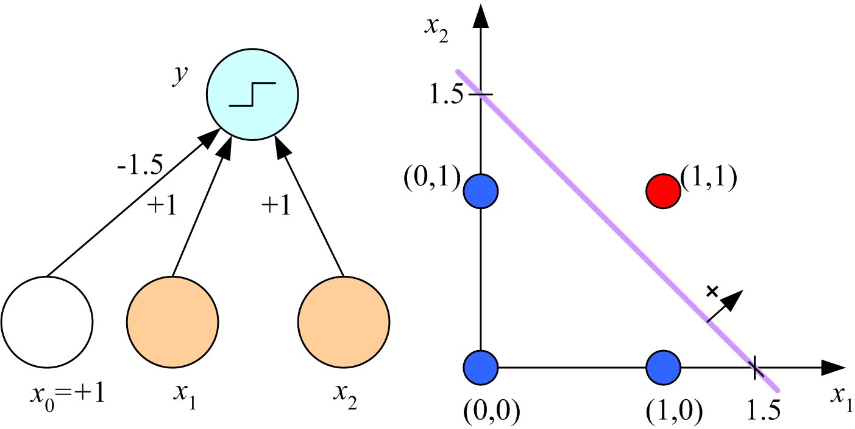
We most often use examples in 2D attribute space where the
linear discriminant is a plane, and the decision boundary is a line.
y=w^{T}x=w₁x+w₀
x

Slide 6
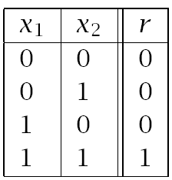
For Boolean AND, member class is a single point (1,1) and non-member class is 3 points. The decision boundary shown is parallel to the line between non-members (0,1) and (1,0) and has equal margins for the 2 patterns. How do I find such a boundary?
Boolean AND
Lecture Notes for E Alpaydın 2010 Introduction to Machine Learning 2e © The MIT Press (V1.0)
6

Slide 7
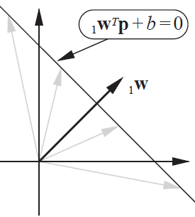
Let p be a 2D attribute vector with attribute values p₁ and p₂
For any point on the decision boundary, w^{T}p+b=0; hence, w^{T}p=-b.
For dot product to be the same for any p on the decision boundary w must be perpendicular to it.

Slide 8
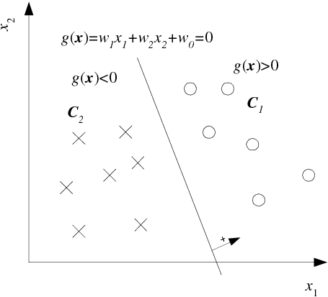
Distance of x^{t} from decision boundary w^{T}x + w₀= 0
w/||w|| is a unit vector
perpendicular to the
decision boundary.
r^{t} = 0
r^{t} = 1
8

Slide 9
Distance of x^{t} from the decision boundary
Express any position vector x as a sum of vectors
parallel and perpendicular to the decision boundary
x = x_{p} + d w/||w||
d is distance of example with attributes x from the decision boundary
r^{t} = 0
r^{t} = 1
Lecture Notes for E Alpaydın 2010 Introduction to Machine Learning 2e © The MIT Press (V1.0)
9

Slide 10
Express the distance of x^{t} from the decision boundary
as a function of the linear discriminant
g(x_{p}) = 0 = g(x - d w/||w||)
0 = w^{T}(x – d w/||w||) + w₀
0 = w^{T}x + w₀ – d ||w||
d = |w^{T}x + w₀|/||w||
d^{t} = |g(x^{t})|/||w||
r^{t} = 1
r^{t} = 0
Lecture Notes for E Alpaydın 2010 Introduction to Machine Learning 2e © The MIT Press (V1.0)
10

Slide 11
Given w, find a decision boundary with equal margins for both patterns
d^{t} = |g(x^{t})|/||w|| = distance of example x^{t} from decision boundary
Let x⁺ and x⁰ be examples from member and non-member classes, respectively, closest to the decision boundary.
g(x⁺) = w^{T}x⁺ + b > 0 |g(x⁺)| = g(x⁺)
g(x⁰) = w^{T}x⁰ + b < 0 |g(x⁰)| = -g(x⁰)
For equal margins, d⁺ = d⁰ which means g(x⁺) = -g(x⁰) note: ||w|| cancels on both sides of the equation
w^{T}x⁺ + b = -w^{T}x⁰ – b
Solve for b = -(w^{T}x⁺ + w^{T}x⁰ )/2
Plot w^{T}x + b = 0
Calculate margins d⁺ = |g(x⁺)|/||w||

Slide 12
Example: Boolean AND dataset
Work on board
12

Slide 13
Example: Boolean AND dataset
If w=[1,1]^{T}, x⁺ = [1,1]^{T}, and x⁰ = [0,1]^{T}, then
w^{T}x⁺ = 2, w^{T}x⁰ = 1, b = -(2+1)/2 = -1.5
Equation of the decision boundary, w^{T}x + b = 0, is x₁ + x₂ = 1.5
Margin = (w^{T}x⁺ + b)/||w|| = (2-1.5)/1.414 = 0.3536
13

Slide 14
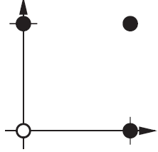
Assignment 10a: Boolean OR dataset
Chose w=[1,1]^{T}
Find a decision boundary with equal margins
Show x and y intercepts on a plot of decision boundary
Calculate margins
Members have label = 1
p₁ p₂ t
0 0 0
0 1 1
1 0 1
1 1 1
Logical OR

Slide 15
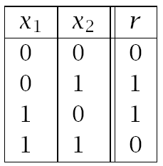
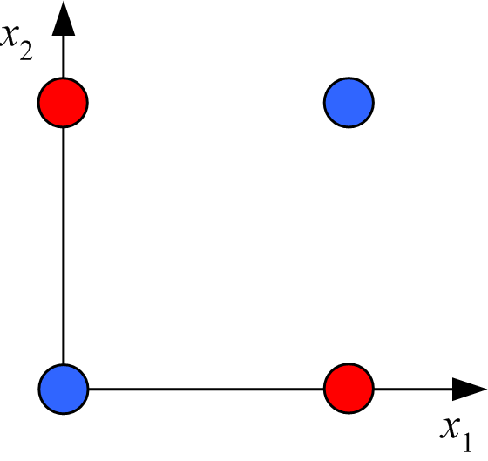
Boolean XOR:
Linearly inseparable pattern
data table
graphical representation
Solution: transform to linearly separable feature space

Slide 16
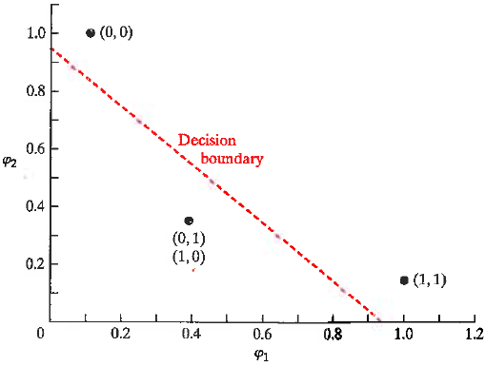
XOR data
XOR in Gaussian feature space
φ₁ = exp(-|X – [1,1]|²)
φ₂ = exp(-|X – [0,0]|²)
X φ₁ φ₂ r
(1,1) 1 0.1353 0
(0,1) 0.3678 0.3678 1
(0,0) 0.1353 1 0
(1,0) 0.3678 0.3678 1
r=0
g(φ)>0
Note that members (r=1) lie of the side of the
decision boundary were g(φ)<0
r=1
g(φ)<0

Slide 17
XOR data
XOR in Gaussian feature space
φ₁ = exp(-|X – [1,1]|²)
φ₂ = exp(-|X – [0,0]|²)
X φ₁ φ₂ r
(1,1) 1 0.1353 0
(0,1) 0.3678 0.3678 1
(0,0) 0.1353 1 0
(1,0) 0.3678 0.3678 1
r=0
Assignment 10b: feature space Boolean XOR
Chose w=[1,1]^{T}
Find a decision boundary with equal margins
Show x and y intercepts on a plot the of decision boundary.
Calculate margins
g(φ)>0
r=1
g(φ)<0

