Slide 1
Methods of classification
Classification by regression
K Nearest Neighbors
Parametric Bayesian classification

Slide 2
Classification by regression
Regression on categorical predictors:
Example: display location as a predictor of nutritional rating
Regression on class labels
Convert alpha class labels to integers
Bin predictions of regression to make class assignments
Most often used for multi-class classification

Slide 3
Example: Beer-bottle glass dataset
Data contains 214 examples of bottle glass from 6 breweries.
Each example has 9 attributes of beer-bottle glass
Develop a model to predict brewery from glass attributes

Slide 4
First 3 rows of data
1 | 1.521 | 13.64 | 4.49 | 1.1 | 71.78 | 0.06 | 8.75 | 0 | 0 | 1
2 | 1.517 | 13.89 | 3.6 | 1.36 | 72.73 | 0.48 | 7.83 | 0 | 0 | 1
3 | 1.516 | 13.53 | 3.55 | 1.54 | 72.99 | 0.39 | 7.78 | 0 | 0 | 1
1. Sample index
2. RI: refractive index
3. Na: Sodium
4. Mg: Magnesium
5. Al: Aluminum
6. Si: Silicon
7. K: Potassium
8. Ca: Calcium
9. Ba: Barium
10. Fe: Iron
11. Type of bottle (class)
1=Anheuser-Busch, Inc.
2=Miller Brewing Co.
3=Blitz-Weinhard Brewing Co.
4=Pete’s Brewing Co.
5=Samuel Adams Brew House
6=Plank Road Brewery

Slide 5
Classification by regression
Setup multivariate linear regression as though brewery number (column 11) were a continuous response.
Solve normal equations for optimum weight vector.
Bin the fit at each datapoint to predict class assignment for examples in dataset.
Use predicted class and true class to calculate a confusion matrix.
Calculate accuracy by class from the confusion matrix

Slide 6
6-way column specific confusion matrix
# in class 1 assigned class 1 # in class 2 assigned class 1 …
# in class 1 assigned class 2 # in class 2 assigned class 2 …
. .
. .
# in class 1 assigned class m # in class 2 assigned class m …
total in class 1 total in class 2
Note this confusion matrix designed so that sum of elements in a column
is total class membership

Slide 7
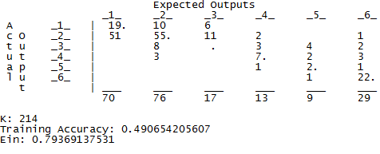
6-way confusion matrix for beer-bottle classification
Classes
Classified as
Less than half of examples predicted correctly. No correct assignment to class 3. Results are best for classes 2 and 6. Class 1 examples frequently assigned to class 2. Classes 1,2, and 6 have the most data. Repeat with just these classes

Slide 8
Assignment 7:
Use dataset glass_data_HW6.csv on the class webpage to develop a classifier for beer-bottle glass by multivariate regression. Keep the class labels as 1, 2, and 6. After fitting class labels as though they are a continuous response, bin the results to make predictions of class assignment. Default bin=2, Fit<1.5, bin=1, and Fit>4, bin=6
Report the following:
coefficient of determination
number of records in each class and accuracy of class assignment
overall accuracy
3-way confusion matrix as shown below
# in class 1 assigned class 1 # in class 2 assigned class 1 # in class 6 assigned class 1
# in class 1 assigned class 2 # in class 2 assigned class 2 # in class 6 assigned class 2
# in class 1 assigned class 6 # in class 2 assigned class 6 # in class 6 assigned class 6

Slide 9
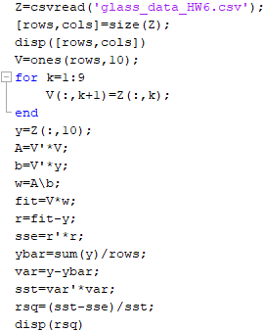
Setup and solve normal equations,
get fit and coefficient of determination

Slide 10
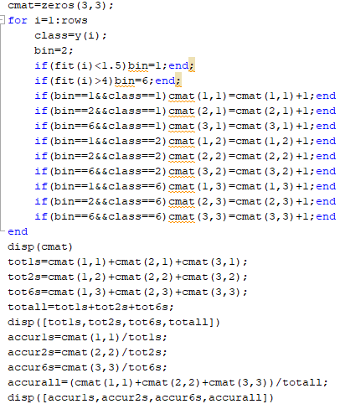
Bin the fit, calculate confusion matrix,
and accuracy of assignments.

Slide 12
Methods of classification
K Nearest Neighbors

Slide 13
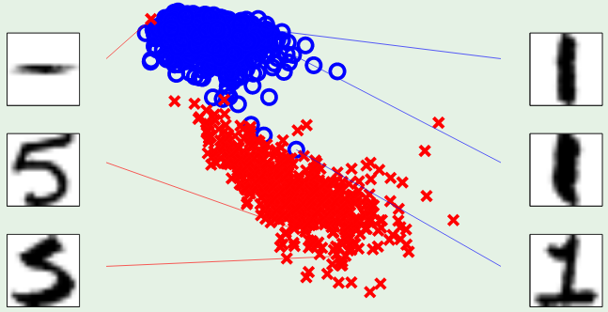
In real-world, examples with small differences in attributes usually belong to the same class.
Basis of “similarity” classification methods.
K Nearest Neighbors (KNN) is this type of classifier.
symmetry
intensity

Slide 14
This is an example of “2D binary” classification. Each example has 2 attributes (symmetry and intensity) that we can represent as a two-component attribute vector. We can think of one class as “members” and the other as “non-members”
symmetry
intensity

Slide 15
KNN method of binary classification
To classify the example with attribute vector x_{k} in the dataset, calculate ||x_{k}-x_{i}||, where x_{i} is every other attribute vector in the dataset.
Rank the results by increasing value.
Choose an odd positive integer for K (typically 1<K<10).
Assign the example with attributes x_{k} to the predominate class among the K examples closest to x_{k}.
For binary classification, an odd value of K means the predominate class among the K examples closest to x_{k} will be unique. A tie between members and non-members is avoided.

Slide 16
KNN is an “instance based” approach to binary classification.
There are no weights to optimize. It classifies based on the similarity of attributes.
Try several values of K (3, 5, 7, 9, etc). Pick the value that gives the smallest in-sample error calculated as the number misclassified.
If in-sample error is acceptable, calculate the mean of attribute
vectors in both classes (members and non-members).
Use the mean attribute vectors to predict class membership of examples in a test set.

Slide 17
Assignment 8a: Classification by KNN uses machine-learning backage Weka
Download and familiarize yourself with current version of Weka.
Download and start the Weka GUI. Follow the instructions on the Weka site:
http://www.cs.waikato.ac.nz/ml/weka/
We will only use the Weka’s Explorer functionality. Extensive documentation can be found at Explorer guide

Slide 18
Assignment 8 uses Weka to answer the question
“Can gene expression data predict the type of leukemia?”
Open the leukemia gene expression file (on class website) in Weka. This file has data from 72 leukemia patients (rows) and expression values are for 150 of their genes (columns). The last column is the type of leukemia (ALL or AML) for each patient.
Go to the “classify” tab. Under “Classifier” click the “Choose” button. Expand the “lazy” menu and choose “IBk”. This is KNN. IBk stands for Instance-Based k.

Slide 19
Click on the text in the parameter box for IBk. A menu will pop up. For “KNN”, enter 5, which means the algorithm will use the five nearest neighbors to classify each example. Leave the rest of the values as default.
Under “Test options” choose “Cross-validation” and under “Folds” enter 5. The drop-down menu below Test options should say “(Nom) leukemia_type”. This means that the algorithm will classify “leukemia_type” (AML or ALL), using the gene expression values as attributes.

Slide 20
Click the “Start’ button. The main window will show a variety of summary statistics, such as accuracy, true positives, false positives, and a confusion matrix.
Report % correctly classified and confusion matrix (ALL positive class). Derive the confusion matrix when AML is the positive class. Calculate the class-dependent TP and FP rates defined in lecture L6 Methods of Classification. Show your work and compare to Weka.

Slide 21
Assignment 8: Summary
Open the leukemia gene expression file (on class website) in Weka.
Find IBk (aka KNN) classification method. Use default values.
Report accuracy of classification and confusion matrix assuming ALL is the positive class (Weka’s choice)
Construct the confusion matrix assuming AML is the positive class
Calculate the class-dependent TP and FP rates. Show your work and compare to Weka.

Slide 22
Methods of classification
Parametric Bayesian classification

Slide 23
Review Bayes’ Rule for binary classification
prior
Class likelihood
posterior
Normalization factor
Prior is usually the proportion of training examples in each class.
Class likelihood is probability that a member of class C will have attributes x
Assign example with attributes x to class C if P(C|x) > 0.5
Notes:
Prior is what we know about credit risk before we observe a clients attributes; might be per-capita bankrupties
Class likelihood, p(x|C), probability of observing x conditioned on the event being in class C
given client is high-risk (C = 1) how likely is X = {x₁, x₂}
deduced by data on a set of known high-risk clients
Evidence, p(x), is essentially a normalization; also called “marginal probability” that x is seen regardless of class
Posterior, P(C|x), probability that client belongs to class C conditioned on attributes being X
When normalized by evidence, posteriors add up to 1

Slide 24
Bayes’ Rule: K>2 Classes
Normalized priors
Assign example with attributes
Notes:
Priors, likelihoods, posteriors, and margins are class specific
Evidence is sum of margins over classes

Slide 25
Parametric Bayesian classification:
1. assume a distribution function for class likelihoods, p(x|C_{i})
2. estimate parameters of distribution from data
3. use relative class sizes in dataset for priors, p(C_{i})
4. assign example with attributes x to class with largest p(C_{i}|x)
Example: 1D with Gaussian class likelihoods
Let x denote the attribute that is the basis for classification.
In each class, the distribution of x values are characterized by a mean value and standard deviation.

Slide 26
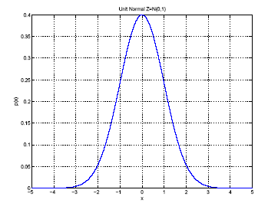
μ and σ are class properties; p(x) is probability that a member of the class will have attribute x
Estimate μ and σ² by
μ
σ
Function of a single random
variable with a shape
characterized by 2 parameters

Slide 27
Naïve Bayes classification based on d attributes:
Assumes that the d attributes are uncorrelated. Unlikely; hence, Naïve Bayes. With this assumption,
class likelihood, P(x|C), is a product of 1D Gaussians for each attribute.
p(x_{i} |C) is the probability that an example in class C will have value x_{i} for attribute i
P(x |C) is the probability that an example in class C will have attribute vector x with d components
Each class is characterized by a mean and variance of the attributes of examples in the dataset that belong to that class.
27

Slide 28
Assignment 8b: Parametric Bayesian Classification
Use WEKA’s naïve Bayes to classify ALL and AML by leukemia gene expression. Compare with KNN results from HW8a

Slide 29
Methods of classification
Bayesian classification by discriminants

Slide 30
Define a discriminant function for a dataset where k classes are predicted by the value of one attribute. Use Bayes’ rule with class likelihoods that are Gaussian distributed g_{i}(x) = log(p(C_{i}|x))
We can drop the term log(p(x)) because it is not class dependent
Lecture Notes for E Alpaydın 2010 Introduction to Machine Learning 2e © The MIT Press (V1.0)
30

Slide 31
Use Gaussian class likelihood and natural logirithm

Slide 32
Given a 1D multi-class dataset
label is a Boolean vector that tells us which class each example is from
Estimate the mean, variance, and prior of each class
Lecture Notes for E Alpaydın 2010 Introduction to Machine Learning 2e © The MIT Press (V1.0)
32

Slide 33
Estimate prior, mean, and variance of all classes
These formulas sum over all the examples in the dataset and let the Boolean label
pick out which class example t belongs to. More simply put, the prior is the faction of
examples in class i and the parameters of each class are the mean and variance of
values of the predictor in class i
33

Slide 34
To classify an example with value of the predictor = x, find the value of the discriminate for all classes and

Slide 35
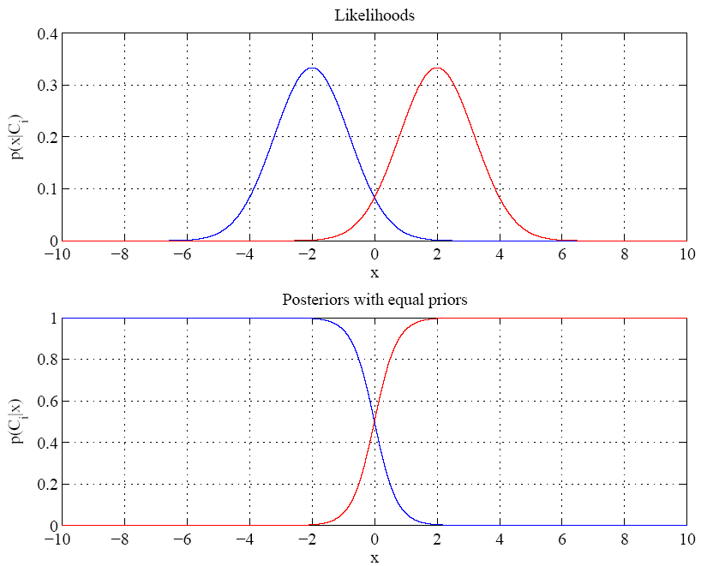
Equal variances
and priors
Example for
1D 2-class
problem
Between + 2
transition between
prediction of class
At boundary most probable class changes
Single boundary at
halfway between means where normalized posteriors are equal to 0.5
Lecture Notes for E Alpaydın 2010 Introduction to Machine Learning 2e © The MIT Press (V1.0)
35
Notes:
Example: 2 classes
Class likelihoods have means + 2 and equal variance
Priors are also equal.
Between -2 and 2 have transition between essentially certain classification of classes as a function of x

Slide 36
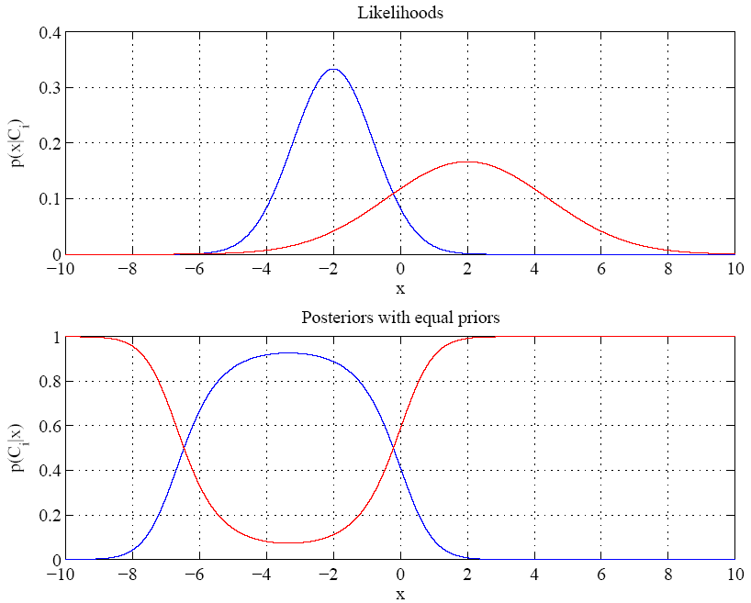
Red class likelihood
dominant for
x < about -7 also
Variances are different
Boundaries where dominant
posterior changes are called
“Bayes discriminant points”
Lecture Notes for E Alpaydın 2010 Introduction to Machine Learning 2e © The MIT Press (V1.0)
36

Slide 37
Find the Bayes discriminate points for a 1D, 2-class dataset.
Points are where the discriminants for the 2 classes are equal.
Set g₁(x) = g₂(x) and solve for x.
After much tedious algebra you find a quadratic equation for discriminate points.
where μ and σ denote mean and standard deviation of x values in a class.

Slide 38
Assignment 9: Bayes’ discriminant points
Write a MATLAB code to find the Bayes’ discriminant points in a 1D, 2-class problem with equal priors and Gaussian class likelihoods by the following method
A function that calculates the coefficients in the quadratic equation on the previous slide.
Find the solution of the quadratic equation by the usual method.
Allow for the possibility only one root if variances are equal, as illustrated in slide 35.
Apply the code to the following example:
Mean and variance of C1 are 3 and 1, respectively
Mean and variance of C2 are 2 and 0.3, respectively

Slide 39
