Slide 1
Fundamentals of Classification
In-sample and out-of-sample errors
Version space
Margins
Confusion matrix

Slide 2
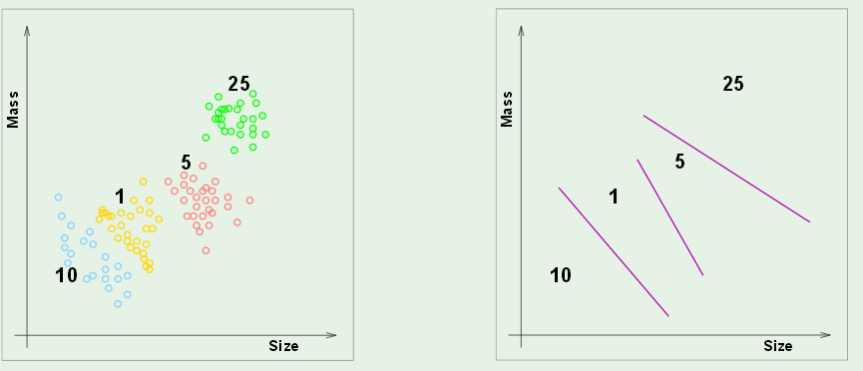
In-sample and out-of-sample error
Classify coins by size and weight
Design a vending machine that uses results
Boundaries in atribute space
Attribute space

Slide 3
In-sample error, E_{in}
How well do boundaries match training data?
Out-of-sample error, E_{out}
How often will this system fail if implement in the field?

Slide 4
A good model has small E_{in} and generalizes well (small E_{out}).
Will not be true if the E_{in} is made small by adapting the model
to the noise in the training set (over fitting).

Slide 5
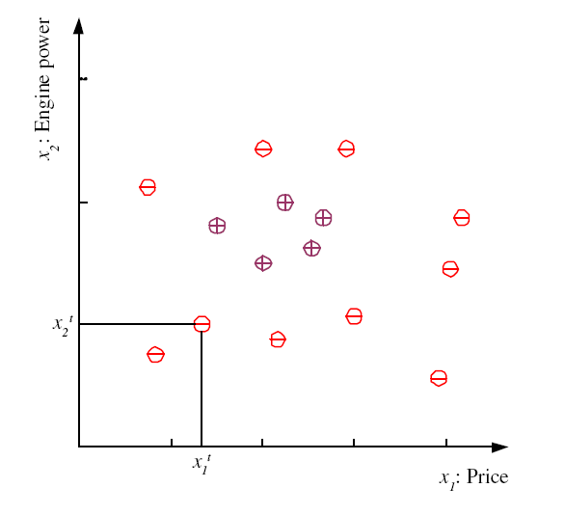
Binary classification in 2D attribute space
examples of family cars
Family-Car is a product line
No uncertainty in the label.
Issue is how well do price
and engine size distinguish
a family car.
examples of other product lines
5
Lecture Notes for E Alpaydın 2010 Introduction to Machine Learning 2e © The MIT Press (V1.0)
Notes:
Χ denotes training set
t is index of training set member
x^{t} is vector of attributes (dimensionality of problem)
r^{t} is label
Label can be either class (classification problem) or real number (regression problem)
This classification problem has only one class (family car) “dichotomizer”
Defined by 2 attributes (price and engine size)
Examples belonging to class are called “positive” and have r = 1
Examples not in class are called “negative” and have r = 0
For some machine learning techniques (SVM) better to assign r = -1 to negative examples
Unsupervised learning: finding attribute space were class members “cluster”

Slide 6
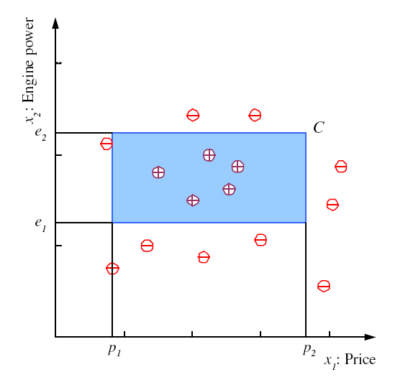
Model: family cars are uniquely defined by a range of price and
engine power. Blue rectangle is one hypothesis of this model
with zero in-sample error on this data set.
6
Notes:
Clustering of positive examples in this training set allows setting of boundaries in the attribute plane that defines a class
Shape is arbitrary but choice of rectangle with sides parallel to attribute axes facilitates math definition of class

Slide 7
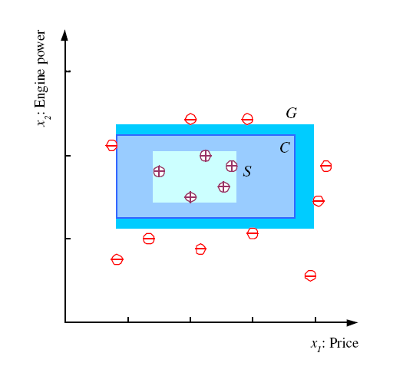
S, G, and the Version Space
most specific hypothesis, S, with no E_{in}
most general hypothesis, G,
with no E_{in}
Set of hypotheses (e.g. C) between S and G makes up the version space. All have no E_{in} which is best?
7
Notes:
S = h(x) with min error (zero in this case) and size (“most specific”)
G = h(x) with min error (zero) and max size (“most general”)
Mitchell calls the range of hypothesis classes between S and G the “version” space
Best choice of h(x) in the version space is one that makes most correct predictions (“generalization”)

Slide 8
Margin: distance between boundary of hypothesis
and closest instance in a specified class
S and G hypotheses have
narrow margins; not expected to “generalize”
well.
Even though E_{in} is zero,
we expect E_{out} to be large.
G
S
8
Notes:
Define “margin” of h(x) as the distance between the boundary of h(x) and the instance closest to it
Hypotheses S and G have zero margin

Slide 9
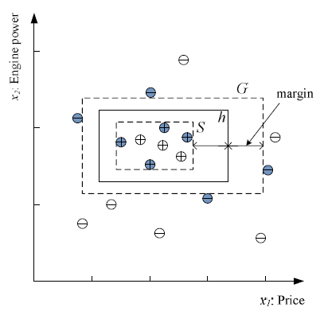
Best choice in version space is hypothesis with largest margins
Choose h in the version space with largest possible margins to maximize generalization.
Data points that determine S and G are shaded. These data points alone enable determination of h. Called “support vectors”.
Hypothesis with E_{in}=0 and wide margins
9
Notes:
Among h(x) in the version space, the one with largest margin is generally considered to be the best choice for class separation, based on the training set
Data points that determine this choice are (shaded in figure) are said to “support” the optimum h(x)
Other data points could be deleted without effecting our choice of optimum h(x) in the version space

Slide 10
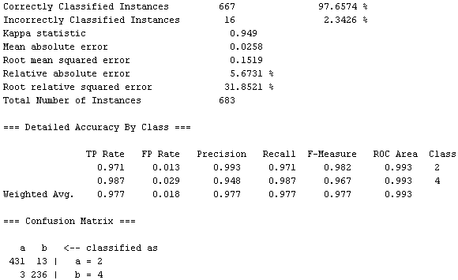
Performance metrics for classification (example from WEKA output)
“Row specific” version of confusion matrix
Row sum is number examples in a class

Slide 11
Analysis of classification results: binary confusion matrix
Call C1 the positive class and C2 the negative class.
False positive rate = FP / (FP+TN) = fraction of C2 instances misclassified.
True positive rate = TP / (TP+FN) = fraction of C1 instances correctly classified.
Lecture Notes for E Alpaydın 2010 Introduction to Machine Learning 2e © The MIT Press (V1.0)
11

Slide 12
Class dependent performance metrics
FP rate = FP/(FP+TN)
TP rate = TP/(TP+FN)
If either class could be the “positive” class, then the Confusion Matrix, TP rate, and FP rates become class specific.
Example:
a is the positive class
a b ← classified as
431 13 | a
236 | b
FP rate = 3/(3+236)=0.013
TP rate = 431/(431+13)=0.971
b is the positive class
b a ← classified as
236 3 | b
431 | a
FP rate = 13/(13+413)=0.029
TP rate = 236/(236+3)=0.987
12

Slide 13
ROC curves: evaluation of class diagnostics
θ is the score of a diagnostic test (e.g. blood sugar).
ROC curves visualize and quantify the quality of θ
(e.g. as a diagnostic for type-2 diabetes).

Slide 14
Pseudo-code for ROC construction
Rank the test subjects by decreasing value of diagnostic score
Flag test subjects by class (member or non-member)
For each test subject calculate (NegFrac, PosFrac), where
PosFrac= fraction of members with equal or greater score
NegFrac= fraction of non-members with equal or greater score
Plot points and calculate area under curve

Slide 15
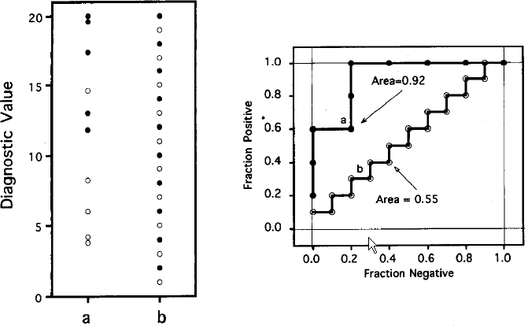
Filled circles: members, Open circle: non-members
data
ROC curves
Good diagnostic: members have high scores
Poor diagnostic: no correlation with class

Slide 17
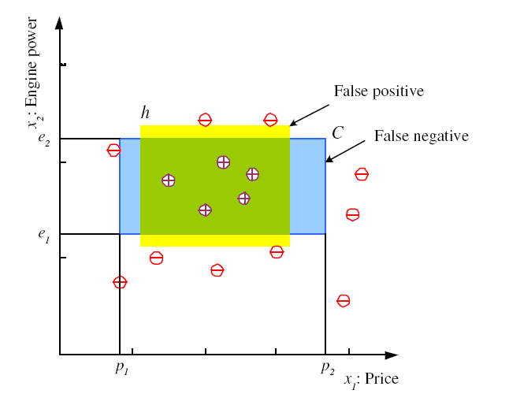
Hypothesis class H: axis aligned rectangles
h = yellow rectangle is a particular member of H that
is exact for the dataset shown.
In-sample error on h is defined by
Count misclassifications
17
Notes:
Even with restrictions on shape, an infinite number of family-car classes are consistent with the training data
Boolean function h(x) is a math expression for any hypothesis derived from the training set subject to the constraints on shape
Yellow area denotes one such hypothesis
If the blue area denotes “truth”, then yellow hypothesis exhibits 2 types of error
false positives (in yellow & not in blue)
false negatives (in blue & not in yellow)
E(h|X) defines a total numerical error associated with h(x) for data set X
For the dataset shown, there are infinite number of h with E(h|X) = 0
How do we make an intelligent choice among these h?

Slide 18
Hypothesis class H: axis aligned rectangles
h = yellow rectangle is a particular member of H
For dataset shown, in-sample error on h is zero, but we expect out-of-sample error to be nonzero
h leaves room for false positives and false negatives
18
Notes:
Even with restrictions on shape, an infinite number of family-car classes are consistent with the training data
Boolean function h(x) is a math expression for any hypothesis derived from the training set subject to the constraints on shape
Yellow area denotes one such hypothesis
If the blue area denotes “truth”, then yellow hypothesis exhibits 2 types of error
false positives (in yellow & not in blue)
false negatives (in blue & not in yellow)
E(h|X) defines a total numerical error associated with h(x) for data set X
For the dataset shown, there are infinite number of h with E(h|X) = 0
How do we make an intelligent choice among these h?

Slide 19
Should we expect the negative examples to cluster?
family car

Slide 20
I have access to a database that associates product line with price, p, and engine power, e, via VIN number. How does the version space change with the following new data: (1) family car (p,e) inside S, (2) family car (p,e) in version space, (3) family car (p,e) outside G, (4) not family (p,e) inside S, (5) not family (p,e) in version space, (6) not family (p,e) outside G
G
S

Slide 21
Margin
Defined as distance between
boundary and closest instance
S and G hypotheses have
narrow margins; not expected to “generalize”
well.
Even though E_{in} is zero,
we expect E_{out} to be large.
Why?
Lecture Notes for E Alpaydın 2010 Introduction to Machine Learning 2e © The MIT Press (V1.0)
21
Notes:
Define “margin” of h(x) as the distance between the boundary of h(x) and the instance closest to it
Hypotheses S and G have zero margin

Slide 22
G
S

Slide 23
What is the VC dimension of the hypothesis class
defined by the union of all axis-aligned rectangles?
Notes:
N because the union could include rectangles small enough to enclose individual data points

Slide 24
Any new data in the version space reduces its size
Positive example increases S, negative example decreases G
G
S

Slide 25
Vapnik Chervonenkis Dimension, d_{VC}
H is a finite hypothesis set for binary classification
H(X) is the set of predictions obtained when each member of H is applied to dataset X.
d_{VC}(H(X)) = number of examples in X that can be correctly classified by some member of H regardless of what class they belong to.
If d_{VC}(H(X)) = m, we say H “shatters” m points in X
d_{VC} quantifies the power of H on X
25

Slide 26
VC dimension of 2D linear binary classifier
2D datasets can be represented by points in attribute plane.
Decision boundaries can be represented by lines.
3 non-collinear data points are linearly separable regardless of class labels. d_{VC} = 3
26

Slide 27
Break point of the 2D linear binary classifier
Every set of 4 non-collinear points has 2 labeling that are
not linearly separable.
k=4 is the break point for the 2D linear binary classifier

Slide 28
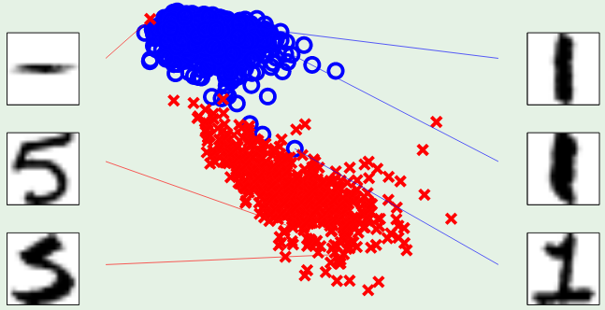
VC ignores the probability distribution from which dataset
was drawn.
In real-world, examples with small differences in attributes usually belong to the same class.
Basis of “similarity” classification methods.
K nearest neighbors (KNN) is this type of classifier.
symmetry
intensity

Slide 29
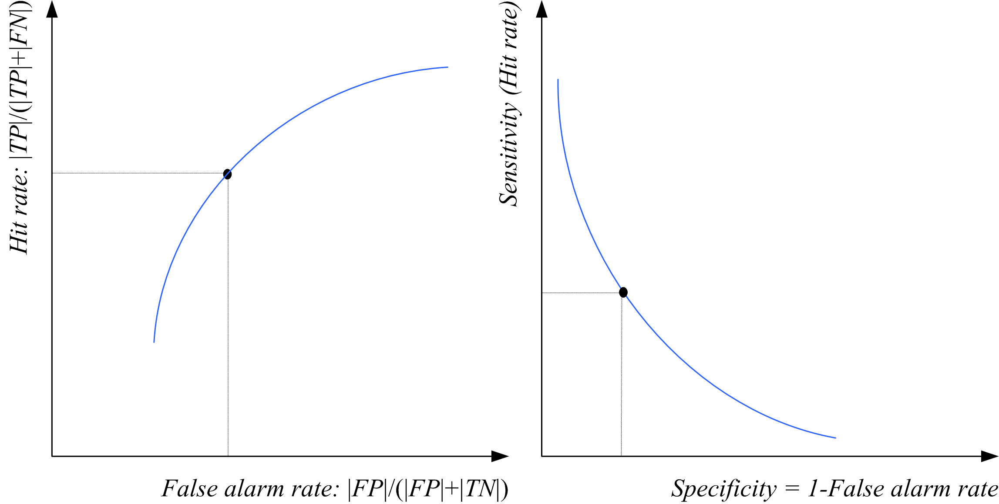
ROC-related Curve
Other combinations of
confusion-matrix variables
can be use in θ-parameter
curve definitions
Lecture Notes for E Alpaydın 2010 Introduction to Machine Learning 2e © The MIT Press (V1.0)
29

