Slide 1
Multivariate Linear Regression: linear models with more than
one predictor
Setup and solution of “normal equations” for optimum parameter values
Are more parameters better?
Statistical inference about the model.

Slide 2
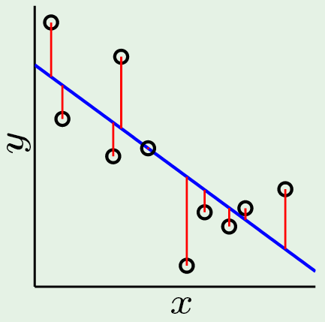
d=1 linear regression: fit a line to N data points
Solve X^{T}Xw = X^{T}y for w₁ and w₀
Y_{fit} = Xw (values of fit at data poins.
Lecture Notes for E Alpaydın 2010 Introduction to Machine Learning 2e © The MIT Press (V1.0)

Slide 3
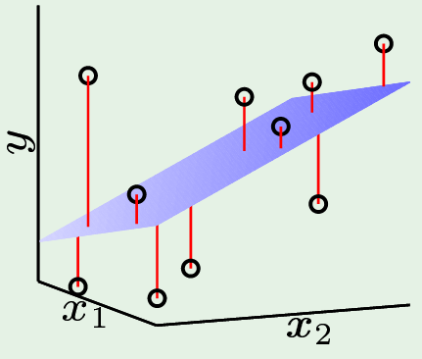
d=2 linear regression: fit a plane to N data points
Solve X^{T}Xw = X^{T}y
for w₂, w₁, and w₀
Y_{fit} = Xw
Each row of the matrix X, is a vector with the 1st component = 1, and the 2nd and 3rd components that are the values of 2 predictors from a record in the dataset.

Slide 4
Multivariate linear regression: fit a hyperplane to data
D=1, D=2, and D=d differ only in the size of the linear
system of equations to be solved for the weights
Solve X^{T}Xw = X^{T}y
for w₀, w₁, … w_{d}
Y_{fit} = Xw
Not easy to illustrate
a hyperplane
Each row of the matrix X, is a vector with the 1st component = 1, and components 2 through d+1 that are the values of predictors from a record in the dataset.

Slide 5
First 11 examples in the Cereals dataset

Slide 6
Data from Cereals dataset with alpha removed

Slide 7
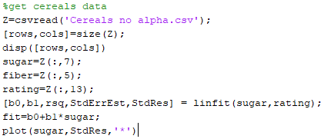
Get data from Cereals no alpha
fit

Slide 8
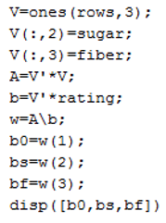
Setup and solve the normal equations

Slide 9
Coefficient of determination and standard error of estimation are
calculated by same formulas as in 1D regression
R² interpreted as the fraction of the total variation of response over the dataset that is explained by the linear fit.
s is interpreted as the typical size of residuals
Example: R² = 80.8% and s = 6.24 for regression of nutritional rating on grams of sugar and fiber

Slide 10
What are the best attributes to explain the response?
R² always increases when an additional attribute is included.
To be useful, a new attribute must significantly increase R².
Example: R² = 58% for linear regression of rating on sugar only.
Adding fiber to the regression, allowed the model to account for an additional 81% – 58% = 23% of variability in rating over the Cereal dataset.
Fiber is a useful attribute to explain nutritional rating of cereals

Slide 11
Standard error of estimation, s, can be lower or higher when another
attribute is added to the model.
Linear regression of rating on sugars alone gives s = 9.16, and
s = 6.17 for regression on rating with sugar and fiber.
Including fiber decreases s by (9.16 – 6.17) = 2.99 rating points, which indicates that fiber is a good attribute for predicting nutritional rating.
To be useful as a new attribute must decrease s.
Decrease should be significant to justify additional attribute in model.
Using R² and s for this purpose is subjective.
Need systematic way to test all combinations of attributes
Attribute selection will be discussed in more detail later.

Slide 12
Assignment 5: Multivariate linear regression on Cereals dataset
Write a script to use linfit2D for regression of nutritional rating vs sugar and fiber. Report b₀, b_{s}, b_{f}, r², s.
Consider protein, fat, and sodium (columns 2, 3, and 4 of Z matrix) separately as a third attribute, in addition to sugar and fiber, to predict the nutritional rating cereals.
Expand your script to use linfit3D for regression of nutritional rating vs sugar, fiber and the third attribute. Report the changes in R² and s relative to their value in fit of nutritional rating vs sugar and fiber for each case of a third attribute.

Slide 13
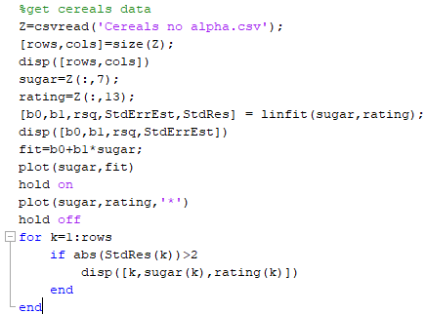
Modify this script to create a script for HW5

Slide 14
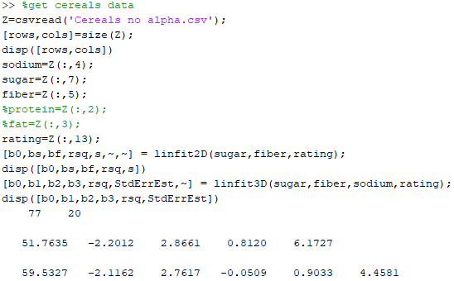
Modify this script to create a script for HW5

Slide 15
Additional assumptions are needed to supports statistical inference
Assumes that response in a population of examples is described by
where, x₁, x₂, …, x_{m} are attributes and β₀, β₁, …, β_{m} are parameters whose true values are unknown.
Assume ε values are independent and normally distributed with zero mean and constant variance.
These assumptions about ε make response values, y, independent, normal-distributed, random variables with variance = σ² and mean
Let b₀, b₁, …, b_{m} denote estimates of β₀, β₁, …, β_{m} from a sample dataset using multivariate regression.

Slide 16
With additional assumptions about the distribution of error in response values, we can address 4 questions.
(1) F-test for significance of entire regression model
(2) Confidence interval for the slope of the i^{th} predictor
(3) Confidence interval for prediction of the mean of responses at a given set of predictor values
(4) Prediction interval for a random value of response at a given set of predictor values

Slide 17
ANOVA Table
ANOVA table is a standardized summary of regression statistics
Note that F-statistic has different degrees of freedom associated with numerator and denominator.
Source of Variation | Sum of Squares | Degrees of Freedom | Mean Square | F
Regression | SSR | m
Error (or Residual) | SSE
Total

Slide 18
F-test for Significance of Overall Regression Model
Hypotheses for F-Test:
H0: β₁ = β₂ = … = β_{m} = 0
Ha: At least one β_{i} ≠ 0
If H0 is true, yhat ~ ybar and SSR is small, but n>>m, so MSR ~ MSE, and F is about 1.
If Ha is true, SSR is at least as large as SSE and n>>m, so MSR>>MSE, and F>>1.

Slide 19
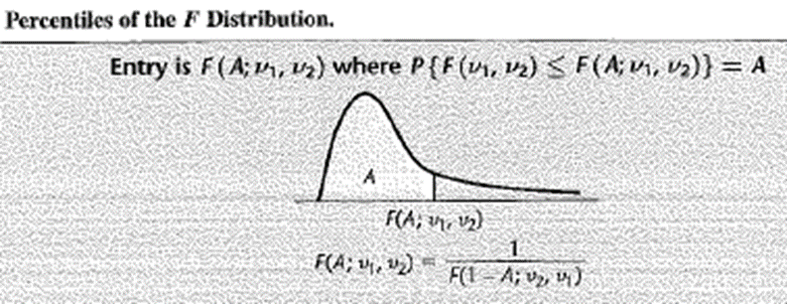
F-test for Significance of Overall Regression Model
The shape of the F_{m, n-m-1} distribution varies somewhat depending on degrees of freedom (m and n-m-1)
Nevertheless, if F_{m, n-m-1} is large, A is near 1, and area in tail is small.
Hence, the p-value for large F_{obs} = MSR/MSE will be small.
Therefore, reject H0.
Confident of a linear relationship between response and at least one of the predictor

Slide 20
F-test for relationship between rating and {sugars, fiber}
H0: β_{s} = β_{f} = 0, Model: y = β₀ + ε
Ha: At least one β_{i} ≠ 0, so one of the following is true: y = β₀ + β_{s}(sugars) + ε, or y = β₀ + β_{f}(fiber) + ε, or y = β₀ + β_{s}(sugars) + β_{f}(fiber) + ε
MSR = 6058.9, m degrees of freedom = 2
MSE = 38.9, n-m-1 degrees of freedom = 74
F-statistic F = 6058.9/38.9 = 155.73
P-value = p(F_{2,74} > 155.73) ~ 0.000
Reject H0.
Confident of linear relationship between rating and the set of predictors, sugars and fiber

Slide 21
Confidence interval slope parameter β_{i}
b_{i} is an estimate of β_{i} with standard error s_{bi}
t_{critical} is based on n-m-1 degrees of freedom and desired confidence
100(1-δ)% confidence that true slope β_{i} lies within
Example: 95% confidence interval for β_{s} for sugars in prediction of nutritional rating by sugar and fiber
b_{s} = –2.2012, s_{bs}= 0.1601, n=77, m=2
T-critical value t_{74,95%} ~ 2.0 (my interpolation method yields 1.9926)
95% confidence interval = –2.2012 ± (1.99) (0.1601) = (–2.52, –1.88)

Slide 22
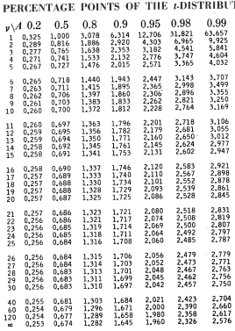
Tabular values for interpolation when
number of degrees of freedom exceeds 30.

Slide 23
Interpretation of Confidence Interval on β_{s}
We are 95% confident β_{s} lies between -2.52 and -1.88
Suppose researcher claims rating falls two points, for every additional gram of sugar, when fiber held constant at its optimum value
Because 2.0 lies within 95% confidence interval, we can accept this assertion, with 95% confidence.

Slide 24
Confidence Interval for prediction of a mean value
100(1-δ)% confidence interval for prediction of E(y(x_{p}))
x_{p} is the vector of predictor values where prediction is made
E(y(x_{p})) is the mean response of a population of examples all at x_{p}
y_{p} is the prediction of the regression model at x_{p}
t_{critical} is based on n-m-1 degrees of freedom and desired confidence
s is the standard error of estimation of the regression model
100(1-δ)% confidence that the true mean response lies within y_{p} + s(t_{critical})sqrt(h(x_{p}))
h(x_{p}) is the “leverage” of x_{p} bounded by 1/n < h(x_{p})<1
When m>1, apply at the low-leverage extreme, h(x_{p}) = 1/n
Example: x_{p} = [5,5], y_{p} = 55.088, 95% confident interval (53.7, 56.5)

Slide 25
Confidence interval for prediction of a random sample at x_{p}
y_{p} + s(t_{critical})sqrt(1+h(x_{p}))
Only difference from confidence interval of a predicted mean value is 1+ in the square root.
In low-leverage extreme, h(x_{p})=1/n
95% confident that rating for randomly chosen cereal with sugars = 5 gm and fiber = 5 gm lies between 42.7 and 67.5 points, which is significantly wider than confidence interval for prediction of a mean value = (53.7, 56.5).

Slide 26
Assignment 6: Inference in multivariate linear regression on Cereals dataset
Write a script to use linfit2D for regression of nutritional rating vs sodium and fiber. Report b₀, b_{s}, b_{f}, r², s, and F. Plot standard residuals as a function of fit.
Expand your script to use inference2D to calculate 95% confidence intervals on slopes bs and bf.
Use the regression model to predict nutritional rating for 200 units of sodium and 5 units of fiber.
Find the 95% confidence intervals on prediction of the mean nutritional rating for a sample of cereals with 200 units of sodium and 5 units of fiber.
Find the 95% confidence intervals on prediction of nutritional rating for a random cereal with 200 units of sodium and 5 units of fiber.

Slide 27
Script to plot StdRes VS Model predictions
Modify for use in HW6
fit

Slide 28
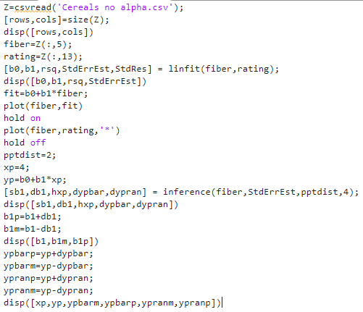
Script for problems 3 and 4 on Quiz 1
Modify to make a script for HW6

Slide 29
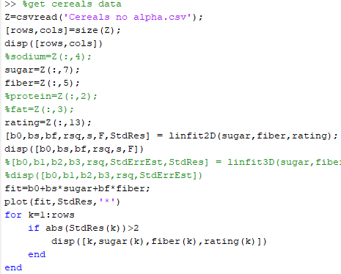

Slide 30
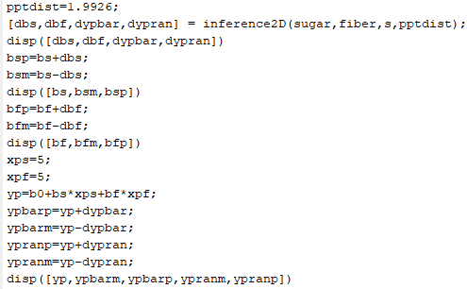
This script written to express confidence limits as
(lower bound, upper bound)

Slide 31
Validation sets and regulatory parameters

Slide 32
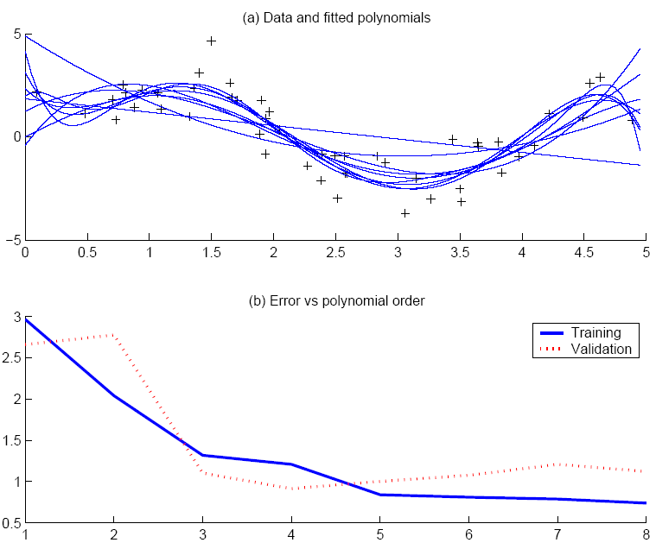
divide real data into training and validation sets
Use validation set to estimate E_{out}
“elbow” in estimate of E_{out} indicates best complexity
Lecture Notes for E Alpaydın 2010 Introduction to Machine Learning 2e © The MIT Press (V1.0)
32

Slide 33
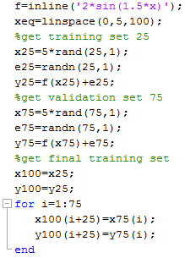
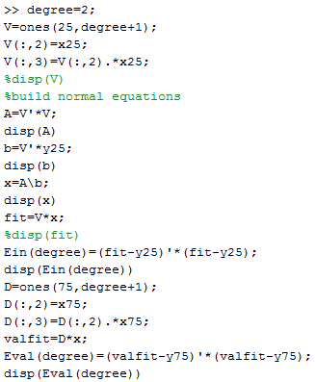
Get in silico data
Calculate in-sample and validation errors

Slide 34
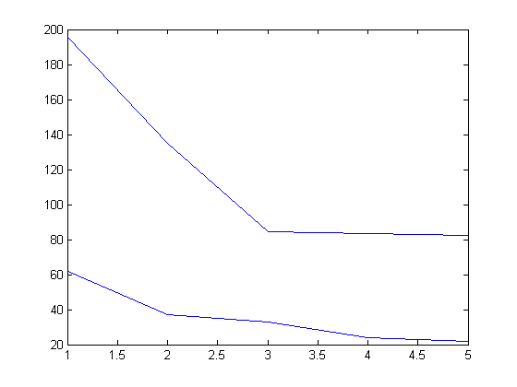
Evidence for cubic as best choice for degree of polynomial
VC bound suggests that small decreases in E_{val} for degree>3 do not indicate better generalization.
E_{in} and E_{val}
Degree of polynomial

Slide 35
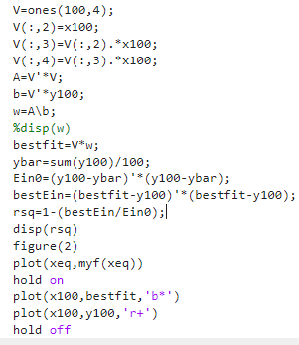
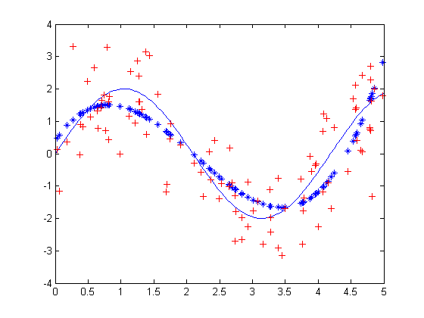
Use all data to get the best fit with cubic model

Slide 36
Assignment 6b:
Generate the in silico data set of 2sin(1.5x)+N(0,1) with 100 random values of x between 0 and 5
Use 25 samples for training, 75 for validation
Fit polynomials of degree 1 – 5 to the training set.
Calculate sum of squared residuals in the training set at each degree.
Without changing the parameters, calculate the sum of squared residuals in the validation set at each degree
Plot sum of squared residuals training and validation as a function of degree on the same axes. What is the best degree of polynomial to use for the model?
Use the full data set to find the optimum polynomial of best polynomial degree
Show this result as plot of data and fit on the same set of axes.
Report the coefficient of determination
OK to use script valpoly that is on the class web page

Slide 38
Over-fitting and Regularization

Slide 39
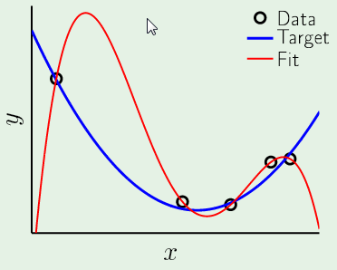
Over-fitting is easy to recognize in 1D
Parabolic target function
4th order polynomial fit
5 data points -> E_{in} = 0

Slide 40
Fit is adapted to the noise in data
Expect poor “generalization”
Large error when applied to example with different noise

Slide 41
Over-fitting is easy to avoid in 1D:
Results from HW1
E_{val}
Sum of squared deviations
E_{in}
Degree of polynomial

Slide 42
What if we want to add higher order terms to a linear model
but don’t have enough data for a validation set?
Solution: Augment the error function used to optimize weights
Example
Penalizes choices with large |w|. Called “weight decay”

Slide 43
Normal equations with weight decay essentially unchanged
(Z^{T}Z + λI) w_{reg} =Z^{T}y

Slide 44
Best value λ is subjective
In this case λ = 0.0001 is large enough to suppress swings
Data still important in determining optimum weights

Slide 45
T-test for Relationship Between x_{i} and y
Hypothesis Test for model:
H0: β_{i} = 0
Ha: β_{i} ≠ 0
Under Ha:
Under H0:
Only difference between models is absence/presence of i_{th} term
Under null hypothesis (i.e. H0), t = b_{i}/ s_{bi} follows t-distribution with n-m-1 degrees freedom, where s_{bi} is standard error of slope for i_{th} predictor

Slide 47
T-test for Relationship Between rating and sugar
H0: β_{s} = 0, Model: y = β₀ + β_{f}(fiber) + ε
Ha: β_{s} ≠ 0, Model: y = β₀ + β_{s}(sugars) + β_{f}(fiber) + ε
b_{s} = –2.2090 and s_{bs}=0.1633
T-statistic t = b_{s}/ s_{bs}= –2.2090/0.1633 = –13.53
P-value = p(t-statistic as least as extreme as –13.53 by chance alone) ~ 0.000
Null hypothesis rejected with high confidence when p-value is this small
Confident that regression provides evidence of linear relationship between rating and sugar, in the presence of fiber at its optimum value

Slide 48
T-test for Relationship Between rating and fiber
H0: β_{f} = 0, Model: y = β₀ + β_{s}(sugars) + ε
Ha: β_{f} ≠ 0, Model: y = β₀ + β_{s}(sugars) + β_{f}(fiber) + ε
b_{f} = 2.8408 and s_{bf}=0.3032
T-statistic t = b_{f}/ s_{bf}= 2.8408 /0.3032 = 9.37
P-value = p(t-statistic as least as extreme as 9.37 by chance alone) ~ 0.000
Null hypothesis rejected with high confidence when p-value is this small
Confident that regression provides evidence of linear relationship between rating and fiber, in the presence of sugar at its optimum

