Slide 1
Inference in regression: basic assumptions
Assume that a linear relationship between predictor and response exist but is obscured by normally-distributed noise with zero mean and variance that is independent of predictor and response values. To trust the results of “inference” these assumptions of about error must be verified
Due to the noise, each example in the population is a random variable
b₀ and b₁ are estimates of β₀ and β₁ obtained by minimizing the sum of squared residuals in fitting the model to set of examples from the population

Slide 2
Explicit assumptions about the error term due to noise in data
(1) Zero Mean Assumption
Error term ε is random variable with a mean of zero
(2) Constant Variance Assumption
Variance of ε is constant, regardless of the value of x
(3) Independence Assumption
Values of ε are independent of each other
(4) Normality Assumption
Values of ε are normally distributed

Slide 3
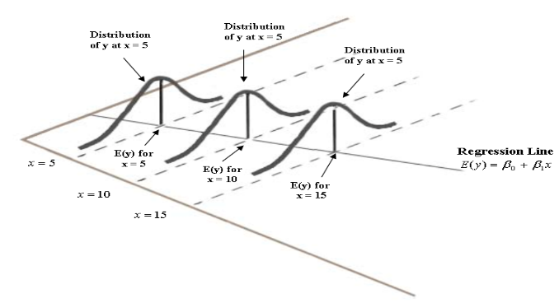
Implications for y due to assumptions about ε
Based on Zero Mean Assumption
For each x, the mean of y’s with different amounts of noise lie on the regression line
(2) Based on Constant Variance Assumption
Regardless of the value of x, distributions of y’s have the same width

Slide 4
More implications for y due to assumptions about ε
(3) Based on Independence Assumption
For any x, values of y are independent
(4) Based on Normality Assumption
y is a normally distributed random variable at every x value
Inference enabled by assumptions about
(1) Confidence interval for slope, β₁
(2) t-test for H₀ that β₁ = 0 (attribute is not a predictor of response)
(3) Confidence interval for mean of response, given an x-value
(4) Prediction interval for random response value, given an x-value

Slide 5
T-test for relationship between x an y
Consider many samples of a population in which
is a valid relationship between predictor x and response y.
Each sample yields a least-squares estimate b₁ of slope β₁
Sampling distribution of b₁ has mean = β₁ and standard error σ_{b1}
s_{b1} is an estimate of σ_{b1,} where s = standard error of estimation

Slide 6
T-test for relationship between x an y
Large values s_{b1} indicate estimate of slope β₁ is unstable and true value of the slope, β₁, could be zero, meaning x is not a predictor of y
T-test is based on the statistic
When the null hypothesis is true (β₁ = 0), t = b₁ / s_{b1} follows t-distribution with n-2 degrees of freedom.
From the p-value of the t-statistic, we can determine, at a selected confidence level, if the null hypothesis can be rejected.
If the null hypothesis can be rejected, then
gives the confidence interval on the slope,
where t_{n-2,1-α} is a percentile point of the t distribution.

Slide 7
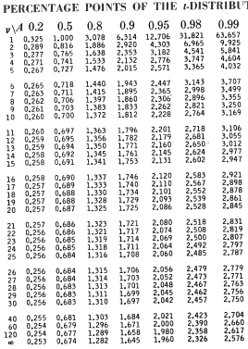
Subroutines to calculate p-values of the t-statistic
and percentile points of t-distribution can be found
on the web.
This table give percentile points for several
confidence levels. For n-2 > 30, the slow rate
of change allows linear interpolation on degrees
of freedom to be used in calculation percentile
points.

Slide 8
Example from “cereals” dataset: sugar as predictor of nutritional rating
b₁ = -2.4193
S_{b1} = 0.2376
T-statistic, t = b₁ / S_{b1} = -2.4193/0.2376 = -10.18
The probability of such an extreme t-value by chance alone (p-value of the t-statistic) is very small; hence, reject the null hypothesis that β₁ = 0.
Percentile point for 95% confidence and 75 degrees of freedom = 2.0
Slope estimate with confidence interval = –2.4193 ± (2.0) (0.2376)
We have 95% confidence that true slope is between –2.8945 and –1.9441

Slide 9
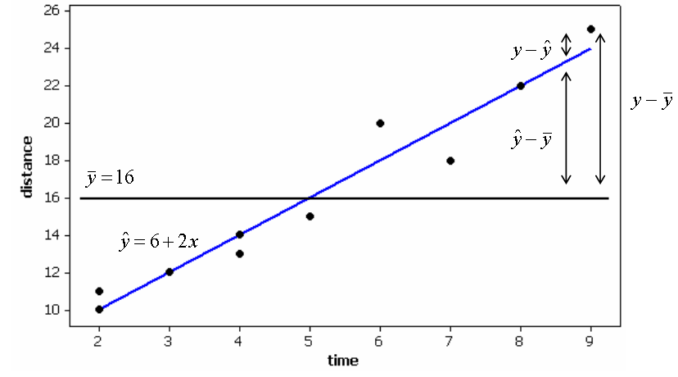
Confidence interval for predictions of regression models
Regression equation estimates value of response for a given value of predictor.
Does not provide probability statement regarding the accuracy of these estimates
Probability statements about accuracy can be obtained for
(1) Confidence interval for the mean of y-values at a given x
(2) Prediction interval of y value for a randomly chosen value of x
Examples from
hiker dataset
StdErrEst=1.2247

Slide 10
Confidence interval for mean value of y, given x
X_{p} = value of x, for which prediction is being made
Y_{p} = regression result for x = x_{p}
s = standard error of estimate
t_{n-2,95} = percentile point of the t distribution
h(x_{p}) = leverage of x_{p}
1/n <= Leverage <= 1.0
x_{p}

Slide 11
Calculate 95% confidence interval on the average distance traveled by hikers that walk 5 hours
x_{p} = 5, y_{p} = 16, s = 1.22474, n = 10, t_{8,95%} = 2.306

Slide 12
Prediction interval of y value for a randomly chosen value of x
Distances walked by individual hikers are more variable than the mean of distances walked by a group of hikers.
Estimates of a group’s average hiking distance are more precise than estimates of an individual’s hiking distance.
In general, easier to predict mean value of a variable than to predict its value for a randomly chosen example.
In general, prediction intervals for a randomly chosen example are more useful to data miners than confidence intervals on mean values

Slide 13
Prediction interval of y value for a randomly chosen value of x
Note similarity to confidence interval for mean of y-values at a given x.
At the same confidence level, prediction interval are always wider than confidence interval on means.

Slide 14
Estimated distance traveled by randomly selected hiker
who walks for 5 hours (95% confidence)

Slide 15
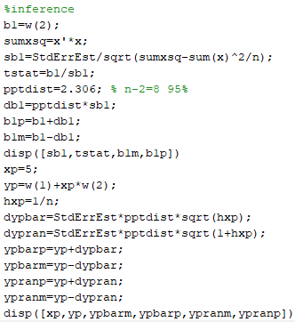
MatLab code
Minimum leverge

Slide 16
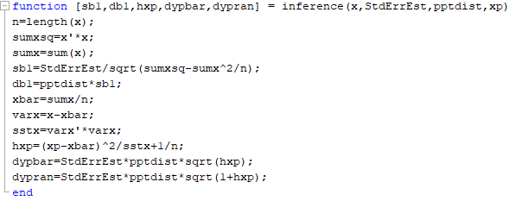
function inference works with output from function linfit (x,y)
Input: x array of data, standard error of estimation, percentile point of t-distribution,
and x-value where model prediction, with confidence interval, is needed.
Percentile point of t-distribution can be read from table. Linear interpolation may be
required.

Slide 17
Output from function inference:
sb1 = standard error of slope estimation
db1 = uncertainty in slope estimation
hxp = leverage of point xp
dypbar = uncertainty in prediction of a mean value at xp
dypran = uncertainty in prediction of a random value at xp

Slide 18
Common mistakes in inference
Don’t confuse t-statistic and pptdist (slide 6).
t-statistic is for p-value test
pptdist is for confidence intervals
Don’t confuse standard error of slope (sb1) with confidence interval on
slope (db1) (slide 8).
All confidence intervals are products of pptdist and a standard error.
For confidence interval on slope, use standard error of slope
For confidence interval on prediction, use standard error estimations
In confidence interval on prediction, we also need the leverage of the point
where prediction is made.
If number of predictors is more than one, use minimum leverage=1/n

Slide 19
Validation of assumptions required for inference
The only basis we have for testing the assumptions about noise in a dataset are residuals at optimum choice of parameters.
Normally distributed residuals are evidence for the validity of model assumptions.
Graphical methods for validation
Normal probability plot of residuals
Plot of standardized residuals against predicted values. Only method you are responsible for.
Diagnostic tests for validation
Anderson-Darling test: Are residuals are normally distributed?
Bartlett’s or Levene’s test: Do residuals have constant variance?
Durban-Watson or Runs test: Are residuals independence of response?

Slide 20
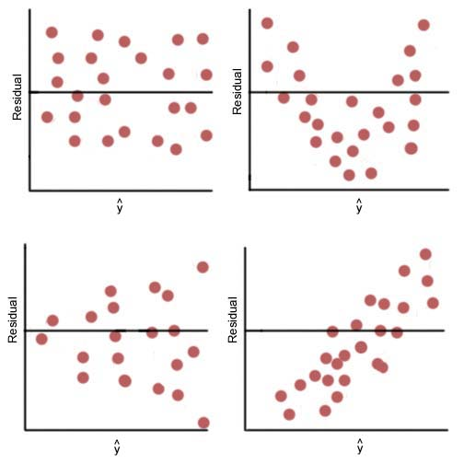
Plots of standardized residuals vs
model prediction can indicate failure of assumptions needed for inference
Probably OK
Not independent
Variance not constant
Mean not zero
A
B
C
D

Slide 21
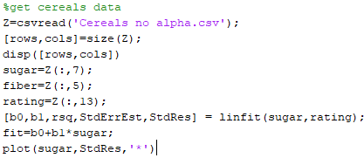
Script to plot StdRes VS Model predictions
fit

Slide 22
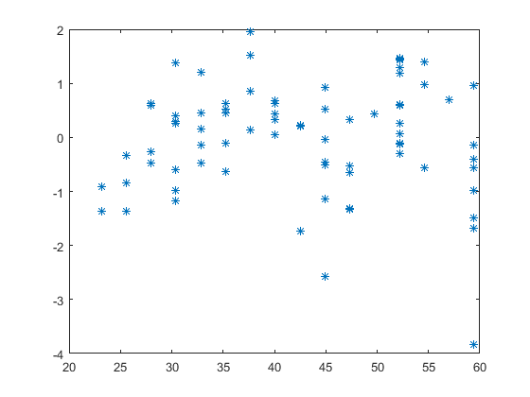
StdRes
Reasonably random pattern
Model predication

Slide 23
Assignment 4: Linear fit with inference
Add another data point to hiker dataset
11th hiker traveled 20 km in 5 hours
Write a script to run function inference on expanded hiker dataset
Confidence level 95%
Take percental point of t-distribution from table
Use results from Assignment 3a for b₀, b₁, s, and standard residuals
Report standard error of slope, t-statistic, confidence interval on slope
Use x_{p}=5,
Report y_{p} and confidence intervals on prediction of mean and random example

