Slide 1
Fit a line to data by minimizing sum of squared residuals
Estimates of slope and intercept
Plot data and fit
Quality of fit
coefficient of determination
standard error of estimation
Test for outliers

Slide 2
Fit = ax + b is a 2-parameter linear model of data.
If a = 0, show that the best choice of b is the average of the data.
We will do this problem in class.

Slide 3
Average of data expresses how much we know in the absence of “predictors”
Example: {y_{k}} = height of students at WSU
Attributes of students (Weight, Age, Country of origin, etc.) are potential “predictors” of height.
For any attribute x_{k}, |a| in fit = ax + b to dataset {x_{k},y_{k}} tells us how important x_{k} is as a predictor of y_{k}
The sign of the slope tells us the direction of the correlation between y_{k} and x_{k}
Find the best slope and intercept by least-squares minimization

Slide 4
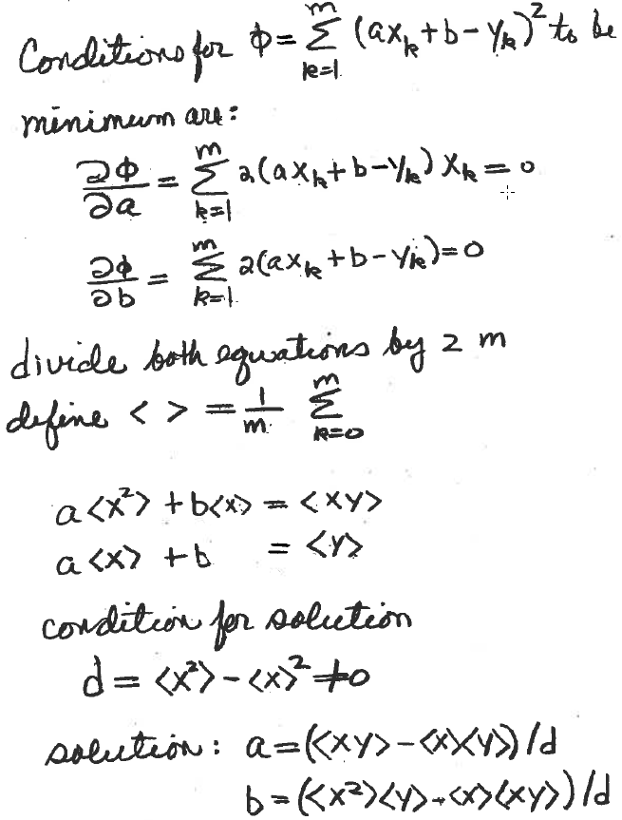
Example: fit y = ax + b to m data points
Find unknown a and b that minimize sum of squared residuals

Slide 5
Polynomial regression with one predictor
Linear regression is a special case of polynomial regression
To develop the general case, we combine calculus with linear algebra

Slide 6
Matrix formulation of linear least squares:
Given dataset {(x_{k},y_{k}), k=1,...,n} and set of functions {f_{j}(x), j=1,...,m}, find the linear combination of functions that best fits the data.
In polynomial regression f_{j}(x) are {1, x, x², …}
Define matrix V where v_{kj} = f_{j}(x_{k}) (i.e. value of j^{th} function evaluated at k^{th} data point)
Define column vector y = [y₁, y₂,...,y_{n}]^{T} of response values
Solve for vector w = [w₁, w₂,...,w_{m}]^{T} of weights in the linear combination of functions
fit = Vw is the value of the fit at each data point
r = fit-y is the deviation between fit and data at each data point
Find best choice of w by minimizing ||r||² = r^{T}r

Slide 7
Normal Equations:
Let r = y – Vw and define f(w) = ||r||² = r^{T}r
f(w) = (y – Vw)^{T}(y – Vw) = y^{T}y –2w^{T} V ^{T}y + w^{T}V^{T}Vw
A necessary condition for w to be a minimum of f(w)
is ∇f(w) = o, where
∇f is a vector with components equal to the partial
derivatives of f(w) with respect to the weights w
∇f(w) = 2V^{T}Vw – 2V^{T}y = o
∴ the optimal set of weights is a solution of the
mxm system linear equations
V^{T}Vw = V^{T}y
Called the “normal” equations of linear least squares

Slide 8
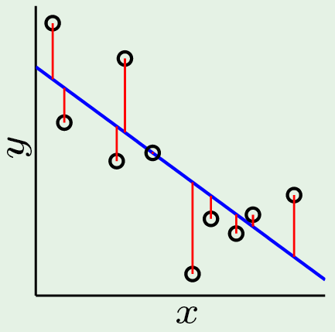
To fit a line to N data points
fit(x) = w₁x + w₀
Solve V^{T}Vw = V^{T}y for w₁ and w₀
Do on broard for 1D case
Lecture Notes for E Alpaydın 2010 Introduction to Machine Learning 2e © The MIT Press (V1.0)

Slide 9
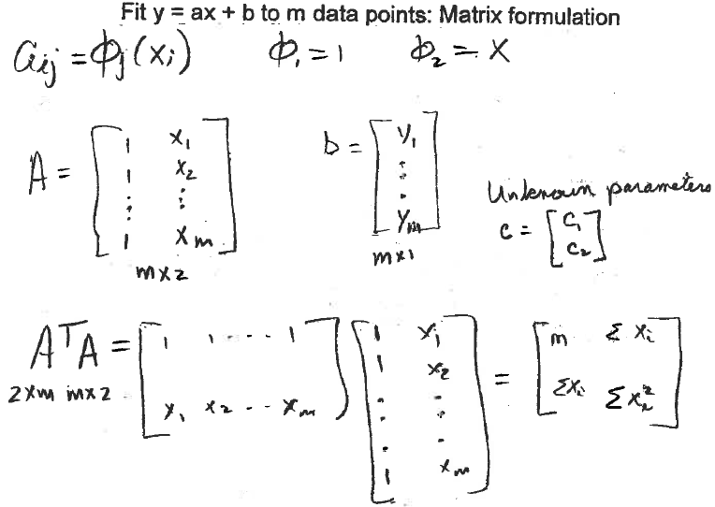

Slide 10
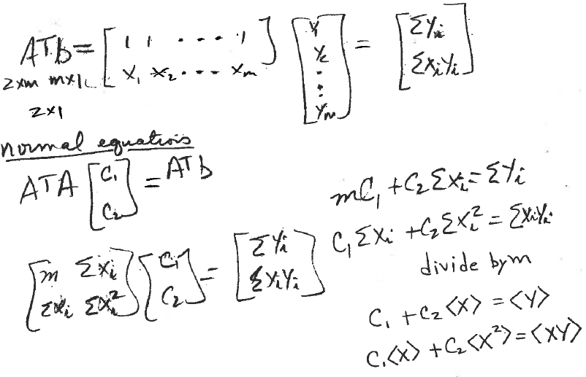
Same set of equations as obtained
by objective function method

Slide 11
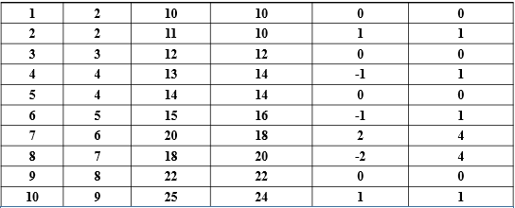
A simple dataset: distance hiked in km vs time in hours
Index x=time y=distance fit=6+2x error (error)²

Slide 12
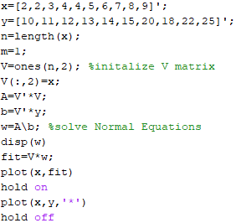
MATLAB code to fit a
line to hiker dataset

Slide 13
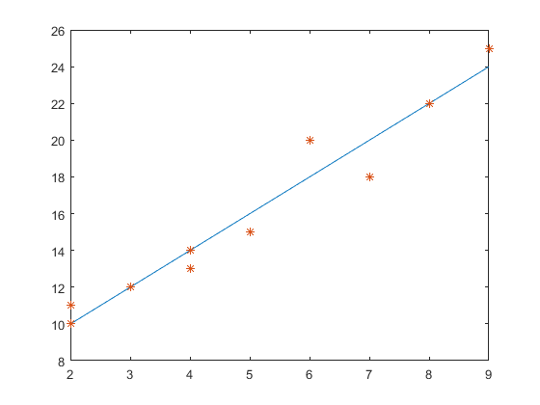
Output from MATLAB code
distance
fit=ax+b
w(1) = b = 6
w(2) = a = 2
distance
time

Slide 14
Analysis of fit

Slide 15
Quality of fit:
coefficient of determination and standard error of estimation
Index x=time y=distance fit=6+2x error (error)²
Sum of squared error (SSE) = 12

Slide 16
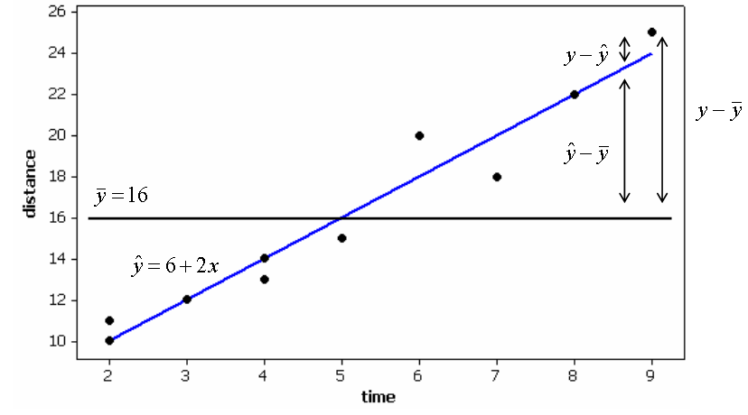
Coefficient of determination: Is Fit a better predictor than the average?
SST = sum of squares total

Slide 17
Sum of Squares Regression
Measures variability from mean response explained by regression
Sum of Squares Error
Measures variability in y from all other sources after linear relationship
between x and y has been accounted for
SST = SSR + SSE follows from the identity

Slide 18
Coefficient of determination: r²= SSR/SST
SST = SSR + SSE
As SSE -> 0, SSR -> SST and r² -> 1 means a perfect fit to data
As SSR -> 0, r² -> 0 fit is the same as the average
r² is interpreted as fraction of response variation explained by the predictor
SST=228
SSE=12
SSR=216
r² = 0.95

Slide 19
Standard Error of the Estimate
Mean Square Error (MSE)
m = number predictors, n = number observations
Standard Error of the Estimate
s is a "typical” residual or error in estimation
From hiker vs time dataset m =1, n=10, SSE = 12 -> s = 1.225 km
Linear regression estimate of hiking distance typically differs from actual distance by about 1.2 km

Slide 20
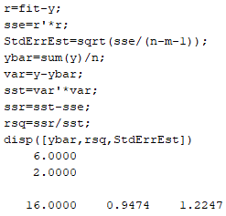
MATLAB code for standard error of estimation and coefficient of determination
Sum of squared residuals
Note: use of MATLAB keyword “sum”
Note: use of dot product to calculate sum of squares

Slide 21
Leverage of observations: potential to effect parameters of linear fit
leverage h_{i} for i^{th} observation:
leverage increases as distance of an x-value from the mean of x-values increases
1/n <= Leverage <= 1.0
observations with leverage > 2(m + 1)/n are considered to have high leverage

Slide 22
Standardized residuals and outliers
Standard error of i^{th} residual
Observation with leverage h_{i}
At minimum leverage of 1/n and large n, standard error of i^{th} residual approaches standard error of estimation
Standardized Residual:
As leverage approaches its maximum values of 1, standardized residual becomes large
Generally, observations with standardized residual > 2 are considered outliers

Slide 23
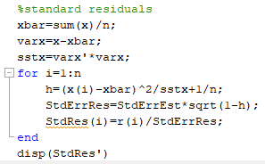
MATLAB code to calculate standardized residuals
Note presidence of operators

Slide 24
function [b0,b1,rsq,StdErrEst,StdRes] = linfit(x,y)
Available on the class webpage
Optimizes parameters by solving the normal equations.
Calculates coefficient of determination.
Calculates standard error of estimation.
Calculates standard residuals.

Slide 25
Assignment 3a: Linear fit with test for fit quality and outliers
Add another data point to hiker dataset
11th hiker traveled 20 km in 5 hours
Write a script to run function linfit on expanded hiker dataset
Plot fit and data and same set of axes
Report b₀, b₁, s, and r²
Determine if the new data point is an outlier
Report standardized residual for new datapoint
Use linfit with data entry like in slide 9
Write a script to do this assignment

Slide 26
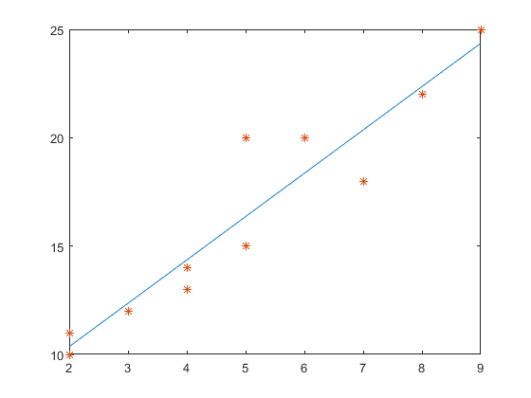
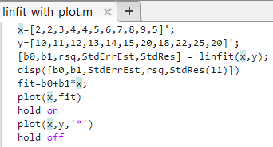
Script for Assignment 3a
Now write a similar script with input from Cereals dataset

Slide 27
Application of linfit to cereals dataset on class web page: nutritional rating vs sugar
First 10 rows cereals dataset as an Excel file

Slide 28
Data without labels in Excel file: setup to use csvread
Write a script to use function linfit(x,y) to fit rating vs sugar
fiber
sugar
rating

Slide 29
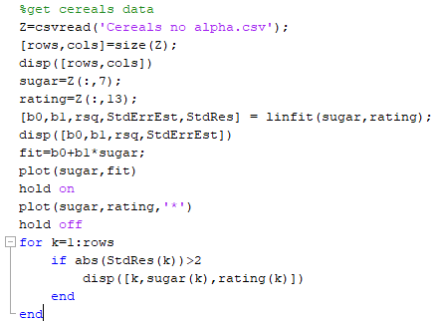

Slide 30
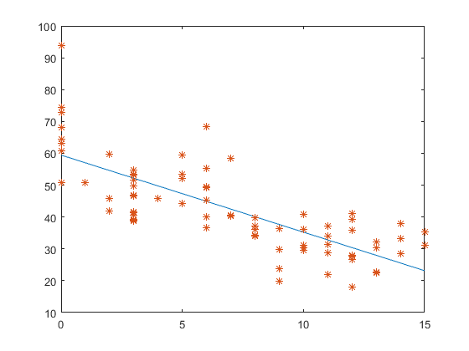
Fit to cereals data: nutritional rating VS sugar with outlier testing
b₀ = 59.4, b1 = -2.42, r²= 0.58, s = 9.16
Outliers:
(0, 93.7)
(6, 68.4)
rating
sugar

Slide 31
Assignment 3b:
Fit rating vs sugar with and without outliers
Compare the coefficient of determination and standard error of estimation
from the 2 fits.

Slide 32
Modify this script to
create sugar and ratings
data without outliers

Slide 33
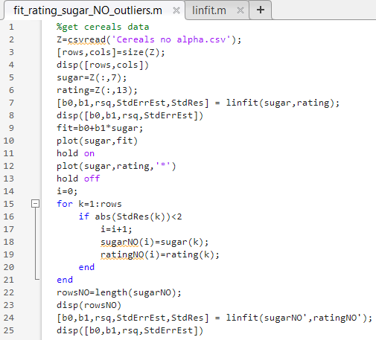

Slide 34
Weighted linear least squares fit

Slide 35
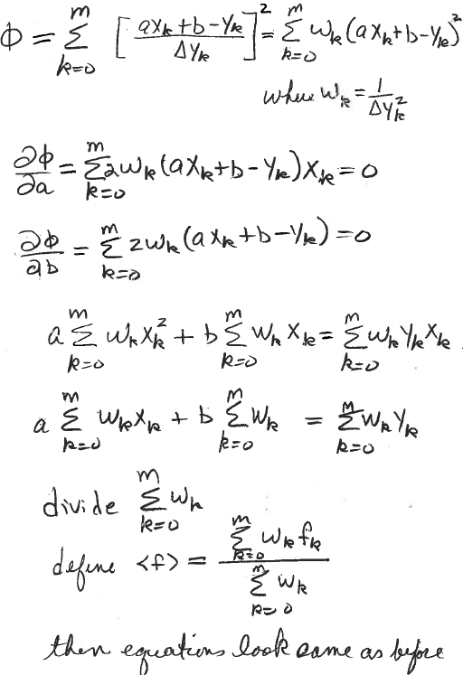
m+1 data points
indexed from zero

Slide 36
Matrix formulation of weighted linear least squares
Let Δy be a column vector of uncertainties in measured values
w = 1./ Δy is a column vector of the square root of the weights
W = diag(w) is a diagonal matrix
V = coefficient matrix of the un-weighted least-squares problem
(Vandermonde matrix in the case of polynomials fitting)
y = column vector of observations
A = W V = weighted coefficient matrix
b = W y = weighted column vector of measured values
Ax = b is over-determined linear system for weighted linear least squares
normal equations A^{T}Ax = A^{T}b become (WV)^{T}WVx = (WV)^{T} W y
(note that w = 1./ Δy gets squared at this point)

Slide 37
Script to fit a weighted parabola to data on surface tension vs temperature
T = [0, 10, 20, 30, 40, 80, 90, 95]’;
S = [68.0, 67.1, 66.4, 65.6, 64.6, 61.8, 61.0, 60.0]’;
dS=[6, 2, 5, 3, 7, 8, 4,1]’; (note small uncertainty assigned to the last point)
% T, S, and dS are all column vectors
weights=1./dS (note component by component vector division)
W=diag(weights);
S=W*S; % Weighted data points
% Construct V-matix (do on board)
V=W*V; % Weighted V-matrix
Setup and solve normal equations (do on board)
Display optimum parameters
Plot the data and fit on the same set of axes

Slide 38
T = [0, 10, 20, 30, 40, 80, 90, 95]’; % column vector
S = [68.0, 67.1, 66.4, 65.6, 64.6, 61.8, 61.0, 60.0]’; %column vector
dS=[6, 2, 5, 3, 7, 8, 4,1]’; % note small uncertainty in last point
npts=8;
V=ones(npts,3);
V(:,2)=T;
T2=T.*T;
V(:,3)=T2;
weights=1./dS
W=diag(weights);
WS=W*S; %weighted vector of observations
WV=W*V; %weighted Vandermonde matrix
A=WV’*WV; % weights are squared
b=WV’*WS; %weights are squared
x=A\b;
disp(x)
fit=V*x;
errorbar(T,S,dS,’*’);
hold on
plot(T,fit);
hold off

Slide 39
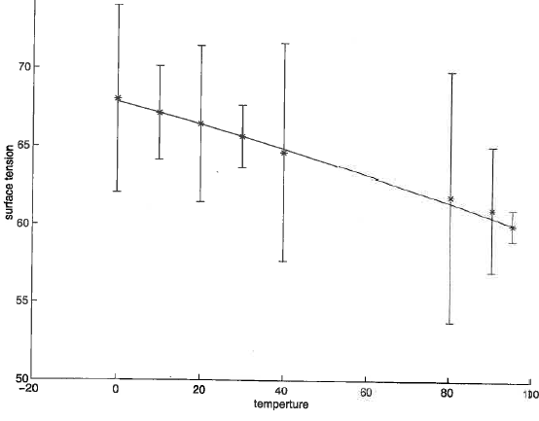
Plot using MatLab’s errorbar
Uncertainties chosen to show how small uncertainty
draws fit to data point at 95

Slide 40
Assignment 3c:
Weighted fit of rating vs sugar with standard deviations at values of sugar with
more than 2 values of rating not including outliers.
Compare the optimum parameters, coefficient of determination, and standard error of estimation to results obtained in assignment 3b.
Plot of fit and data with error bars.

Slide 41
Take data off graph by placing cursor on data points. Avoid outliers, calculate mean and standard deviation. Use function weighted_linfit on class webpage.
b₀ = 59.4, b1 = -2.42, r²= 0.58, s = 9.16
Outliers:
(0, 93.7)
(6, 68.4)
rating
sugar

