Slide 1
Radial Basis Function Network:
Dimensionality reduction by clustering.

Slide 2
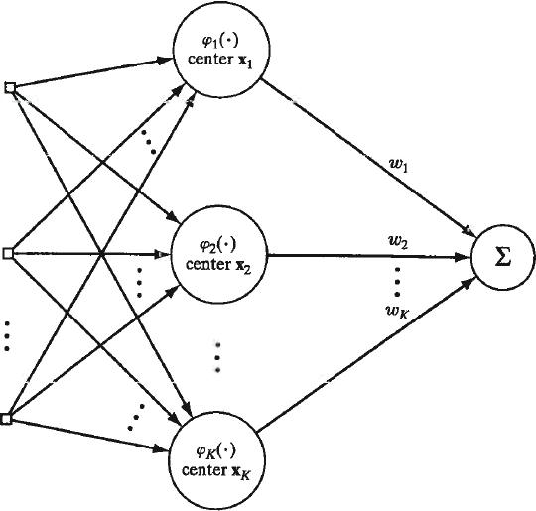
Example of Radial Basis Function (RBF) network
Single output that is linear combination of basis function
Input vectors
d dimensions
K nodes in the hidden layer are basis functions with parameters defined by clustering of attribute vectors

Slide 3
Gaussians are the most frequently used basis function
ϕ_{j}(x) = exp(-½(|x-μ_{j}|/σ_{j})²)
Clusters of input data are
parameterized by a mean and
variance. X is an attribute
vector in the training set.
Optimum number of clusters usually not obvious from training data. Validation set can be used to investigate.

Slide 4
Linear least squares with basis functions
Given training set
Find the mean and variance of K clusters of input data. Construct the NxK matrix D with columns that are each basis function evaluated at all the examples in the training set. Construct a Nx1 column vector r with the response values of the attribute vectors in the training set.
If needed, add a column of ones to include a bias node.
Solve normal equations D^{T}Dw = D^{T}r for a weight vector w connecting hidden nodes to output node

Slide 5
RBF networks perform best with large datasets
With large datasets, expect redundancy (i.e., multiple
examples expressing the same general pattern)
In RBF network, hidden layer is a feature-space
representation of the data where averaging has
been used to reduce noise.

Slide 6
Background on clustering
Clustering is unsupervised learning to find regularities in data.
In clustering, we look for regularities as group membership
Assume we know the best number of clusters, K
Given K and dataset X, we find the size of each cluster P(G_{i}) and its component density p_{i}(x|G_{i}), the probability that attribute vector x belongs to cluster i.

Slide 7
K-Means Clustering: hard labels
Find group labels using the geometric interpretation of a cluster
as points in attribute space closer to a “center” than they are to
data points not in the cluster
Define trial centers by reference vectors m_{j} j = 1…k
Define group labels
based on nearest center
Get new trial centers
based on group labels
Judge convergence by

Slide 8
Defining cluster membership by Boolean vectors makes the math pretty but hides the simple interpretation.
is the average of the positions of points in the cluster, also called the centroid of the cluster.
is the sum of the dispersions of the clusters. Dispersion is the average distances of points in a cluster from the centroid of the cluster.

Slide 9
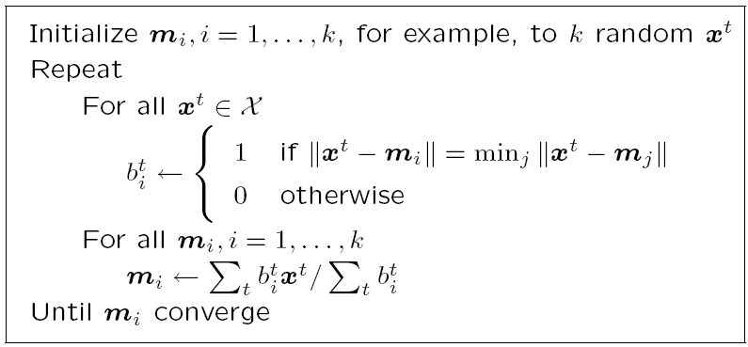
K-means clustering pseudo code
9

Slide 10
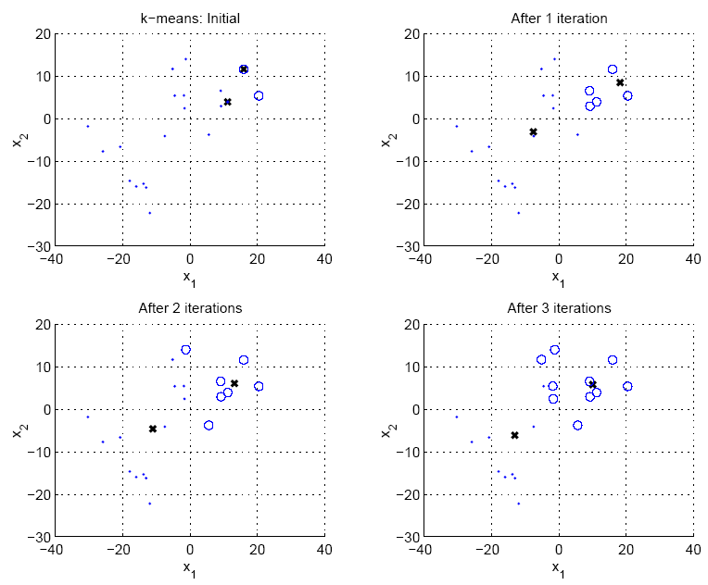
Example of pseudo code application K=2

Slide 11
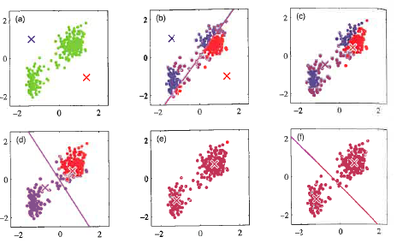
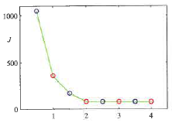
Example of K-means with arbitrary starting centers and convergence plot
Convergence

Slide 12
K-means is an example of the Expectation-Maximization (EM) approach to Maximum Likelihood Estimation (MLE), which is the process of finding the parameters of a distribution function by maximizing the probability that the training set belongs to the distribution.
MLE of mixture model cannot be solved analytically.
Use a 2-step iterative method:
E-step: estimate group labels of x^{t} from current knowledge
of mixture components
M-step: update mixture component using group labels
from E-step
12
Notes:
12

Slide 13
K-means clustering pseudo code with EM steps labeled
E - step
M - step
13

Slide 14
Davies-Bouldin index (DBI) is one of several methods used to find the optimum number of clusters.
Rationale: Choose K that makes the clusters least similar
R_{ij} = similarity of clusters i and j = (S_{i} + S_{j})/M_{ij} where
S_{k} is the dispersion of cluster k, which is the average
separation of its members from the centroid.
M_{ij} is the distance between the centroids of clusters i and j.
Small dispersions and wide separation -> low similarity

Slide 15
With K clusters, calculate R_{ij} = similarity of clusters i and j
for K(K-1)/2 distinct ordered pairs.
For each cluster i, find R_{i} = max_{j}(R_{ij})
DBI is the simple average of R_{i} over the K clusters
Plot DBI(K) over the desired range of K.
Chose K with the minimum DBI(K)

Slide 16
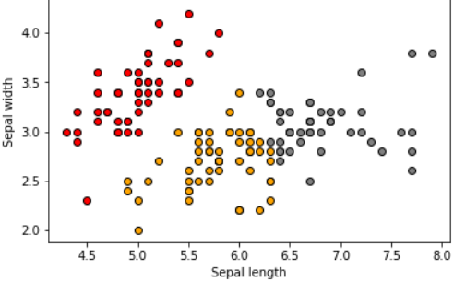
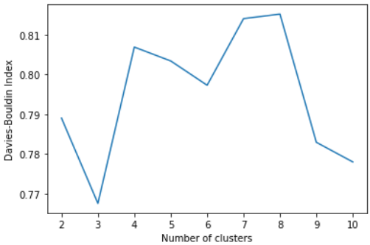
Example with 2D labeled data.
DBI predicts 3 as best number of clusters between 2 and 10
With labeled data, the next question is usually
Are class members in the same cluster?
In this case, yes to a large degree.

Slide 17
More information on DBI can be found at
https://pyshark.com/davies-bouldin-index-for-k-means-clustering-evaluation-in-python/
Davies-Bouldin Index for K-Means Clustering Evaluation in ...

Slide 18
Application of K-means clustering to RBF network
ϕ_{j}(x) = exp(-½(|x-μ_{j}|/σ_{j})²)
Given converged K-means centers, estimate variance for RBFs by σ² = d²_{max}/2K, where d_{max} is the largest distance between clusters.
How do we calculate distance between clusters?
d_{ij} = ||m_{i}-m_{j}||
Gaussian features have different means but the same variance

Slide 19
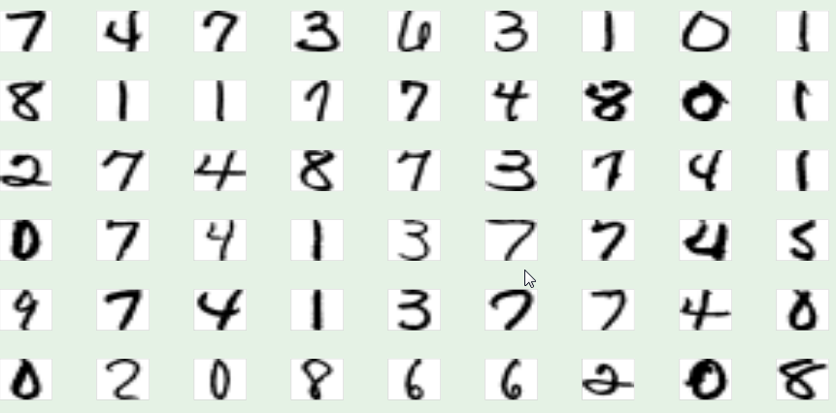
RBF network for digit recognition
Examples of hand-written digits from zip codes

Slide 20
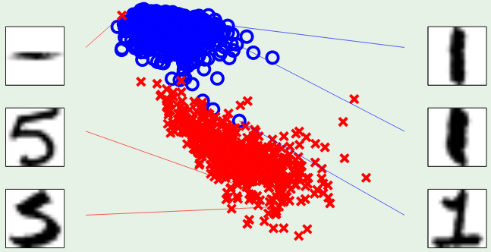
2-attribute digit model: intensity and symmetry
Use Weka to model with a K=2 RBF network
symmetry
intensity
Intensity: how much black is in the image
Symmetry: how similar are mirror images

Slide 21
Assignment 15
Use Weka’s RBFnetwork to distinguish hand-written digits 1vs5.
Load Weka’s RBFnetwork from package manager under Tools on the main menu.
Use one-five-1561-no name.csv for training.
Use one-five-424-no name.csv for testing. After loading the test set, select output predictions under more options. Choose CSV.
Run with default settings.
Save the results buffer that contains predictions of model on test-set examples. Report actual, predicted, and error for the first 7 test examples.
Use code HW15_1vs5_testset and data file RBF1vs5Resutls no alpha to calculate the accuracy of predictions in each class, the overall accuracy, and the confusion matrix with column sums equal to class size.

Slide 22
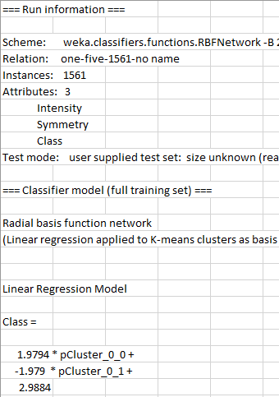
Part of csv file from
results buffer.

Slide 23
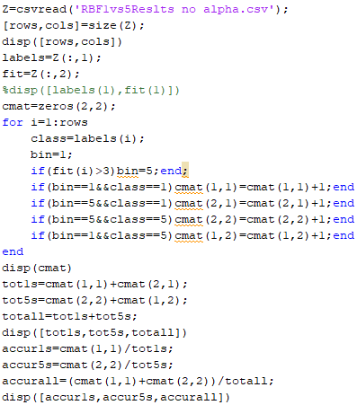
HW15 has only 2 classes
with labels 1 and 5.
Choose bin boundary
equal to 3
(average of 1 and 5)

Slide 25
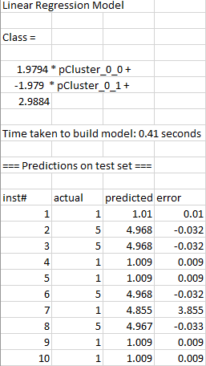
More of csv file from results buffer.
2D linear regression model.
R² = 95.75% without optimization.
Copy and paste columns “actual”
and “predicted” into new csv file for analysis of predictions by confusion matrix.

