Slide 1
WEKA’s GA applied to attribute selection
Default values:
Population size = 20
Crossover probability = 0.6
Mutation probability = 0.033
Example: breast-cancer classification
Wisconsin Breast Cancer Database
Breast-cancer.arff
683 instances
9 numerical attributes
2 target classes
benign=2
malignant=4

Slide 2
Examples of records from dataset
Severity scores
5,1,1,1,2,1,3,1,1,2
5,4,4,5,7,10,3,2,1,2
3,1,1,1,2,2,3,1,1,2
6,8,8,1,3,4,3,7,1,2
4,1,1,3,2,1,3,1,1,2
8,10,10,8,7,10,9,7,1,4
1,1,1,1,2,10,3,1,1,2
2,1,2,1,2,1,3,1,1,2
2,1,1,1,2,1,1,1,5,2
4,2,1,1,2,1,2,1,1,2
Tumor characteristics
clump-thickness
uniform-cell size
uniform-cell shape
marg-adhesion
single-cell size
bare-nuclei
bland-chomatin
normal-nucleoli
mitoses
Severity scores are attributes
Last number in a row is class label

Slide 3
Severity score
5,1,1,1,2,1,3,1,1,2
5,4,4,5,7,10,3,2,1,2
3,1,1,1,2,2,3,1,1,2
6,8,8,1,3,4,3,7,1,2
4,1,1,3,2,1,3,1,1,2
8,10,10,8,7,10,9,7,1,4
1,1,1,1,2,10,3,1,1,2
2,1,2,1,2,1,3,1,1,2
2,1,1,1,2,1,1,1,5,2
4,2,1,1,2,1,2,1,1,2
Characteristic
clump-thickness
uniform-cell size
uniform-cell shape
marg-adhesion
single-cell size
bare-nuclei
bland-chomatin
normal-nucleoli
mitoses
Chromosomes have 9 binary genes
gene_{k} = 1 means of severity score k^{th} attribute included
Fitness: accuracy of naïve Bayes classification

Slide 4
Attribute selection using WEKA’s genetic algorithm
Open file breast-cancer.arff
Check attribute 10 (class) to see the number of
examples in each class

Slide 5
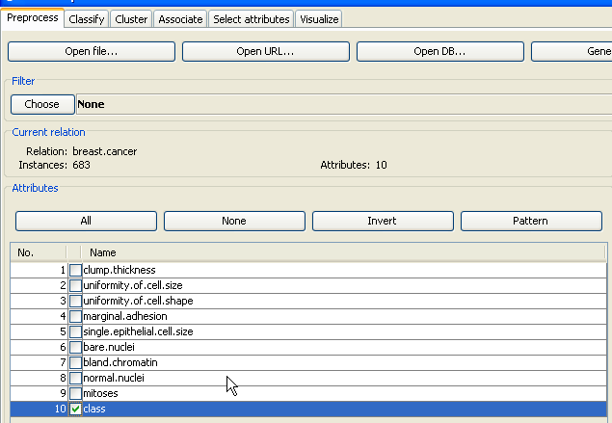

Slide 6
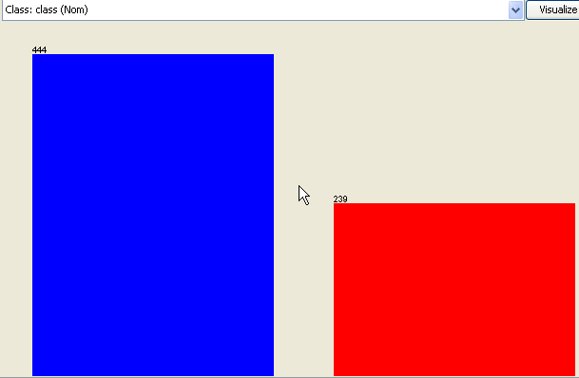
benign
malignant

Slide 7
Attribute selection using WEKA’s genetic algorithm
Click on any other attribute to see how it is
distributed between classes.

Slide 8
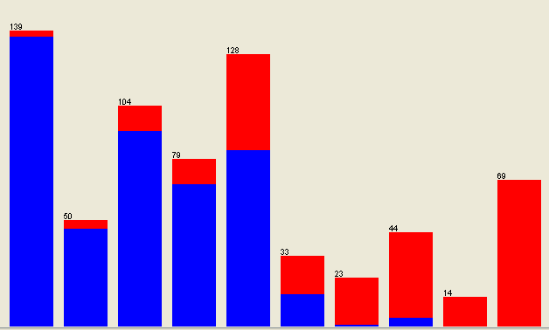
clump thickness
increasing severity →
Distribution of severity scores (1 – 10) over examples in dataset
Severity of clump thickness positively correlated with malignancy

Slide 9
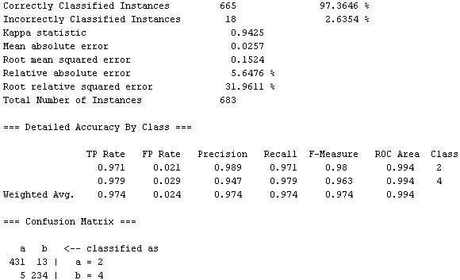
Baseline performance using severity scores for all 9 tumor
attributes based on naïve Bayes classifier

Slide 10
Under the Select-Attributes tab of Weka Explorer
Press choose button under Attribute Evaluator
Under Attribute Selection find WrapperSubsetEval

Slide 11
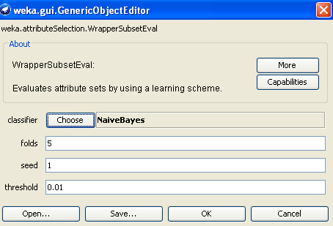
Click on WrapperSubsetEval to bring up dialog box
which shows ZeroR as the default classifier
Find the Naïve Bayes classifier, click OK
Evaluator has been selected

Slide 12
Under the Select-Attribute tab of Weka Explorer
Press choose button under Search Method
Find Genetic Search (you may need to load from
package manager)
Start search with default settings including
“Use full training set”

Slide 13
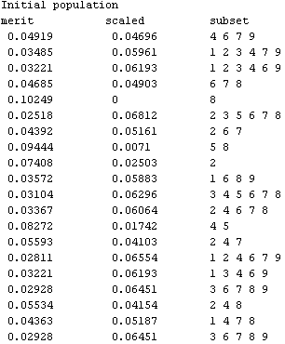
Each chromosome denotes a subset of tumor characteristics
used in classification.
Fitness function:
linear scaling of
the error rate
of naïve Bayes
classification
such that the
highest error rate
corresponds to a
fitness of zero

Slide 14
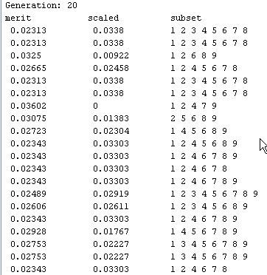
Results with Weka 3.6
Expect different results
with current version.
Note 4 repeats of most
fit chromosome that
excludes attribute 9

Slide 15
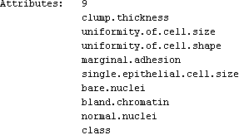
Increasing the number of generations to 100
does not change the attributes selected
9th attribute “mitoses” has been deselected
Return to Preprocess tab, remove “mitoses”
and reclassify

Slide 16
Performance with reduced attribute set is slightly improved
Results with Weka 3.6
Expect different results
with current version.
False negatives in malignant class
decreased by 2

Slide 17
Assignment 14:
Repeat the work shown in the above slides using the current version of WEKA and file Breast cancer for data GA.arff on the class webpage.
Report percent accuracy and confusion matrix using naïve Bayes classifier
with all attributes. Report attribute list, percent accuracy, and confusion matrix
after attribute selection by GA.

