Slide 1
Review of statistics in data mining
Attribute space
Parameters of normally (aka Gaussian) distributed data
Hypothesis testing by p-values
Discrete probability distributions
Bayes' rule applied to binary classification
Hoeffding’s rule applied to hypothesis testing

Slide 2
Attribute Space
Any vector that specifies the position of a point in physical space has length 3 (x,y,z), (r,θ,φ), (ρ,φ,z), etc. We can say that a point in physical space has 3 “attributes”.
An object of data mining may have many attributes. For example, apples to be harvested by a robot need 6 attributes. 3 attributes that determine its location in space are used to determine joint angles of a robotic arm for picking. 3 more attributes (RGB) specify its color, which the robot needs to distinguish apples from leaves, branches, etc.
For robotic apple harvesting the “attribute space” is 6D. Sensor input interpreted by computer vision software identifies the points in this 6D space that are likely to be a pickable apple.

Slide 3
Growing apples for automatic harvesting: invert V configuration puts more apple close to picking arm. Apples tend to be close to trellis structure.

Slide 4
Mean, total sum of squares, standard deviation
Mean (m) and standard deviation (SD) are commonly used to describe data taken with replicates even though the variation between replicates may not follow a normal distribution.
Total sum of squares (SST) is a commonly used as a
measure of the total variability of an attribute, relative to its mean, over a dataset regardless of its actual distribution.

Slide 5
Z-scores: attributes transformed to zero mean and unit variance
If variable x is normally distributed with mean μ and variance σ²,
then z = (x – μ)/σ
is a normally-distributed variable with zero mean and unit variance.
It is common practice to transform attributes to z-scores even if the
samples in the dataset are not normally distributed.
One justification is that z-scores are dimensionless and have similar
scale, even though attributes may have different scale due to units.
Commonly believed that data mining techniques work better with z-scores.

Slide 6
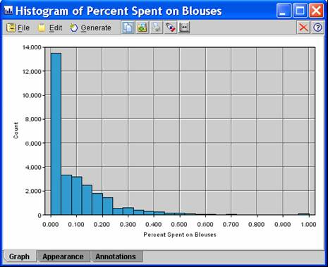
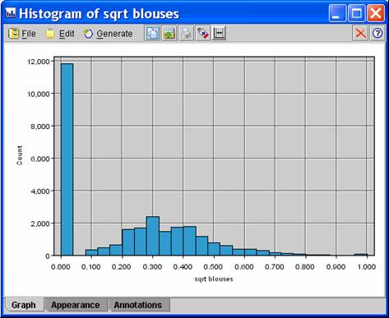
Sometimes we can make an attribute’s distribution more “normal”
before converting it to a z-scores. Example: transform by square root

Slide 7
Terms used to describe the variation of attribute values
Variability: the scale of attribute deviation from the mean of the population
Variance: a quantitative measure of variability generally associated with a normally distribution attributes
Proportion of variance: A part of total variability attributed to a cause. Example: A part variation of weight in a human population is due to age.
Correlation: related variation of different attributes. Age and weight show positive correlation.
Covariance: a quantitative measure of correlation generally associated with a normally distribution attributes.
Common variance: correlation among a subset of attributes due to an underlying cause, like annual income.
7

Slide 8
Multivariate normal distribution
Vector with components that
are the mean of each attribute
Variance is a symmetric matrix
called “covariance”.
Diagonal elements are variance
of individual attributes.
Off diagonals elements are
pairwise co-variances of
attributes.
Not independent of attribute units
(i.e. change miles to kilometers;
covariance matrix changes)
dxd
dx1
1xd
8

Slide 9
Correlation matrix
dxd
dx1
1xd
All elements of covariance are quadratic. Divide all elements,
including diagonals, by the product of standard deviations. Gives
1’s on the diagonal and correlation coefficients off diagonal.
Correlation matrix is the covariance matrix of z-scores

Slide 10
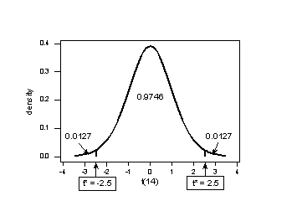
Hypothesis testing by p-values
Given null hypothesis H₀ and alternative H_{a}, use sample data (assuming H₀ is true) to calculate
the value of a test statistic, t-stat.
We must know how t-stat is distributed if H₀ is true (usually involves degrees of freedom).
We must know if t-stat is always positive (1-sided) or if + values need to be considered (2-sided)
Calculate the probability of values at least as extreme as t-stat. This is equivalent to the question
“If the defendent is innocent, what is the chance that we would observe such extreme criminal
evidence?”
This calculation is the area under the probability distribution of t-stat
for extreme values (1- tail or 2-tails).
If probability is less than your doubt threshold (e.g. < 0.05 for
95% confidence), reject H₀ and assume H_{a}.

Slide 11
In data mining we sometimes encounter discrete probabilities
Discrete probabilities are defined in terms of a finite sample space S.
Usually S is a collection of outcomes of independent experiments, such as flipping coins, throwing dice, pulling cards, etc.
Example: S = set of outcomes from flipping 2 coins = {HH, HT, TH, TT}
Events are subsets of S. (S itself is called the “certain” event.)
In {HH, HT, TH, TT} the event of getting 1 head and 1 trail = {HT, TH}
The empty subset, ∅, called the “null” event.

Slide 12
Conditional probability: Given some knowledge about outcomes, we want the probability of an outcome conditioned on our prior knowledge about it.
Suppose that someone flips 2 coins and tells us that at least one shows heads. What is the probability that both coins are show heads?
S = {HH, HT, TH, TT}
Our prior knowledge eliminates outcome TT.
The remaining 3 outcomes are equally likely.
Pr{HH |conditioned on at least 1 head showing} = 1/3.
In the absence of the prior knowledge Pr{HH}=1/4.

Slide 13
Conditional probability: general definition
Probability of A conditioned on B, Pr{A|B}, is meaningful only
if Pr{B} ≠ 0.
Given that B occurs, the probability that A also occurs is related
to the set of outcomes in which both A and B occur.
∴ Pr{A|B} is proportional to Pr{A∩B}
If we normalize Pr{A|B} by dividing by Pr{B} (which ≠ 0), then
Pr{B|B} = Pr{B∩B}/Pr{B} = Pr{B}/Pr{B} = 1

Slide 14
Bayes’ Rule for binary classification
prior
Class likelihood
posterior
Evidence (normalization)
Prior is information relevant to classifying that is independent
of attributes in vector x
Class likelihood is probability that a member of class C will have
attribute vector x
Posterior is the probability that example with attributes x should
be assigned to class C
Since P(C|x) is normalized, assign example with attributes x to class C if P(C|x) > 0.5
Notes:
Prior is what we know about credit risk before we observe a clients attributes; might be per-capita bankrupties
Class likelihood, p(x|C), probability of observing x conditioned on the event being in class C
given client is high-risk (C = 1) how likely is X = {x₁, x₂}
deduced by data on a set of known high-risk clients
Evidence, p(x), is essentially a normalization; also called “marginal probability” that x is seen regardless of class
Posterior, P(C|x), probability that client belongs to class C conditioned on attributes being X
When normalized by evidence, posteriors add up to 1

Slide 15
Bayes’ Rule for binary classification
prior
Class likelihood
posterior
Evidence (normalization)
If your only interest is whether x belongs in class C or not (i.e., if P(C|x) >0.5), then you don’t have to calculate p(x).
Just determine which is larger P(C)p(x|C) or P(C)p(x|C), where C denotes the non-member class
Notes:
Prior is what we know about credit risk before we observe a clients attributes; might be per-capita bankrupties
Class likelihood, p(x|C), probability of observing x conditioned on the event being in class C
given client is high-risk (C = 1) how likely is X = {x₁, x₂}
deduced by data on a set of known high-risk clients
Evidence, p(x), is essentially a normalization; also called “marginal probability” that x is seen regardless of class
Posterior, P(C|x), probability that client belongs to class C conditioned on attributes being X
When normalized by evidence, posteriors add up to 1

Slide 16
Example of application of Bayes’ rule for binary classification
prior
Class likelihood
posterior
normalization
Phone service offers discount for 1st year.
Cancellation after 1st year called “churn”
Phone service has options, voice mail, international plan, caller ID, etc.
Based on historical data, how do these options affect the probability of churn?
Let C denote the class of churn=true
Let C denote the class of churn=false
p(x) = P(C)P(C|x) + P(C)P(C|x)
Notes:
Prior is what we know about credit risk before we observe a clients attributes; might be per-capita bankrupties
Class likelihood, p(x|C), probability of observing x conditioned on the event being in class C
given client is high-risk (C = 1) how likely is X = {x₁, x₂}
deduced by data on a set of known high-risk clients
Evidence, p(x), is essentially a normalization; also called “marginal probability” that x is seen regardless of class
Posterior, P(C|x), probability that client belongs to class C conditioned on attributes being X
When normalized by evidence, posteriors add up to 1

Slide 17
Data on churn: 3333 records
Class size: 483 churn = true -> prior(C) = 483/3333 = 0.1449
Prior knowledge: most customer stick with the service
Since P(C|x) proportional to P(C)P(x|C), x must be a strong predictor of churn to
overcome our prior knowledge that churn is rare.
For records with churn=true, 80 out of 483 sign up for voice mail: P(V|C)=0.1656
Voice mail is not an attribute that makes the likelihood of churn high.
For records with churn=true, 137 out of 483 sign up for International plan:
P(I|C)=0.2836 is a stronger likelihood of churn but is it strong enough?

Slide 18
Is international plan a predictor of churn?
churn no churn
Total 483 2850
I-plan 137 186
P(C) = 483/(483+2850) = 0.1449
P(C) = 1-P(C) = 0.8551
p(I|C) = 137/483 = 0.2836 p(I|C) = 186/2850 = 0.0653
P(C)p(I|C) = 0.0411 P(C)p(I|C) = 0.0558
Without normalization: No
p(I) = 0.0411+ 0.0558 = 0.0969
P(C|I) = 0.0411/0.0969 = 0.4241 < 0.5
With normalization: No

Slide 19
Dominance of priors
The imbalance in the churn data set toward customers that do not churn makes
the posterior for the non-churn class greater for all options in the phone plan.
To explore the fine detail of how options might influence churning requires a more
balanced data set.
This could be achieved by randomly deleting some non-churner examples in the data set.

Slide 20
Assignment 1:
Random deletion of data on customers that do not churn results in the following data set.
churn not churn
Total records 483 1425
Voice mail 80 421
International 137 93
Use Bayes’ rules to test the following hypotheses:
Subscribers with voice mail are more likely to churn
Subscribers with international option are more likely to churn
With and without normalization

Slide 21
Write a MATLAB code for this assignment

Slide 22
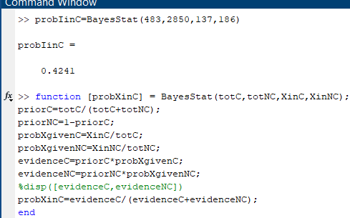

Slide 23
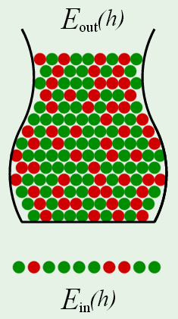
Hoeffding’s rule in hypothesis testing with a sample of size N
Let h be a hypothesis tested by data mining.
For example: Signing for international calling causes churn
E_{test}(h) is the error (red dots) when h is applied to a test set
E_{out}(h) is the error when h is applied to the general population
Use Hoeffding’s rule to get an upper bound on |E_{test}(h)-E_{out}(h)|
E_{test}(h)
E_{test}(h)=0.3
The upper bound on the probability that |E_{test}(h)-E_{out}(h)| exceeds ε is called the “doubt threshold”, δ. Our “confidence” in the result from a test set is 1-δ.

Slide 24
Applying Hoeffding’s rule with a sample of size N and doubt threshold δ
δ = 2exp(-2ε²N) is a relationship between δ, ε, and N. We use it to find the value of one of these, given the other 2.
With sample of size N, we can say with confidence 1-δ that
|E_{test} - E_{out}|< ε(δ,N) = sqrt(ln(2/δ)/2N)
Given the required confidence and error tolerance, the required
sample size is N=ln(2/δ)/(2ε²).
For a given sample size N, the confidence we can have that the
difference in error is less than ε is 1- 2exp(-2ε²N).
E_{test}(h)

Slide 25
Assignment 2a:
Sponsor requires 98% confidence that |E_{test} - E_{out}| < 0.1.
How large does N have to be to meet this requirement?
Assignment 2b:
N=100
How much confidence can I have that |E_{test} - E_{out}| < 0.1?

Slide 26
Write a MATLAB code for this assignment

Slide 27
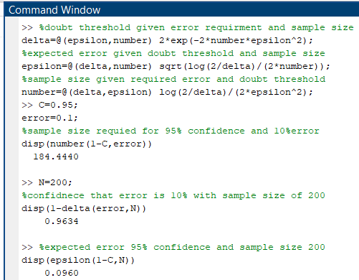
Script for Hoeffding’s rule with examples of application

