Slide 1
Arrays in MATLAB
Arrays are data structure. Usually, real numbers with indices
Arrays can have any number dimensions
The dimension of an array is the number of indices required to specify an element of the array.
Most of the arrays that you will encounter in this class have 1 or 2 dimension.
1-dimensional arrays are called “vectors”
2-dimensional arrays are called “matrices”
The “length” of a vector is the number of elements in the 1D array.
The “size” of a matrix is the number of rows and columns in the 2D array.
MATLAB does not require specification of array size before it is used; however, it reminds you that for efficiency this is desirable.

Slide 2
Row and Column vectors in MATLAB
>>x=linspace(-1,4,10); produces a “row” vector (i.e. 1x10 matrix)
Semicolon at the end of a statement suppresses output
>>disp(x) displays the elements in x in rows
If x is a row vector, then x’ is a “column” vector (i.e. 10x1 matrix)
>>disp(x’) displays the elements in x as a column
Start MATLAB and enter these statements in the command window
The rows of a matrix M can be use as row-vectors M(k, :)
The columns of a matrix M can be use a column-vectors M(:, k)

Slide 3
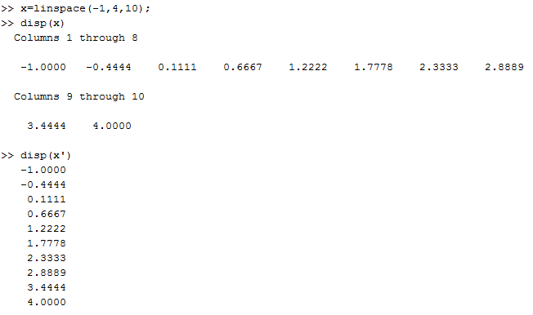

Slide 4
Vector input to MATLAB functions
x=linspace(-1,4,10); produces a “row” vector (i.e. 1x10 matrix)
If a row vector is passed to a function, MatLab returns a row vector.
If a column vector is passed to a function, MatLab returns a column vector.
>>myf=@(x) exp(x)-3*x.^2; is setup to receive vector input
x.^2 means square vector x “component by component”
Add this function to the command window, run it, and display the results as 2 columns, x and myf(x).
The arrays in a call to display (e.g. disp([x,y,z])) must all be the same size.
What is wrong with the statement disp(x’,myf(x))?
What 2 ways can it be fixed?

Slide 5
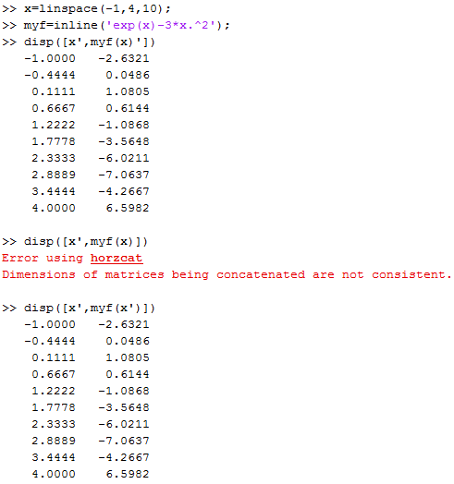

Slide 6
For loops avoid vector input and generate row vectors
In the editor (under “new” choose “script”)
x=linspace(-1,4,10);
for i=1:10
myf(i)=exp(x(i))-3*x(i)^2;
end
Clear the command window and the work space.
Copy and paste the script into the command window
Display the results as 2 columns, x and myf(x).
Change the first line to create x as a column vector. Run and display as 2 columns

Slide 7
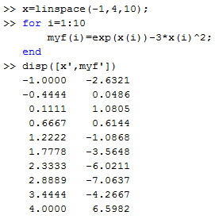
For loops generate row vectors
x=linspace(-1,4,10);
To specify components of x in a calculation, use x(index).
Note .^ unnecessary
The for loop defined a
row vector

Slide 8
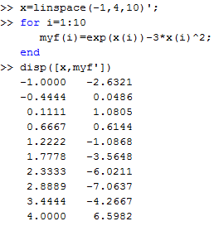
Arrays in MatLab
x=linspace(-1,4,10);
To specify components of x in a calculation, use x(index).
The for loop defined a row
vector even though x was
a column vector because
my calculation only involved
components of x.

